Slide 1
Manufacturing Processes
Combined lecture deck
Lectures 2-21, 24-25 and 26-27
Topics arranged by exam priority
HOT
WARM
POSSIBLE
23 source decks. All 365 original slides retained.
Priority labels follow the supplied notes PDF.
Manufacturing Processes / MP - Notes (MUJStella)
Notes:
Sources: all 23 supplied lecture PPTX files and MP - Notes (MUJStella).pdf. Lecture numbers follow the filenames. Rating legend: PDF pp. 2 and 41.

Slide 2
Priority labels and reading order
HOT
Multiple appearances or very likely in the PDF
WARM
One appearance or likely in the PDF
POSSIBLE
In syllabus or expected. Includes the PDF label LIKELY
SUPPORTING
Source content without an explicit topic rating
Each lecture keeps its title slide, followed by its priority guide.
Topics then run HOT, WARM, POSSIBLE and SUPPORTING.
Process sequences stay together. Mixed slides show secondary labels.
Manufacturing Processes / MP - Notes (MUJStella)
Notes:
PDF p. 2 defines HOT, WARM and POSSIBLE. PDF p. 41 defines LIKELY as in syllabus, possible. Use the highest explicit rating for the same question/topic. A separately rated subquestion retains its specific label. Process context shares the rating of its topic block. PDF page references are physical PDF page numbers, starting at 1.

Slide 3
Lecture index
Select a lecture to jump to its title slide
02 Pattern and allowances
08 Welding concepts and classification
03 Moulding sand
09 Gas welding and flames
04 Mould and core making
10 Arc welding, SMAW and SAW
05 Gating system
11 Resistance welding
06 Die and centrifugal casting
12 Soldering and brazing
07 Investment casting
13 Metal forming basics
Manufacturing Processes / MP - Notes (MUJStella)

Slide 4
Lecture index / continued
Select a lecture to jump to its title slide
14 Forging
20 Single-point cutting tool geometry
15 Rolling
21 Lathe operations
16 Extrusion
24 Milling
17 Drawing and sheet metal forming
25 Drilling
18 Principles of metal cutting
26-27 CNC turning and milling
19 Cutting tool materials and applications
Manufacturing Processes / MP - Notes (MUJStella)

Slide 5
Different ratings in the notes
The deck uses the higher stated rating for the same topic
Topic
Main guide
Unit questions
Used
Die casting comparison
WARM p. 2
HOT p. 11
HOT
DC arc polarity
POSSIBLE p. 2
WARM p. 15
WARM
Brazing versus soldering
WARM p. 2
HOT p. 18
HOT
G01 meaning / use
POSSIBLE p. 3
HOT p. 32
HOT
G90 versus G91
POSSIBLE p. 3
WARM p. 32
WARM
A broad topic and a specific subquestion can have different ratings.
Example: the five-allowance question is HOT, while rapping alone is POSSIBLE.
Manufacturing Processes / MP - Notes (MUJStella)
Notes:
Source: MP - Notes (MUJStella).pdf, physical pp. 2, 3, 11, 15, 18 and 32. Flux definition/function is HOT p. 12, electrode coating functions WARM p. 15. Original source text and diagrams are preserved. Priority is a prediction label from the supplied PDF.

Slide 6
CASTING:
Pattern & Allowances
Lecture 2
L02 LECTURE
Pattern and allowances
Lecture 2. Source slide 1. Lecture title.
6
Notes:
Priority: INTRO. Topic: Pattern and allowances.
Lecture 2. Source slide 1. Lecture title.
Priority source: MP - Notes (MUJStella).pdf.
Original deck: Lecture 2 Pattern and Allowances - Copy.pptx.
The five-allowance overview is HOT. The PDF separately rates the rapping question POSSIBLE.

Slide 7
Lecture 2
Pattern and allowances
HOT
Pattern allowances, shrinkage, machining, draft and distortion (PDF pp. 2, 6)
WARM
Pattern types, match plate and cope-and-drag patterns; Green sand mould making (PDF pp. 6, 9)
POSSIBLE
Single-piece and split patterns; Rapping allowance (PDF pp. 2, 6)
SUPPORTING
Other source material, references and closing slides
The five-allowance overview is HOT. The PDF separately rates the rapping question POSSIBLE.
Manufacturing Processes / MP - Notes (MUJStella)
Notes:
Source lecture: C:\Users\agam7\Documents\Obsidian\MUJ\MP (3)\Lectures\Lecture 2 Pattern and Allowances - Copy.pptx
Priority source: MP - Notes (MUJStella).pdf.
HOT: Pattern allowances, shrinkage, machining, draft and distortion. Source slides 19, 20, 21, 22, 23, 24, 25, 28, 29. PDF pages 2, 6.
WARM: Pattern types, match plate and cope-and-drag patterns. Source slides 10, 11, 12, 15. PDF pages 6.
WARM: Green sand mould making. Source slides 8. PDF pages 6, 9.
POSSIBLE: Single-piece and split patterns. Source slides 14. PDF pages 6.
POSSIBLE: Rapping allowance. Source slides 26, 27. PDF pages 2.
SUPPORTING: Additional lecture material and closing slides. Source slides 2, 3, 4, 5, 6, 7, 9, 13, 16, 17, 18, 30, 31, 32, 33. PDF pages not explicitly rated.
The five-allowance overview is HOT. The PDF separately rates the rapping question POSSIBLE.

Slide 8
Pattern Allowances
Shrinkage allowance
Draft or Taper allowance
3. Machining or Finishing allowance
4. Camber or distortion allowance
5. Shake or Rapping allowance
8
L02 HOT
Pattern allowances, shrinkage, machining, draft and distortion
Lecture 2. Source slide 19. Notes PDF pp. 2, 6.
8
Notes:
Priority: HOT. Topic: Pattern allowances, shrinkage, machining, draft and distortion.
Lecture 2. Source slide 19. Notes PDF pp. 2, 6.
Priority source: MP - Notes (MUJStella).pdf.
Original deck: Lecture 2 Pattern and Allowances - Copy.pptx.
The five-allowance overview is HOT. The PDF separately rates the rapping question POSSIBLE.

Slide 9
Pattern Allowances
Shrinkage allowance
Most of the metals used in casting contract during cooling from pouring temperature to room temperature
Provided to compensate for solid contraction by providing adequate allowances in the pattern
Amount of contraction varies with different metals
9
L02 HOT
Pattern allowances, shrinkage, machining, draft and distortion
Lecture 2. Source slide 20. Notes PDF pp. 2, 6.
9
Notes:
Priority: HOT. Topic: Pattern allowances, shrinkage, machining, draft and distortion.
Lecture 2. Source slide 20. Notes PDF pp. 2, 6.
Priority source: MP - Notes (MUJStella).pdf.
Original deck: Lecture 2 Pattern and Allowances - Copy.pptx.
The five-allowance overview is HOT. The PDF separately rates the rapping question POSSIBLE.

Slide 10

Pattern Allowances
Shrinkage allowance
10
L02 HOT
Pattern allowances, shrinkage, machining, draft and distortion
Lecture 2. Source slide 21. Notes PDF pp. 2, 6.
10
Notes:
Priority: HOT. Topic: Pattern allowances, shrinkage, machining, draft and distortion.
Lecture 2. Source slide 21. Notes PDF pp. 2, 6.
Priority source: MP - Notes (MUJStella).pdf.
Original deck: Lecture 2 Pattern and Allowances - Copy.pptx.
The five-allowance overview is HOT. The PDF separately rates the rapping question POSSIBLE.

Slide 11
Pattern Allowances
2. Machining Allowance
Given on the surface of the pattern by increasing the metal
thickness there to compensate for loss of metal due to
machining on these surfaces
Depends mainly upon method of machining to be employed
Given in addition to the shrinkage allowance
11
L02 HOT
Pattern allowances, shrinkage, machining, draft and distortion
Lecture 2. Source slide 22. Notes PDF pp. 2, 6.
11
Notes:
Priority: HOT. Topic: Pattern allowances, shrinkage, machining, draft and distortion.
Lecture 2. Source slide 22. Notes PDF pp. 2, 6.
Priority source: MP - Notes (MUJStella).pdf.
Original deck: Lecture 2 Pattern and Allowances - Copy.pptx.
The five-allowance overview is HOT. The PDF separately rates the rapping question POSSIBLE.

Slide 12
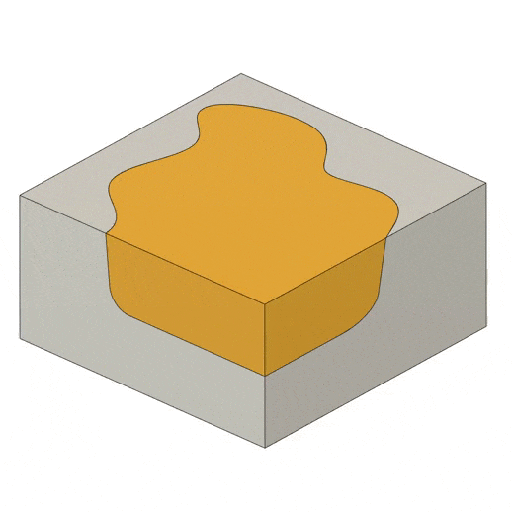
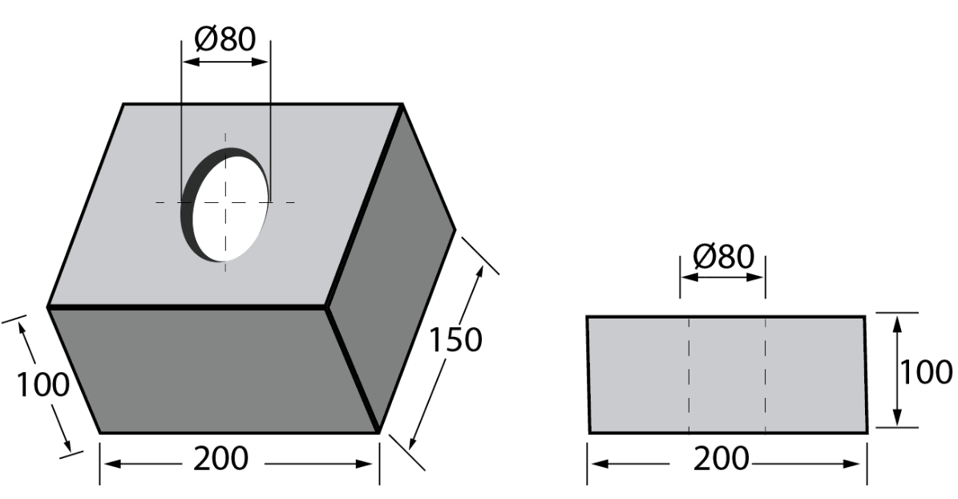
Pattern Allowances
Machining Allowance
12
L02 HOT
Pattern allowances, shrinkage, machining, draft and distortion
Lecture 2. Source slide 23. Notes PDF pp. 2, 6.
12
Notes:
Priority: HOT. Topic: Pattern allowances, shrinkage, machining, draft and distortion.
Lecture 2. Source slide 23. Notes PDF pp. 2, 6.
Priority source: MP - Notes (MUJStella).pdf.
Original deck: Lecture 2 Pattern and Allowances - Copy.pptx.
The five-allowance overview is HOT. The PDF separately rates the rapping question POSSIBLE.

Slide 13
Pattern Allowances
3. Draft or Taper allowance
Given slight taper on the vertical surfaces of the pattern
parallel to the direction of withdrawal from the mould
Provided on both internal & external surfaces
For easy withdrawal of pattern from the mould
13
L02 HOT
Pattern allowances, shrinkage, machining, draft and distortion
Lecture 2. Source slide 24. Notes PDF pp. 2, 6.
13
Notes:
Priority: HOT. Topic: Pattern allowances, shrinkage, machining, draft and distortion.
Lecture 2. Source slide 24. Notes PDF pp. 2, 6.
Priority source: MP - Notes (MUJStella).pdf.
Original deck: Lecture 2 Pattern and Allowances - Copy.pptx.
The five-allowance overview is HOT. The PDF separately rates the rapping question POSSIBLE.

Slide 14
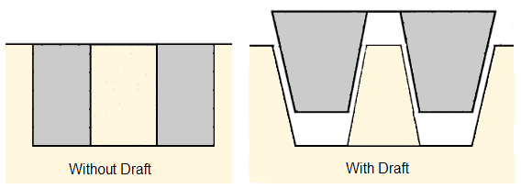
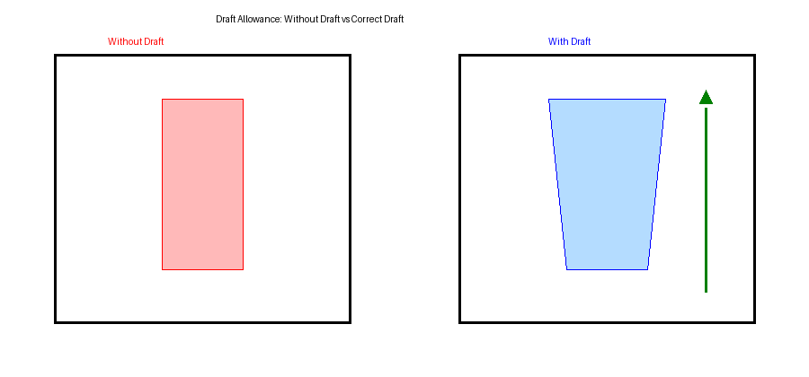
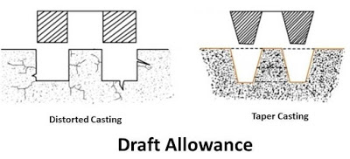
Pattern Allowances
Draft or Taper allowance
14
L02 HOT
Pattern allowances, shrinkage, machining, draft and distortion
Lecture 2. Source slide 25. Notes PDF pp. 2, 6.
14
Notes:
Priority: HOT. Topic: Pattern allowances, shrinkage, machining, draft and distortion.
Lecture 2. Source slide 25. Notes PDF pp. 2, 6.
Priority source: MP - Notes (MUJStella).pdf.
Original deck: Lecture 2 Pattern and Allowances - Copy.pptx.
The five-allowance overview is HOT. The PDF separately rates the rapping question POSSIBLE.

Slide 15
Pattern Allowances
5. Distortion allowance
Castings having irregular shape, will not have uniform
contraction during their cooling
Results in distortion of the castings
Remedy:
An opposite distortion is provided in the pattern
15
L02 HOT
Pattern allowances, shrinkage, machining, draft and distortion
Lecture 2. Source slide 28. Notes PDF pp. 2, 6.
15
Notes:
Priority: HOT. Topic: Pattern allowances, shrinkage, machining, draft and distortion.
Lecture 2. Source slide 28. Notes PDF pp. 2, 6.
Priority source: MP - Notes (MUJStella).pdf.
Original deck: Lecture 2 Pattern and Allowances - Copy.pptx.
The five-allowance overview is HOT. The PDF separately rates the rapping question POSSIBLE.

Slide 16
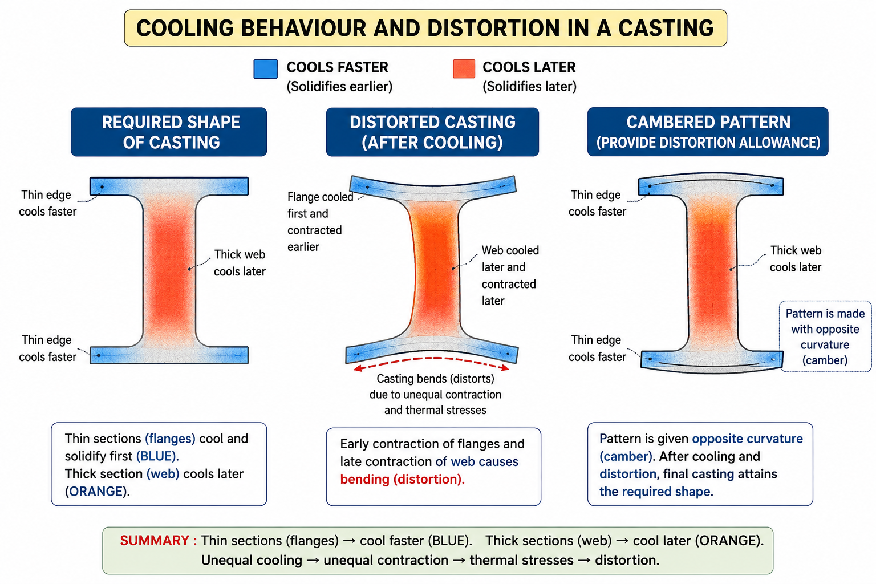
Pattern Allowances
Distortion allowance
16
L02 HOT
Pattern allowances, shrinkage, machining, draft and distortion
Lecture 2. Source slide 29. Notes PDF pp. 2, 6.
16
Notes:
Priority: HOT. Topic: Pattern allowances, shrinkage, machining, draft and distortion.
Lecture 2. Source slide 29. Notes PDF pp. 2, 6.
Priority source: MP - Notes (MUJStella).pdf.
Original deck: Lecture 2 Pattern and Allowances - Copy.pptx.
The five-allowance overview is HOT. The PDF separately rates the rapping question POSSIBLE.

Slide 17
Types of patterns
1. Single piece pattern 2. Match plate pattern
3. Gated pattern 4. Split pattern
5. Cope & Drag pattern 6. Loose-piece pattern
7. Skeleton pattern
17
L02 WARM
Pattern types, match plate and cope-and-drag patterns
Lecture 2. Source slide 10. Notes PDF pp. 6.
17
Notes:
Priority: WARM. Topic: Pattern types, match plate and cope-and-drag patterns.
Lecture 2. Source slide 10. Notes PDF pp. 6.
Priority source: MP - Notes (MUJStella).pdf.
Original deck: Lecture 2 Pattern and Allowances - Copy.pptx.
The five-allowance overview is HOT. The PDF separately rates the rapping question POSSIBLE.

Slide 18
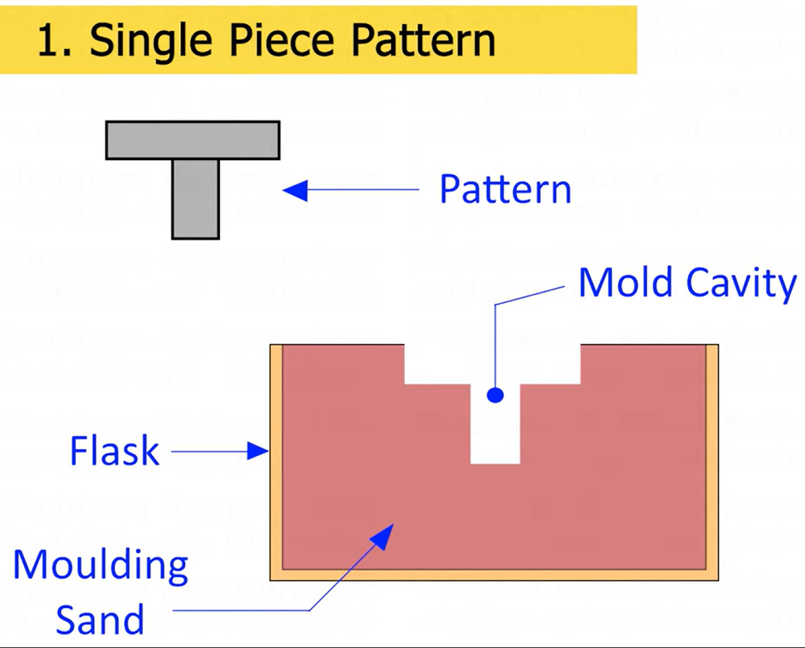
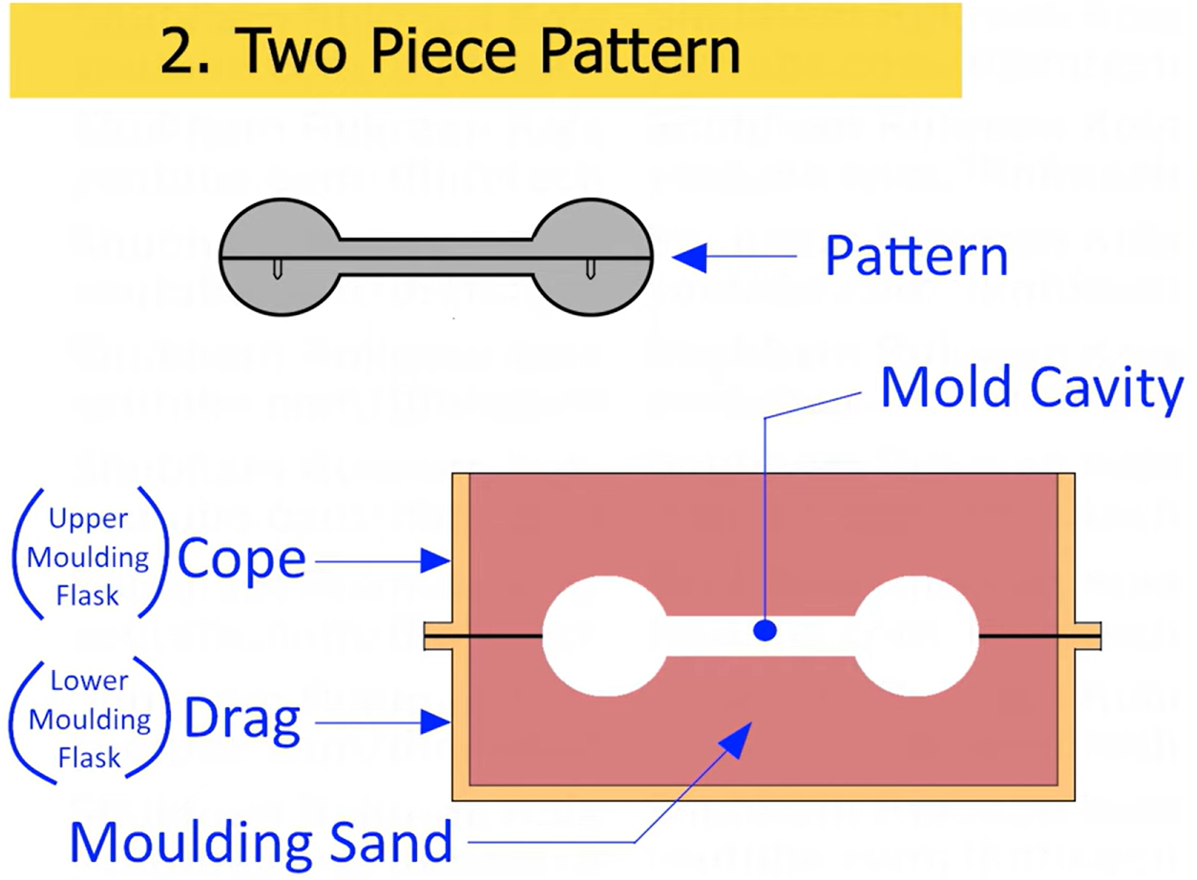
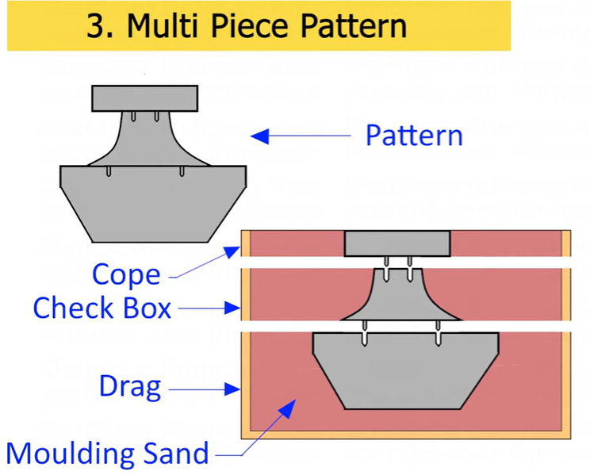
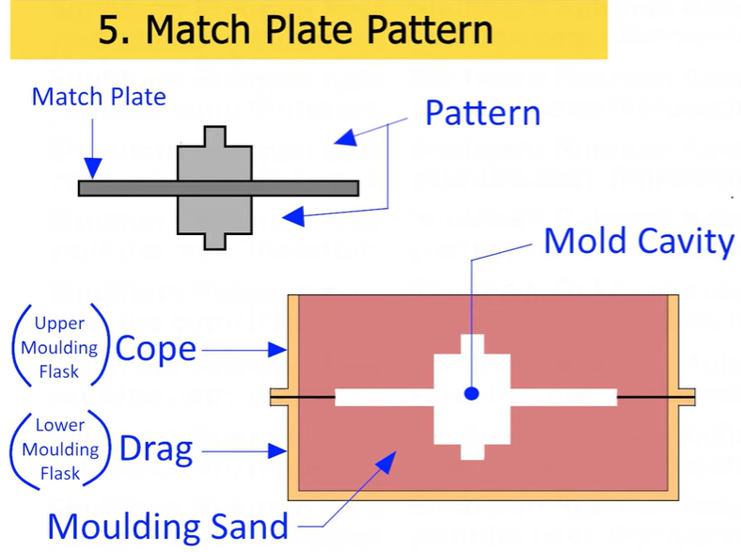
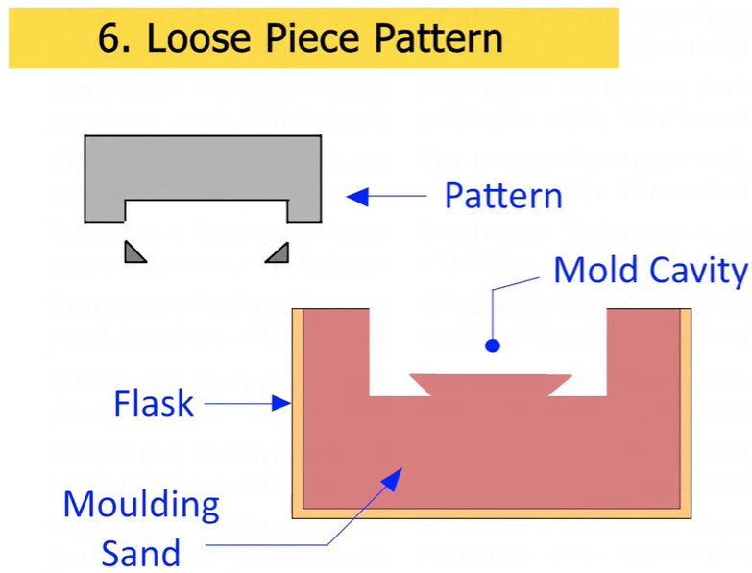
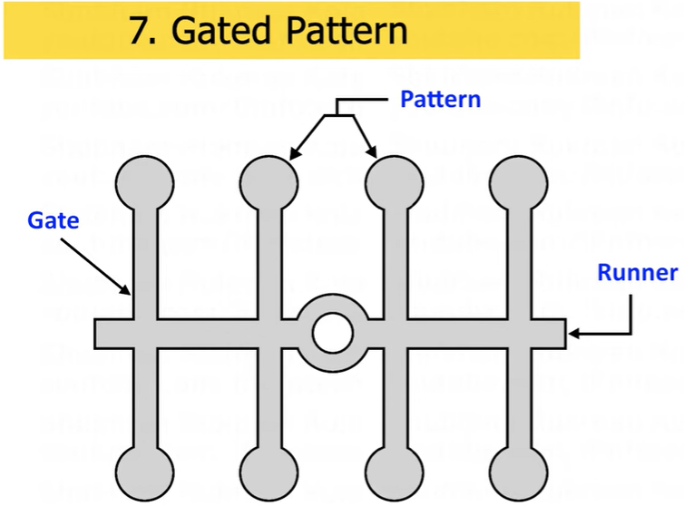
Types of patterns
L02 WARM
Pattern types, match plate and cope-and-drag patterns
Lecture 2. Source slide 11. Notes PDF pp. 6. POSSIBLE: split pattern.
18
Notes:
Priority: WARM. Topic: Pattern types, match plate and cope-and-drag patterns.
Lecture 2. Source slide 11. Notes PDF pp. 6. POSSIBLE: split pattern.
Priority source: MP - Notes (MUJStella).pdf.
Original deck: Lecture 2 Pattern and Allowances - Copy.pptx.
The five-allowance overview is HOT. The PDF separately rates the rapping question POSSIBLE.

Slide 19
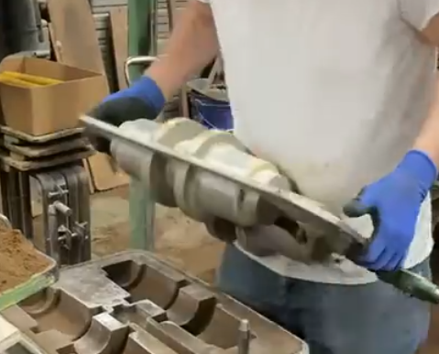
Match Plate Pattern
L02 WARM
Pattern types, match plate and cope-and-drag patterns
Lecture 2. Source slide 12. Notes PDF pp. 6.
19
Notes:
Priority: WARM. Topic: Pattern types, match plate and cope-and-drag patterns.
Lecture 2. Source slide 12. Notes PDF pp. 6.
Priority source: MP - Notes (MUJStella).pdf.
Original deck: Lecture 2 Pattern and Allowances - Copy.pptx.
The five-allowance overview is HOT. The PDF separately rates the rapping question POSSIBLE.

Slide 20
Cope and Drag pattern
Similar to split patterns
The cope & drag halves of the pattern along with the gating
and riser systems prepared separately
But they are attached separately to the metal or wooden
plate along with alignment pins
Match plate pattern
An extension of cope and drag pattern
Here the cope & drag patterns along with the gating &
risering are mounted on a single matching or metal plate
on either side
20
L02 WARM
Pattern types, match plate and cope-and-drag patterns
Lecture 2. Source slide 15. Notes PDF pp. 6.
20
Notes:
Priority: WARM. Topic: Pattern types, match plate and cope-and-drag patterns.
Lecture 2. Source slide 15. Notes PDF pp. 6.
Priority source: MP - Notes (MUJStella).pdf.
Original deck: Lecture 2 Pattern and Allowances - Copy.pptx.
The five-allowance overview is HOT. The PDF separately rates the rapping question POSSIBLE.

Slide 21

Green sand mold
with pattern
Drag
Drag
Drag
Drag
Pattern
Pattern
Molding board
Molding board
Molding board
Molding board
FIRST OPERATION
FIRST OPERATION
Vents
Weight
Lifter
Riser pin
Sprue pin
Pouring basin
Cope
Riser
Parting
line
Parting
line
Runner
Gate
Core
SECOND OPERATION
COMPLETE MOLD
21
L02 WARM
Green sand mould making
Lecture 2. Source slide 8. Notes PDF pp. 6, 9.
21
Notes:
Priority: WARM. Topic: Green sand mould making.
Lecture 2. Source slide 8. Notes PDF pp. 6, 9.
Priority source: MP - Notes (MUJStella).pdf.
Original deck: Lecture 2 Pattern and Allowances - Copy.pptx.
The five-allowance overview is HOT. The PDF separately rates the rapping question POSSIBLE.

Slide 22
Types of patterns
Single piece pattern
Made from one piece & does not contain loose pieces
Inexpensive & are of simplest type
Split pattern
Most widely used pattern for intricate castings
Here the pattern is split into 2 parts so that one part is in
the cope & other is in the drag
Two halves of the pattern is aligned properly by using
dowel pins
22
L02 POSSIBLE
Single-piece and split patterns
Lecture 2. Source slide 14. Notes PDF pp. 6.
22
Notes:
Priority: POSSIBLE. Topic: Single-piece and split patterns.
Lecture 2. Source slide 14. Notes PDF pp. 6.
Priority source: MP - Notes (MUJStella).pdf.
Original deck: Lecture 2 Pattern and Allowances - Copy.pptx.
The five-allowance overview is HOT. The PDF separately rates the rapping question POSSIBLE.

Slide 23
Pattern Allowances
4. Rapping allowance
Negative allowance to be provided in the pattern
When pattern is withdrawn from the mould by striking over
it from side to side, size of the cavity increases
To compensate this rapping allowance is provided
23
L02 POSSIBLE
Rapping allowance
Lecture 2. Source slide 26. Notes PDF pp. 2.
23
Notes:
Priority: POSSIBLE. Topic: Rapping allowance.
Lecture 2. Source slide 26. Notes PDF pp. 2.
Priority source: MP - Notes (MUJStella).pdf.
Original deck: Lecture 2 Pattern and Allowances - Copy.pptx.
The five-allowance overview is HOT. The PDF separately rates the rapping question POSSIBLE.

Slide 24
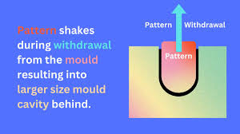
Pattern Allowances
Rapping allowance
24
L02 POSSIBLE
Rapping allowance
Lecture 2. Source slide 27. Notes PDF pp. 2.
24
Notes:
Priority: POSSIBLE. Topic: Rapping allowance.
Lecture 2. Source slide 27. Notes PDF pp. 2.
Priority source: MP - Notes (MUJStella).pdf.
Original deck: Lecture 2 Pattern and Allowances - Copy.pptx.
The five-allowance overview is HOT. The PDF separately rates the rapping question POSSIBLE.

Slide 25
Casting
It is the process of producing metallic parts by pouring a molten metal in to the mould and allowing the metal to solidify.
25
L02 SUPPORTING
Additional lecture material and closing slides
Lecture 2. Source slide 2. No explicit rating in the notes.
25
Notes:
Priority: SUPPORTING. Topic: Additional lecture material and closing slides.
Lecture 2. Source slide 2. No explicit rating in the notes.
Priority source: MP - Notes (MUJStella).pdf.
Original deck: Lecture 2 Pattern and Allowances - Copy.pptx.
The five-allowance overview is HOT. The PDF separately rates the rapping question POSSIBLE.

Slide 26
Casting Process
Mould is prepared
Metal is Heated above Melting Point Temp
Liquid Metal is Poured into Mold
Metal Solidifies into Shape of Mold
Casted Part is Removed from Mold
Post Casting Operations
  Cutting
  Clean Up
  Machining
26
L02 SUPPORTING
Additional lecture material and closing slides
Lecture 2. Source slide 3. No explicit rating in the notes.
26
Notes:
Priority: SUPPORTING. Topic: Additional lecture material and closing slides.
Lecture 2. Source slide 3. No explicit rating in the notes.
Priority source: MP - Notes (MUJStella).pdf.
Original deck: Lecture 2 Pattern and Allowances - Copy.pptx.
The five-allowance overview is HOT. The PDF separately rates the rapping question POSSIBLE.

Slide 27
27
L02 SUPPORTING
Additional lecture material and closing slides
Lecture 2. Source slide 4. No explicit rating in the notes.
27
Notes:
Priority: SUPPORTING. Topic: Additional lecture material and closing slides.
Lecture 2. Source slide 4. No explicit rating in the notes.
Priority source: MP - Notes (MUJStella).pdf.
Original deck: Lecture 2 Pattern and Allowances - Copy.pptx.
The five-allowance overview is HOT. The PDF separately rates the rapping question POSSIBLE.

Slide 28
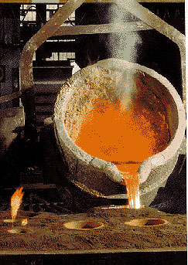
28
L02 SUPPORTING
Additional lecture material and closing slides
Lecture 2. Source slide 5. No explicit rating in the notes.
28
Notes:
Priority: SUPPORTING. Topic: Additional lecture material and closing slides.
Lecture 2. Source slide 5. No explicit rating in the notes.
Priority source: MP - Notes (MUJStella).pdf.
Original deck: Lecture 2 Pattern and Allowances - Copy.pptx.
The five-allowance overview is HOT. The PDF separately rates the rapping question POSSIBLE.

Slide 29
Pattern
A pattern is a replica of a casting to be made.
Using pattern, impressions (mould cavity) can be formed in the damp sand to make a mould.
29
L02 SUPPORTING
Additional lecture material and closing slides
Lecture 2. Source slide 6. No explicit rating in the notes.
29
Notes:
Priority: SUPPORTING. Topic: Additional lecture material and closing slides.
Lecture 2. Source slide 6. No explicit rating in the notes.
Priority source: MP - Notes (MUJStella).pdf.
Original deck: Lecture 2 Pattern and Allowances - Copy.pptx.
The five-allowance overview is HOT. The PDF separately rates the rapping question POSSIBLE.

Slide 30
Pattern materials
Wood: easy to work & readily available, can be cut in to required shapes and used when small number of castings
Metal: do not change their shape when subjected to moist condition, used when small number of castings
Plastics: do not absorb moisture, smooth, can be withdrawn from the mold easily, without damaging the mold
Plaster: High compressive strength
30
L02 SUPPORTING
Additional lecture material and closing slides
Lecture 2. Source slide 7. No explicit rating in the notes.
30
Notes:
Priority: SUPPORTING. Topic: Additional lecture material and closing slides.
Lecture 2. Source slide 7. No explicit rating in the notes.
Priority source: MP - Notes (MUJStella).pdf.
Original deck: Lecture 2 Pattern and Allowances - Copy.pptx.
The five-allowance overview is HOT. The PDF separately rates the rapping question POSSIBLE.

Slide 31
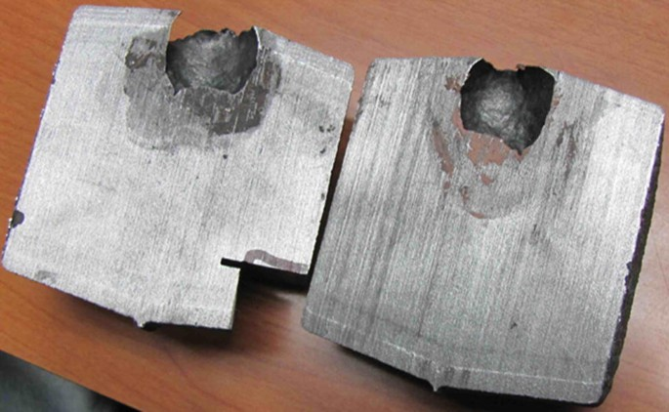
Casting Defect
L02 SUPPORTING
Additional lecture material and closing slides
Lecture 2. Source slide 9. No explicit rating in the notes.
31
Notes:
Priority: SUPPORTING. Topic: Additional lecture material and closing slides.
Lecture 2. Source slide 9. No explicit rating in the notes.
Priority source: MP - Notes (MUJStella).pdf.
Original deck: Lecture 2 Pattern and Allowances - Copy.pptx.
The five-allowance overview is HOT. The PDF separately rates the rapping question POSSIBLE.

Slide 32
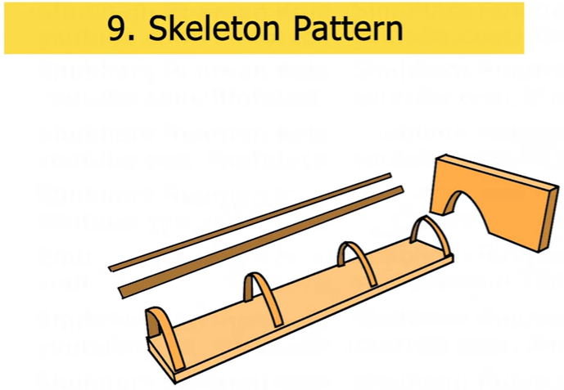
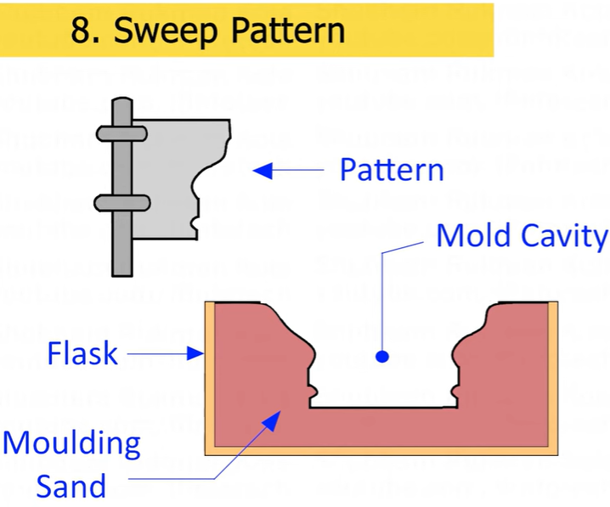
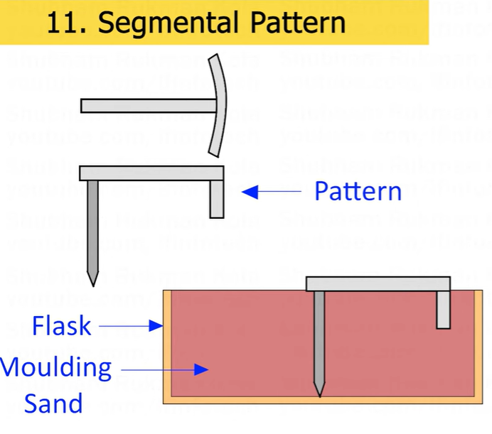
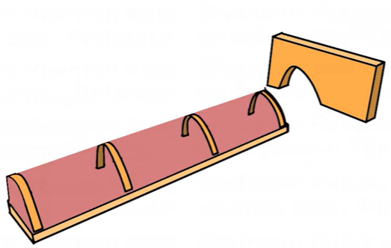
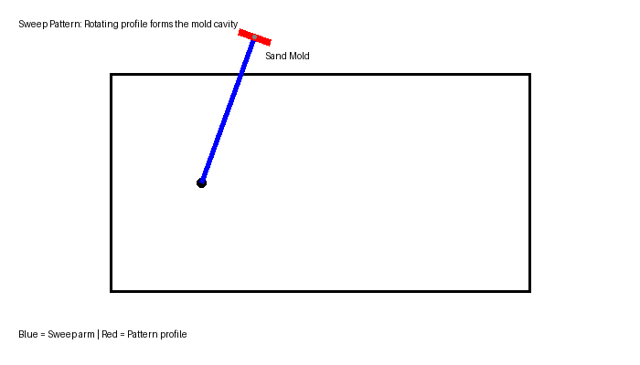
Types of patterns
L02 SUPPORTING
Additional lecture material and closing slides
Lecture 2. Source slide 13. No explicit rating in the notes.
32
Notes:
Priority: SUPPORTING. Topic: Additional lecture material and closing slides.
Lecture 2. Source slide 13. No explicit rating in the notes.
Priority source: MP - Notes (MUJStella).pdf.
Original deck: Lecture 2 Pattern and Allowances - Copy.pptx.
The five-allowance overview is HOT. The PDF separately rates the rapping question POSSIBLE.

Slide 33
Loose piece pattern
Used when contour of the part is such that withdrawing the pattern from the mold is not possible
Obstructing part is held as a loose piece
Skeleton pattern
Made of strips of wood for preparing final pattern
by pouring the sand around the pattern and packing it
33
L02 SUPPORTING
Additional lecture material and closing slides
Lecture 2. Source slide 16. No explicit rating in the notes.
33
Notes:
Priority: SUPPORTING. Topic: Additional lecture material and closing slides.
Lecture 2. Source slide 16. No explicit rating in the notes.
Priority source: MP - Notes (MUJStella).pdf.
Original deck: Lecture 2 Pattern and Allowances - Copy.pptx.
The five-allowance overview is HOT. The PDF separately rates the rapping question POSSIBLE.

Slide 34
Gated pattern
Usually made of metal which increases their strength and reduces tendency to warp
Section connecting different patterns serve as runner and gates
A gated pattern can manufacture many castings at one time
Used in mass production systems
34
L02 SUPPORTING
Additional lecture material and closing slides
Lecture 2. Source slide 17. No explicit rating in the notes.
34
Notes:
Priority: SUPPORTING. Topic: Additional lecture material and closing slides.
Lecture 2. Source slide 17. No explicit rating in the notes.
Priority source: MP - Notes (MUJStella).pdf.
Original deck: Lecture 2 Pattern and Allowances - Copy.pptx.
The five-allowance overview is HOT. The PDF separately rates the rapping question POSSIBLE.

Slide 35
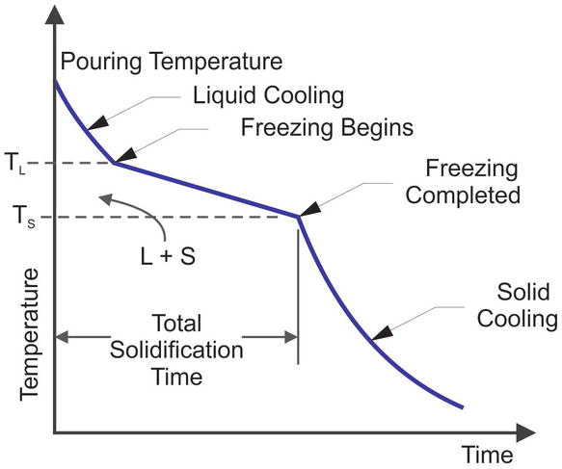
Molten Metal Cooling Curve
L02 SUPPORTING
Additional lecture material and closing slides
Lecture 2. Source slide 18. No explicit rating in the notes.
35
Notes:
Priority: SUPPORTING. Topic: Additional lecture material and closing slides.
Lecture 2. Source slide 18. No explicit rating in the notes.
Priority source: MP - Notes (MUJStella).pdf.
Original deck: Lecture 2 Pattern and Allowances - Copy.pptx.
The five-allowance overview is HOT. The PDF separately rates the rapping question POSSIBLE.

Slide 36
11
L02 SUPPORTING
Additional lecture material and closing slides
Lecture 2. Source slide 30. No explicit rating in the notes.
36
Notes:
Priority: SUPPORTING. Topic: Additional lecture material and closing slides.
Lecture 2. Source slide 30. No explicit rating in the notes.
Priority source: MP - Notes (MUJStella).pdf.
Original deck: Lecture 2 Pattern and Allowances - Copy.pptx.
The five-allowance overview is HOT. The PDF separately rates the rapping question POSSIBLE.

Slide 37
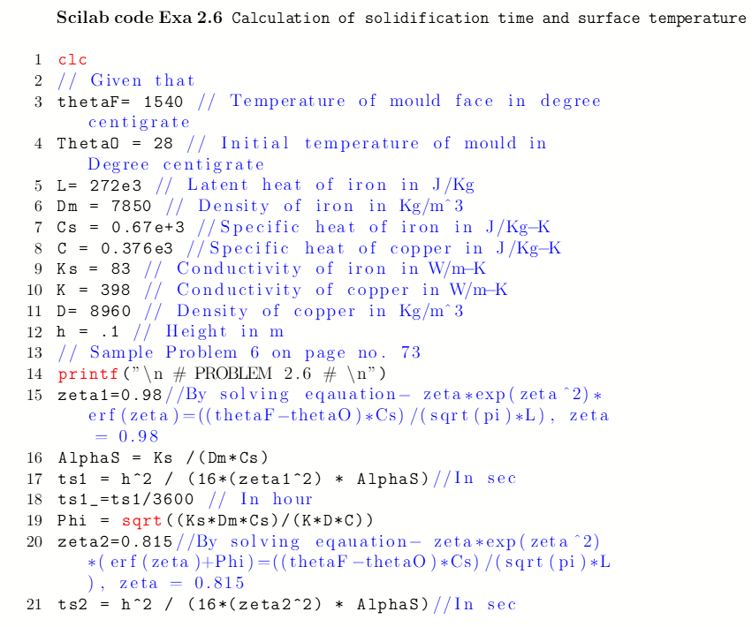
L02 SUPPORTING
Additional lecture material and closing slides
Lecture 2. Source slide 31. No explicit rating in the notes.
37
Notes:
Priority: SUPPORTING. Topic: Additional lecture material and closing slides.
Lecture 2. Source slide 31. No explicit rating in the notes.
Priority source: MP - Notes (MUJStella).pdf.
Original deck: Lecture 2 Pattern and Allowances - Copy.pptx.
The five-allowance overview is HOT. The PDF separately rates the rapping question POSSIBLE.

Slide 38
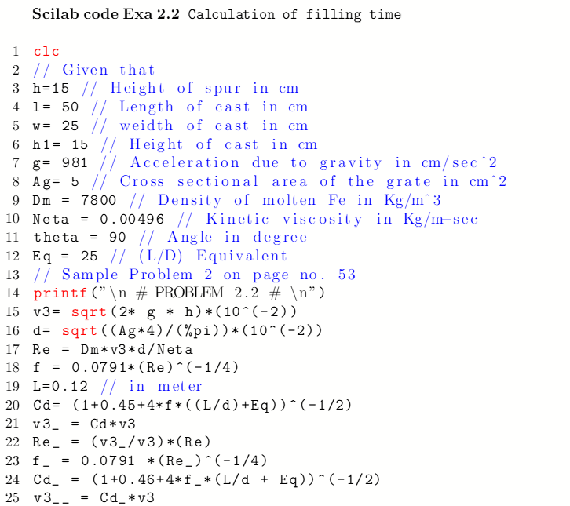
L02 SUPPORTING
Additional lecture material and closing slides
Lecture 2. Source slide 32. No explicit rating in the notes.
38
Notes:
Priority: SUPPORTING. Topic: Additional lecture material and closing slides.
Lecture 2. Source slide 32. No explicit rating in the notes.
Priority source: MP - Notes (MUJStella).pdf.
Original deck: Lecture 2 Pattern and Allowances - Copy.pptx.
The five-allowance overview is HOT. The PDF separately rates the rapping question POSSIBLE.

Slide 39
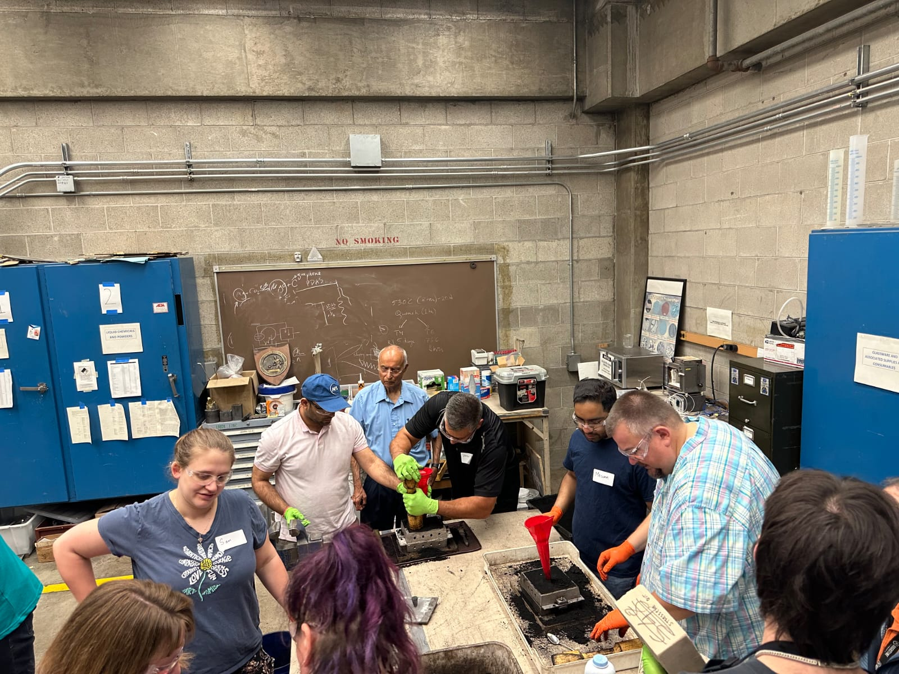
L02 SUPPORTING
Additional lecture material and closing slides
Lecture 2. Source slide 33. No explicit rating in the notes.
39
Notes:
Priority: SUPPORTING. Topic: Additional lecture material and closing slides.
Lecture 2. Source slide 33. No explicit rating in the notes.
Priority source: MP - Notes (MUJStella).pdf.
Original deck: Lecture 2 Pattern and Allowances - Copy.pptx.
The five-allowance overview is HOT. The PDF separately rates the rapping question POSSIBLE.

Slide 40
Lecture 3
Moulding Sand
L03 LECTURE
Moulding sand
Lecture 3. Source slide 1. Lecture title.
40
Notes:
Priority: INTRO. Topic: Moulding sand.
Lecture 3. Source slide 1. Lecture title.
Priority source: MP - Notes (MUJStella).pdf.
Original deck: Lecture 3 Moulding Sand...pptx.
Sand types are POSSIBLE in the main guide. The green/dry comparison is WARM. Parting sand remains POSSIBLE.

Slide 41
Lecture 3
Moulding sand
HOT
Moulding sand properties and permeability (PDF pp. 2, 7)
WARM
Green sand versus dry sand; Green sand mould making (PDF pp. 6, 7, 9)
POSSIBLE
Sand composition, preparation and mixing; Moulding sand classification and types (PDF pp. 2, 7)
SUPPORTING
Other source material, references and closing slides
Sand types are POSSIBLE in the main guide. The green/dry comparison is WARM. Parting sand remains POSSIBLE.
Manufacturing Processes / MP - Notes (MUJStella)
Notes:
Source lecture: C:\Users\agam7\Documents\Obsidian\MUJ\MP (3)\Lectures\Lecture 3 Moulding Sand...pptx
Priority source: MP - Notes (MUJStella).pdf.
HOT: Moulding sand properties and permeability. Source slides 7, 8. PDF pages 2, 7.
WARM: Green sand versus dry sand. Source slides 3. PDF pages 7.
WARM: Green sand mould making. Source slides 12, 13. PDF pages 6, 9.
POSSIBLE: Sand composition, preparation and mixing. Source slides 6, 9, 10, 11. PDF pages 7.
POSSIBLE: Moulding sand classification and types. Source slides 2, 4, 5. PDF pages 2, 7.
SUPPORTING: Additional lecture material and closing slides. Source slides 14, 15, 16. PDF pages not explicitly rated.
Sand types are POSSIBLE in the main guide. The green/dry comparison is WARM. Parting sand remains POSSIBLE.

Slide 42
Properties of a molding sand
Porosity (permeability): Sand must be porous to allow the gases/ moisture present within the molds to be removed freely when molten metal is poured.
Adhesiveness: Sand particles must be capable of adhering to sides of molding boxes.
Cohesiveness / Strength: Ability of sand particles to stick together and should be sufficient to permit the mold to be formed to the desired shape even after the hot metal is poured in the mold.
Refractoriness: Molding sands with a poor refractoriness may burn on to the casting. Measured by sinter point of sand.
42
L03 HOT
Moulding sand properties and permeability
Lecture 3. Source slide 7. Notes PDF pp. 2, 7.
42
Notes:
Priority: HOT. Topic: Moulding sand properties and permeability.
Lecture 3. Source slide 7. Notes PDF pp. 2, 7.
Priority source: MP - Notes (MUJStella).pdf.
Original deck: Lecture 3 Moulding Sand...pptx.
Sand types are POSSIBLE in the main guide. The green/dry comparison is WARM. Parting sand remains POSSIBLE.

Slide 43
Properties of a molding sand
Collapsibility: Mold made out of sand to collapse as the molten metal gets solidified in it.
Flowability: Ability of the sand to behave like a fluid so that, when rammed sand will flow to all portions of a mold and around the pattern and take up the required shape.
  It increases as clay & water content increase.
  High flowability is required of a molding sand of uniform density.
  To obtain good impression of the pattern in the mold.
43
L03 HOT
Moulding sand properties and permeability
Lecture 3. Source slide 8. Notes PDF pp. 2, 7.
43
Notes:
Priority: HOT. Topic: Moulding sand properties and permeability.
Lecture 3. Source slide 8. Notes PDF pp. 2, 7.
Priority source: MP - Notes (MUJStella).pdf.
Original deck: Lecture 3 Moulding Sand...pptx.
Sand types are POSSIBLE in the main guide. The green/dry comparison is WARM. Parting sand remains POSSIBLE.

Slide 44
Molding sand classification
Green Sand: Containing silica sand, clay, and water, possesses good strength and permeability.
Dry Sand: Stronger and more thermally stable than green sand, used for larger, heavier castings.
Loam Sand: A mixture with a high clay content (around 50%) and used for large castings with skeleton patterns.
Facing Sand: Used to form the mold face, providing a smooth surface for the casting to prevent metal penetration.
44
L03 WARM
Green sand versus dry sand
Lecture 3. Source slide 3. Notes PDF pp. 7.
44
Notes:
Priority: WARM. Topic: Green sand versus dry sand.
Lecture 3. Source slide 3. Notes PDF pp. 7.
Priority source: MP - Notes (MUJStella).pdf.
Original deck: Lecture 3 Moulding Sand...pptx.
Sand types are POSSIBLE in the main guide. The green/dry comparison is WARM. Parting sand remains POSSIBLE.

Slide 45
Green sand mold
45
L03 WARM
Green sand mould making
Lecture 3. Source slide 12. Notes PDF pp. 6, 9.
45
Notes:
Priority: WARM. Topic: Green sand mould making.
Lecture 3. Source slide 12. Notes PDF pp. 6, 9.
Priority source: MP - Notes (MUJStella).pdf.
Original deck: Lecture 3 Moulding Sand...pptx.
Sand types are POSSIBLE in the main guide. The green/dry comparison is WARM. Parting sand remains POSSIBLE.

Slide 46
Green sand mold
with pattern
Drag
Drag
Drag
Drag
Pattern
Pattern
Molding board
Molding board
Molding board
Molding board
FIRST OPERATION
FIRST OPERATION
Vents
Weight
Lifter
Riser pin
Sprue pin
Pouring basin
Cope
Riser
Parting
line
Parting
line
Runner
Gate
Core
SECOND OPERATION
COMPLETE MOLD
46
L03 WARM
Green sand mould making
Lecture 3. Source slide 13. Notes PDF pp. 6, 9.
46
Notes:
Priority: WARM. Topic: Green sand mould making.
Lecture 3. Source slide 13. Notes PDF pp. 6, 9.
Priority source: MP - Notes (MUJStella).pdf.
Original deck: Lecture 3 Moulding Sand...pptx.
Sand types are POSSIBLE in the main guide. The green/dry comparison is WARM. Parting sand remains POSSIBLE.

Slide 47
Sand preparation
Very few natural sands have all the qualities required by a molding sand
It is mixed with other sands which possess the required characteristics
Sufficient moisture must be added to the sand
Sand must be properly conditioned before use
47
L03 POSSIBLE
Sand composition, preparation and mixing
Lecture 3. Source slide 6. Notes PDF pp. 7.
47
Notes:
Priority: POSSIBLE. Topic: Sand composition, preparation and mixing.
Lecture 3. Source slide 6. Notes PDF pp. 7.
Priority source: MP - Notes (MUJStella).pdf.
Original deck: Lecture 3 Moulding Sand...pptx.
Sand types are POSSIBLE in the main guide. The green/dry comparison is WARM. Parting sand remains POSSIBLE.

Slide 48
Key components of sand
Silica Sand: The base material of the mold. Typically silica sand.
Clay: Binds the sand particles together, providing strength and durability to the mold. Bentonite, Kaolinite etc.
Water: Essential for the binding properties of clay in green sand.
Binders (Resins): Used in dry sand or resin sand casting to create a strong, solid mold e.g. phenolic resins, furan resins, urea resins, epoxy resins and acrylic resins.
Auxiliary Substances: May include sawdust, coal powder, or straw, improving air permeability and heat resistance of the mold
L03 POSSIBLE
Sand composition, preparation and mixing
Lecture 3. Source slide 9. Notes PDF pp. 7.
48
Notes:
Priority: POSSIBLE. Topic: Sand composition, preparation and mixing.
Lecture 3. Source slide 9. Notes PDF pp. 7.
Priority source: MP - Notes (MUJStella).pdf.
Original deck: Lecture 3 Moulding Sand...pptx.
Sand types are POSSIBLE in the main guide. The green/dry comparison is WARM. Parting sand remains POSSIBLE.

Slide 49
Key components of sand
Silica sand (SiO₂): Act as the primary mold material provides refractoriness, typical range is 80-92%.
Clay: Acts as a binder, common types include bentonite clay (e.g., sodium bentonite), typical range is 6-12%.
Water: Activates the clay binder, enabling it to hold the sand grains together, typical range is 3-6%.
Other additives: Include sea coal, silica flour, and other organic materials. They improve flowability, permeability of the mold and surface finish of the casting.
L03 POSSIBLE
Sand composition, preparation and mixing
Lecture 3. Source slide 10. Notes PDF pp. 7.
49
Notes:
Priority: POSSIBLE. Topic: Sand composition, preparation and mixing.
Lecture 3. Source slide 10. Notes PDF pp. 7.
Priority source: MP - Notes (MUJStella).pdf.
Original deck: Lecture 3 Moulding Sand...pptx.
Sand types are POSSIBLE in the main guide. The green/dry comparison is WARM. Parting sand remains POSSIBLE.

Slide 50
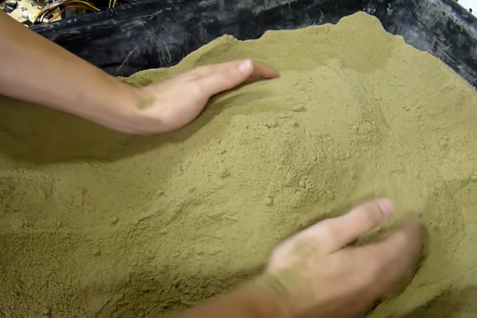
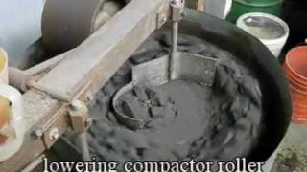
Sand mixing
L03 POSSIBLE
Sand composition, preparation and mixing
Lecture 3. Source slide 11. Notes PDF pp. 7.
50
Notes:
Priority: POSSIBLE. Topic: Sand composition, preparation and mixing.
Lecture 3. Source slide 11. Notes PDF pp. 7.
Priority source: MP - Notes (MUJStella).pdf.
Original deck: Lecture 3 Moulding Sand...pptx.
Sand types are POSSIBLE in the main guide. The green/dry comparison is WARM. Parting sand remains POSSIBLE.

Slide 51
Molding sand classification
They can be classified as:
  Natural molding sand (Green sand)
- Taken from river-beds & contain major amount of clay
- Easily available at low cost
  Synthetic sand
  - Contain little or no binder (clay)
  - Strength & bonding property can be easily controlled
  - More expensive than natural sand
  Special sand
    - Ideal in getting special characteristics.
51
L03 POSSIBLE
Moulding sand classification and types
Lecture 3. Source slide 2. Notes PDF pp. 2, 7.
51
Notes:
Priority: POSSIBLE. Topic: Moulding sand classification and types.
Lecture 3. Source slide 2. Notes PDF pp. 2, 7.
Priority source: MP - Notes (MUJStella).pdf.
Original deck: Lecture 3 Moulding Sand...pptx.
Sand types are POSSIBLE in the main guide. The green/dry comparison is WARM. Parting sand remains POSSIBLE.

Slide 52
Molding sand classification
Backing Sand: Supports the facing sand and fills the rest of the mold cavity, contains permeability.
System Sand: Applied in machine molding, possessing high strength, permeability, and refractoriness.
Core Sand: Used to make cores and includes binders such as linseed oil, phenol-formaldehyde, urea-formaldehyde, dextrin, starch sodium silicate and fire clay.
Parting Sand: Used to prevent sand from sticking together at the parting line of the mold.
52
L03 POSSIBLE
Moulding sand classification and types
Lecture 3. Source slide 4. Notes PDF pp. 2, 7.
52
Notes:
Priority: POSSIBLE. Topic: Moulding sand classification and types.
Lecture 3. Source slide 4. Notes PDF pp. 2, 7.
Priority source: MP - Notes (MUJStella).pdf.
Original deck: Lecture 3 Moulding Sand...pptx.
Sand types are POSSIBLE in the main guide. The green/dry comparison is WARM. Parting sand remains POSSIBLE.

Slide 53
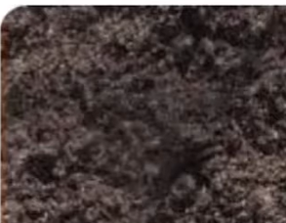
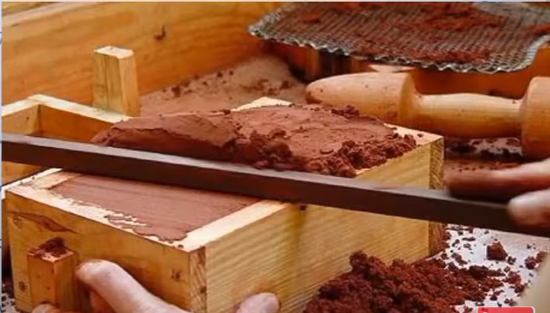
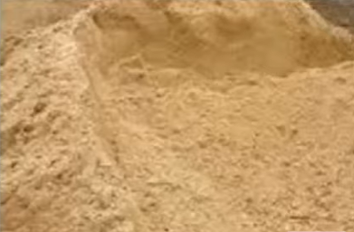
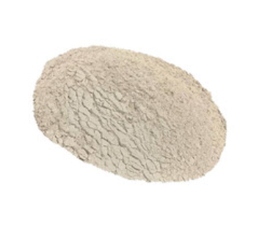
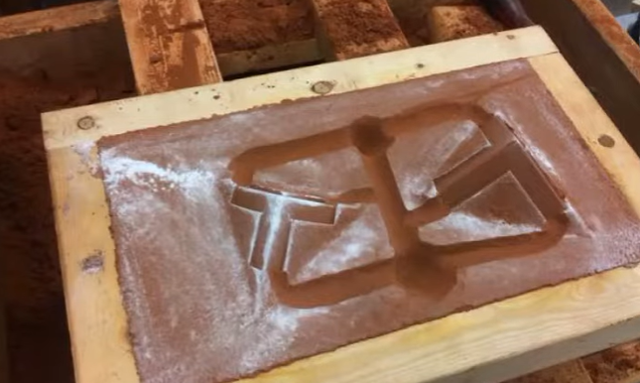
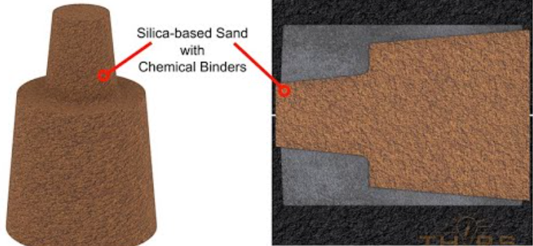
Types of Molding Sand
Green Sand
Dry Sand
Loam Sand
Parting Sand
Facing Sand
Core Sand
L03 POSSIBLE
Moulding sand classification and types
Lecture 3. Source slide 5. Notes PDF pp. 2, 7. POSSIBLE: parting sand.
53
Notes:
Priority: POSSIBLE. Topic: Moulding sand classification and types.
Lecture 3. Source slide 5. Notes PDF pp. 2, 7. POSSIBLE: parting sand.
Priority source: MP - Notes (MUJStella).pdf.
Original deck: Lecture 3 Moulding Sand...pptx.
Sand types are POSSIBLE in the main guide. The green/dry comparison is WARM. Parting sand remains POSSIBLE.

Slide 54
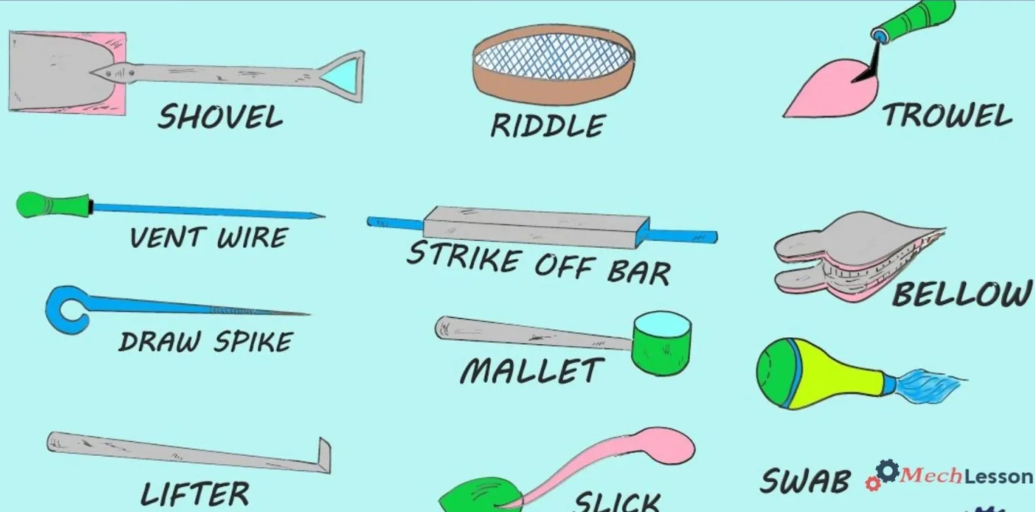
Molding tools
LINK: https://www.youtube.com/watch?v=FihNxujyu08
L03 SUPPORTING
Additional lecture material and closing slides
Lecture 3. Source slide 14. No explicit rating in the notes.
54
Notes:
Priority: SUPPORTING. Topic: Additional lecture material and closing slides.
Lecture 3. Source slide 14. No explicit rating in the notes.
Priority source: MP - Notes (MUJStella).pdf.
Original deck: Lecture 3 Moulding Sand...pptx.
Sand types are POSSIBLE in the main guide. The green/dry comparison is WARM. Parting sand remains POSSIBLE.

Slide 55
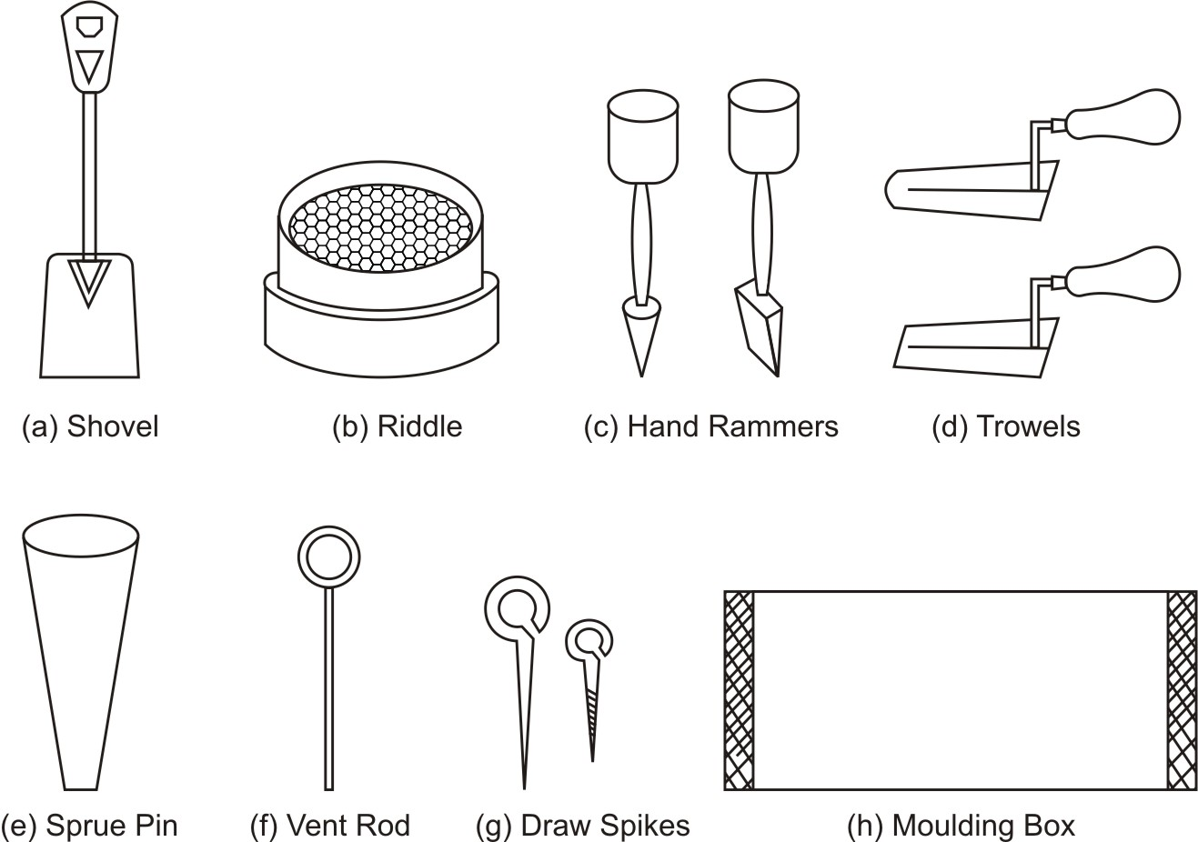
L03 SUPPORTING
Additional lecture material and closing slides
Lecture 3. Source slide 15. No explicit rating in the notes.
55
Notes:
Priority: SUPPORTING. Topic: Additional lecture material and closing slides.
Lecture 3. Source slide 15. No explicit rating in the notes.
Priority source: MP - Notes (MUJStella).pdf.
Original deck: Lecture 3 Moulding Sand...pptx.
Sand types are POSSIBLE in the main guide. The green/dry comparison is WARM. Parting sand remains POSSIBLE.

Slide 56
11
L03 SUPPORTING
Additional lecture material and closing slides
Lecture 3. Source slide 16. No explicit rating in the notes.
56
Notes:
Priority: SUPPORTING. Topic: Additional lecture material and closing slides.
Lecture 3. Source slide 16. No explicit rating in the notes.
Priority source: MP - Notes (MUJStella).pdf.
Original deck: Lecture 3 Moulding Sand...pptx.
Sand types are POSSIBLE in the main guide. The green/dry comparison is WARM. Parting sand remains POSSIBLE.

Slide 57
Lecture 4
Molding and core making
L04 LECTURE
Mould and core making
Lecture 4. Source slide 1. Lecture title.
57
Notes:
Priority: INTRO. Topic: Mould and core making.
Lecture 4. Source slide 1. Lecture title.
Priority source: MP - Notes (MUJStella).pdf.
Original deck: Lecture 4 Mould making - Copy.pptx.

Slide 58
Lecture 4
Mould and core making
HOT
No separately rated slide block in this lecture.
WARM
Green sand mould making procedure; Core purpose and core making (PDF pp. 2, 6, 9)
POSSIBLE
No separately rated slide block in this lecture.
SUPPORTING
Other source material, references and closing slides
Manufacturing Processes / MP - Notes (MUJStella)
Notes:
Source lecture: C:\Users\agam7\Documents\Obsidian\MUJ\MP (3)\Lectures\Lecture 4 Mould making - Copy.pptx
Priority source: MP - Notes (MUJStella).pdf.
WARM: Green sand mould making procedure. Source slides 2, 3, 4, 5, 6, 7, 8. PDF pages 6, 9.
WARM: Core purpose and core making. Source slides 9, 10, 11, 12, 13. PDF pages 2, 9.
SUPPORTING: Additional lecture material and closing slides. Source slides 14. PDF pages not explicitly rated.

Slide 59
Conventional Molding Process
Green Sand Molding
Green sand is the most diversified molding method used in metal casting operations. The process utilizes a mold made of compressed or compacted moist sand. The term "green" denotes the presence of moisture in the molding sand. The mold material consists of silica sand mixed with a suitable bonding agent (usually clay) and moisture.
L04 WARM
Green sand mould making procedure
Lecture 4. Source slide 2. Notes PDF pp. 6, 9.
59
Notes:
Priority: WARM. Topic: Green sand mould making procedure.
Lecture 4. Source slide 2. Notes PDF pp. 6, 9.
Priority source: MP - Notes (MUJStella).pdf.
Original deck: Lecture 4 Mould making - Copy.pptx.

Slide 60
Green Sand Molding
Advantages
Most metals can be cast by this method.
Pattern costs and material costs are relatively low.
No Limitation with respect to size of casting and type of metal or alloy used
Disadvantages
Surface Finish of the castings obtained by this process is not good and machining is often required to achieve the finished product.
L04 WARM
Green sand mould making procedure
Lecture 4. Source slide 3. Notes PDF pp. 6, 9.
60
Notes:
Priority: WARM. Topic: Green sand mould making procedure.
Lecture 4. Source slide 3. Notes PDF pp. 6, 9.
Priority source: MP - Notes (MUJStella).pdf.
Original deck: Lecture 4 Mould making - Copy.pptx.

Slide 61
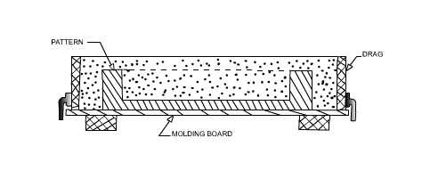
Green Sand Molding Steps
The first step in making mold is to place the pattern on the molding board.
The drag is placed on the board
Dry facing sand is sprinkled over the board and pattern to provide a non sticky layer.
Molding sand is then riddled in to cover the pattern with the fingers; then the drag is completely filled.
L04 WARM
Green sand mould making procedure
Lecture 4. Source slide 4. Notes PDF pp. 6, 9.
61
Notes:
Priority: WARM. Topic: Green sand mould making procedure.
Lecture 4. Source slide 4. Notes PDF pp. 6, 9.
Priority source: MP - Notes (MUJStella).pdf.
Original deck: Lecture 4 Mould making - Copy.pptx.

Slide 62
Green Sand Molding Steps
The sand is then firmly packed in the drag by means of hand rammers. The ramming must be proper i.e. it must neither be too hard or soft.
After the ramming is over, the excess sand is leveled off with a straight bar known as a strike off bar.
With the help of vent rod, vent holes are made in the drag to facilitate the removal of gases during pouring and solidification.
The finished drag flask is now rolled over to the bottom board exposing the pattern.
L04 WARM
Green sand mould making procedure
Lecture 4. Source slide 5. Notes PDF pp. 6, 9.
62
Notes:
Priority: WARM. Topic: Green sand mould making procedure.
Lecture 4. Source slide 5. Notes PDF pp. 6, 9.
Priority source: MP - Notes (MUJStella).pdf.
Original deck: Lecture 4 Mould making - Copy.pptx.

Slide 63
Green Sand Molding Steps
Cope half of the pattern is then placed over the drag pattern with the help of locating pins. The cope flask on the drag is located aligning again with the help of pins.
The dry parting sand is sprinkled all over the drag and on the pattern.
A sprue pin for making the sprue passage is located at a small distance from the pattern. Also, riser pin, if required, is placed at an appropriate place.
The operation of filling, ramming and venting of the cope proceed in the same manner as performed in the drag.
L04 WARM
Green sand mould making procedure
Lecture 4. Source slide 6. Notes PDF pp. 6, 9.
63
Notes:
Priority: WARM. Topic: Green sand mould making procedure.
Lecture 4. Source slide 6. Notes PDF pp. 6, 9.
Priority source: MP - Notes (MUJStella).pdf.
Original deck: Lecture 4 Mould making - Copy.pptx.

Slide 64
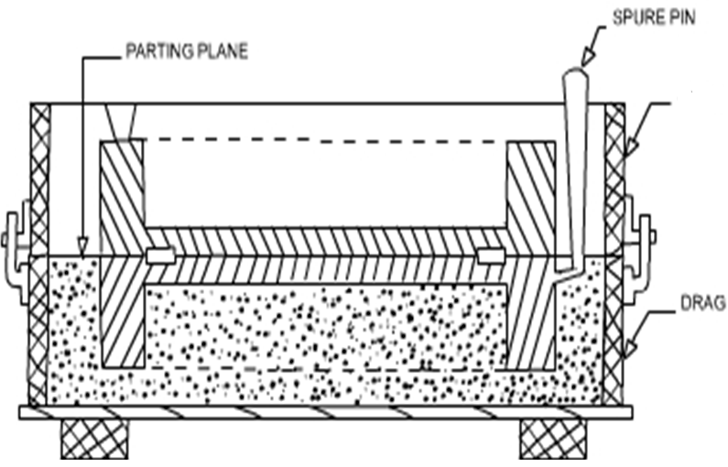
Green Sand Molding Steps
COPE
L04 WARM
Green sand mould making procedure
Lecture 4. Source slide 7. Notes PDF pp. 6, 9.
64
Notes:
Priority: WARM. Topic: Green sand mould making procedure.
Lecture 4. Source slide 7. Notes PDF pp. 6, 9.
Priority source: MP - Notes (MUJStella).pdf.
Original deck: Lecture 4 Mould making - Copy.pptx.

Slide 65
Green Sand Molding Steps
The sprue and riser pins are removed first and a pouring basin is scooped out at the top to pour the liquid metal.
Then pattern from the cope and drag is removed and facing sand in the form of paste is applied, if required all over the mold cavity and runners which would give the finished casting a good surface finish.
The mold is now assembled. The mold now is ready for pouring
L04 WARM
Green sand mould making procedure
Lecture 4. Source slide 8. Notes PDF pp. 6, 9.
65
Notes:
Priority: WARM. Topic: Green sand mould making procedure.
Lecture 4. Source slide 8. Notes PDF pp. 6, 9.
Priority source: MP - Notes (MUJStella).pdf.
Original deck: Lecture 4 Mould making - Copy.pptx.

Slide 66
Core
A core is a specialized insert, typically made of sand, that creates hollow spaces or intricate internal features within a cast part.
Cores are used to form internal cavities, recesses, undercuts, and other features in castings that the mold itself cannot create.
Cores are crucial for producing a wide variety of cast components, from engine blocks with internal cooling passages to more complex shapes with internal features.
L04 WARM
Core purpose and core making
Lecture 4. Source slide 9. Notes PDF pp. 2, 9.
66
Notes:
Priority: WARM. Topic: Core purpose and core making.
Lecture 4. Source slide 9. Notes PDF pp. 2, 9.
Priority source: MP - Notes (MUJStella).pdf.
Original deck: Lecture 4 Mould making - Copy.pptx.

Slide 67
Core making steps
Selection of Sand: Properties of core sand are highly crucial and are required to have characteristics like permeability, green strength, refractoriness, flowability, collapsibility, adhesiveness, cohesiveness, and dry strength.
Mixing of sand with additives: After thorough mixing of sand, binder is added to the silica sand with moisture content and other additives like coal dust, dextrin, or silica flour to create a mixture.
Blowing or Shooting: Mixture is blown into the core box, This process is also referred to as core shooting process and modern foundries use dedicated core blowing/shooting machines for optimal production.
L04 WARM
Core purpose and core making
Lecture 4. Source slide 10. Notes PDF pp. 2, 9.
67
Notes:
Priority: WARM. Topic: Core purpose and core making.
Lecture 4. Source slide 10. Notes PDF pp. 2, 9.
Priority source: MP - Notes (MUJStella).pdf.
Original deck: Lecture 4 Mould making - Copy.pptx.

Slide 68
Core making steps
Venting: It is essential to provide a venting passage gases as if remain entrapped inside the mold, these gases can result in casting defects. Therefore, to obtain good permeability additional venting holes are made in the cores.
Reinforcement of Cores: Some cores, heavy & large cores in particular, might need additional reinforcement material like cast iron grids or low-carbon steel wires to maintain coherence.
Baking of Cores: To obtain strength baking of sand cores is done in conventional oven at temperature between 200° C to 250° C (392° F and 482° F), the heat causes the binder to polymerize.
L04 WARM
Core purpose and core making
Lecture 4. Source slide 11. Notes PDF pp. 2, 9.
68
Notes:
Priority: WARM. Topic: Core purpose and core making.
Lecture 4. Source slide 11. Notes PDF pp. 2, 9.
Priority source: MP - Notes (MUJStella).pdf.
Original deck: Lecture 4 Mould making - Copy.pptx.

Slide 69
Core making steps
Cleaning & Finishing: After baking, following methods are used to clean cores -
Trimming of cores involve removing loose pieces and other unwanted projections
Brushing is used to remove loose sand off the core with fine wire brush
Coating is crucial step for finishing and involves coating of cores with refractory material to improve heat resistance.
Inspection: This step includes either manual or machine inspection of the cores for dimensional accuracy.
Assembling: This includes assembling of multiple cores together with core glue and placement of core in mould as in figure provided in next slide.
L04 WARM
Core purpose and core making
Lecture 4. Source slide 12. Notes PDF pp. 2, 9.
69
Notes:
Priority: WARM. Topic: Core purpose and core making.
Lecture 4. Source slide 12. Notes PDF pp. 2, 9.
Priority source: MP - Notes (MUJStella).pdf.
Original deck: Lecture 4 Mould making - Copy.pptx.

Slide 70
Assembled Core
FIRST OPERATION
Vents
Weight
Lifter
Riser pin
Sprue pin
Pouring basin
Cope
Riser
Parting
line
Parting
line
Runner
Gate
Core
Mold without core
Mold with core
70
L04 WARM
Core purpose and core making
Lecture 4. Source slide 13. Notes PDF pp. 2, 9.
70
Notes:
Priority: WARM. Topic: Core purpose and core making.
Lecture 4. Source slide 13. Notes PDF pp. 2, 9.
Priority source: MP - Notes (MUJStella).pdf.
Original deck: Lecture 4 Mould making - Copy.pptx.

Slide 71

71
L04 SUPPORTING
Additional lecture material and closing slides
Lecture 4. Source slide 14. No explicit rating in the notes.
71
Notes:
Priority: SUPPORTING. Topic: Additional lecture material and closing slides.
Lecture 4. Source slide 14. No explicit rating in the notes.
Priority source: MP - Notes (MUJStella).pdf.
Original deck: Lecture 4 Mould making - Copy.pptx.

Slide 72
Lecture 5
Gating System
L05 LECTURE
Gating system
Lecture 5. Source slide 1. Lecture title.
72
Notes:
Priority: INTRO. Topic: Gating system.
Lecture 5. Source slide 1. Lecture title.
Priority source: MP - Notes (MUJStella).pdf.
Original deck: Lecture 5 Gating System - Copy.pptx.

Slide 73
Lecture 5
Gating system
HOT
Gating components, requirements and aspiration (PDF pp. 2, 9)
WARM
No separately rated slide block in this lecture.
POSSIBLE
Riser purpose and gate versus riser (PDF pp. 9)
SUPPORTING
Other source material, references and closing slides
Manufacturing Processes / MP - Notes (MUJStella)
Notes:
Source lecture: C:\Users\agam7\Documents\Obsidian\MUJ\MP (3)\Lectures\Lecture 5 Gating System - Copy.pptx
Priority source: MP - Notes (MUJStella).pdf.
HOT: Gating components, requirements and aspiration. Source slides 2, 6, 7, 8, 9, 14. PDF pages 2, 9.
POSSIBLE: Riser purpose and gate versus riser. Source slides 15. PDF pages 9.
SUPPORTING: Additional lecture material and closing slides. Source slides 3, 4, 5, 10, 11, 12, 13, 16. PDF pages not explicitly rated.

Slide 74
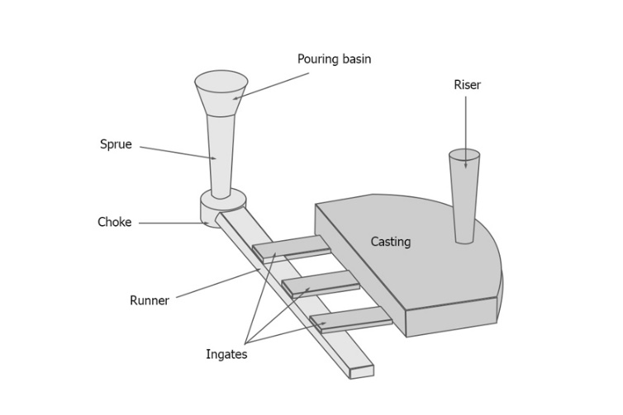
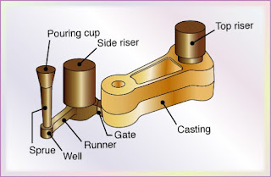
Gating System parts
L05 HOT
Gating components, requirements and aspiration
Lecture 5. Source slide 2. Notes PDF pp. 2, 9.
74
Notes:
Priority: HOT. Topic: Gating components, requirements and aspiration.
Lecture 5. Source slide 2. Notes PDF pp. 2, 9.
Priority source: MP - Notes (MUJStella).pdf.
Original deck: Lecture 5 Gating System - Copy.pptx.

Slide 75
Gating System
A gate is a specific part of the gating system, acting as the entry point for molten metal into the mold cavity.
It's designed to control the flow rate and direction of the molten metal as it enters the mold.
Gates can be designed in various shapes and sizes, depending on the casting process, material, and desired part characteristics.
The gate's design and placement are crucial for achieving a sound and defect-free casting.
L05 HOT
Gating components, requirements and aspiration
Lecture 5. Source slide 6. Notes PDF pp. 2, 9.
75
Notes:
Priority: HOT. Topic: Gating components, requirements and aspiration.
Lecture 5. Source slide 6. Notes PDF pp. 2, 9.
Priority source: MP - Notes (MUJStella).pdf.
Original deck: Lecture 5 Gating System - Copy.pptx.

Slide 76
Requirements of Gating System
A good gating design should ensure proper distribution of molten metal without excessive temperature loss, turbulence, gas entrapping and slags.
Slow pouring will increase filling time that leads to premature solidification. Hence, super heating of metal is required, but this may cause solubility.
Faster pouring of molten metal cause erosion of the mould cavity.
Therefore, gating design is important and it depends on the metal and molten metal composition. For example, aluminium can get oxidized easily.
L05 HOT
Gating components, requirements and aspiration
Lecture 5. Source slide 7. Notes PDF pp. 2, 9.
76
Notes:
Priority: HOT. Topic: Gating components, requirements and aspiration.
Lecture 5. Source slide 7. Notes PDF pp. 2, 9.
Priority source: MP - Notes (MUJStella).pdf.
Original deck: Lecture 5 Gating System - Copy.pptx.

Slide 77
Functions of gating system
• Controlling flow: Gates regulate the rate at which molten metal enters the mold cavity, preventing turbulence and ensuring a smooth, consistent flow.
• Minimizing defects: By controlling the flow, gates help prevent issues like air entrapment, shrinkage, and porosity, which can lead to defects in the final casting.
• Directing metal flow: Gates can be strategically placed to guide the molten metal to specific areas of the mold, ensuring proper filling of complex shapes.
• Shrinkage control: In some cases, gates are designed to act as risers, providing a reservoir of molten metal to compensate for shrinkage during solidification.
L05 HOT
Gating components, requirements and aspiration
Lecture 5. Source slide 8. Notes PDF pp. 2, 9.
77
Notes:
Priority: HOT. Topic: Gating components, requirements and aspiration.
Lecture 5. Source slide 8. Notes PDF pp. 2, 9.
Priority source: MP - Notes (MUJStella).pdf.
Original deck: Lecture 5 Gating System - Copy.pptx.

Slide 78
Aspiration effect
Aspiration effect: entering of gases from baking of organic compounds present in the mould into the molten metal stream. This will produce porous castings. Pressure anywhere in the liquid stream should not become negative.
L05 HOT
Gating components, requirements and aspiration
Lecture 5. Source slide 9. Notes PDF pp. 2, 9.
78
Notes:
Priority: HOT. Topic: Gating components, requirements and aspiration.
Lecture 5. Source slide 9. Notes PDF pp. 2, 9.
Priority source: MP - Notes (MUJStella).pdf.
Original deck: Lecture 5 Gating System - Copy.pptx.

Slide 79
Gating System parts
Pouring Basin: A funnel-shaped reservoir at the top of the mold (sprue hole) where molten metal is initially poured from crucible.
Sprue: The vertical channel that connects the pouring basin to the runner system and control the flow rate of the metal.
Sprue Well: A small reservoir at the bottom of the sprue, which regulates the flow of metal into the runner and reduces turbulence.
Runner: The horizontal channel(s) that distribute the molten metal from the sprue to the gates.
Runner Extension: An elongated part of runner, used to feed multiple gates or collection place for impurities.
In-gate (or Gate): End opening through which molten metal enters the mold cavity.
L05 HOT
Gating components, requirements and aspiration
Lecture 5. Source slide 14. Notes PDF pp. 2, 9.
79
Notes:
Priority: HOT. Topic: Gating components, requirements and aspiration.
Lecture 5. Source slide 14. Notes PDF pp. 2, 9.
Priority source: MP - Notes (MUJStella).pdf.
Original deck: Lecture 5 Gating System - Copy.pptx.

Slide 80
Riser
Riser acts as a metal reservoir which holds extra molten metal, which ensures flow of metal into the mold cavity during casting material shrinks.
Riser should be the last part of the mold to solidify, which ensures the continuous feeding of metal until the complete casting is solidified.
It provides shrinkage compensation of molten metal, without which shrinkage would create voids or porosity within the casting.
It prevents defects by preventing shrinkage cavities and maintaining the desired shape and dimensions.
L05 POSSIBLE
Riser purpose and gate versus riser
Lecture 5. Source slide 15. Notes PDF pp. 9.
80
Notes:
Priority: POSSIBLE. Topic: Riser purpose and gate versus riser.
Lecture 5. Source slide 15. Notes PDF pp. 9.
Priority source: MP - Notes (MUJStella).pdf.
Original deck: Lecture 5 Gating System - Copy.pptx.

Slide 81
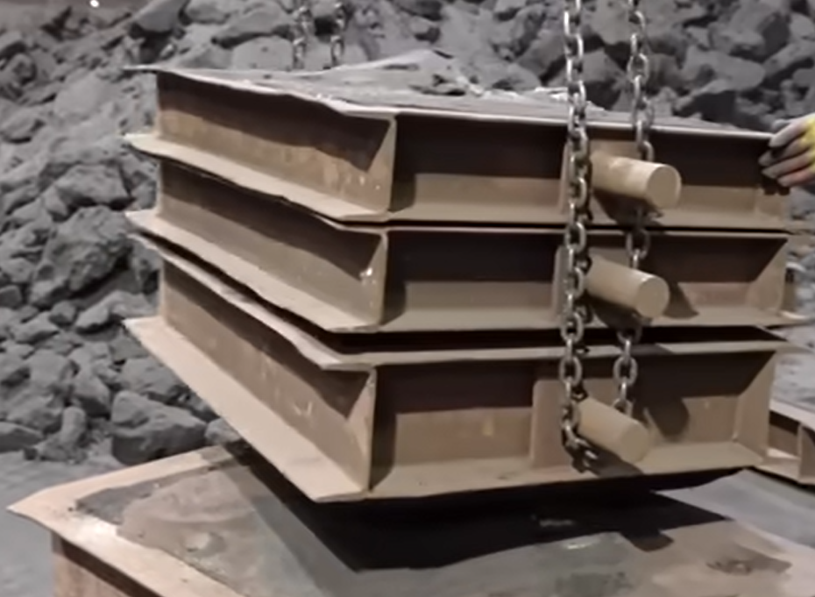
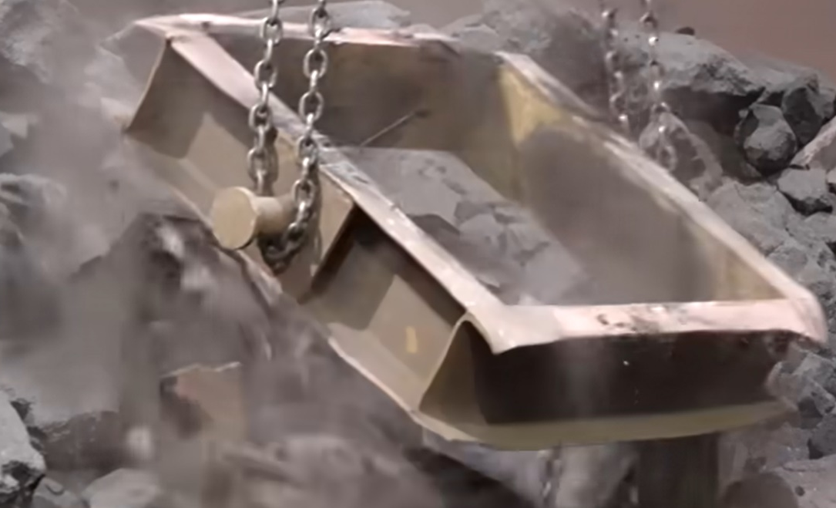
Mold Collapsing
L05 SUPPORTING
Additional lecture material and closing slides
Lecture 5. Source slide 3. No explicit rating in the notes.
81
Notes:
Priority: SUPPORTING. Topic: Additional lecture material and closing slides.
Lecture 5. Source slide 3. No explicit rating in the notes.
Priority source: MP - Notes (MUJStella).pdf.
Original deck: Lecture 5 Gating System - Copy.pptx.

Slide 82
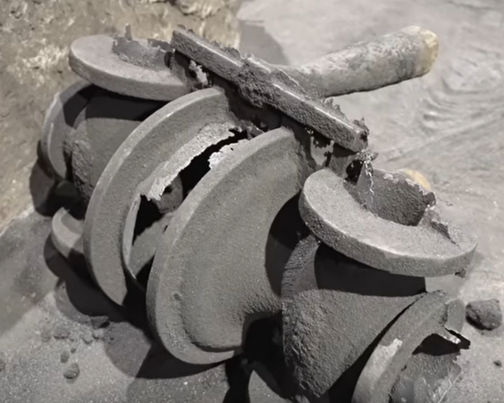
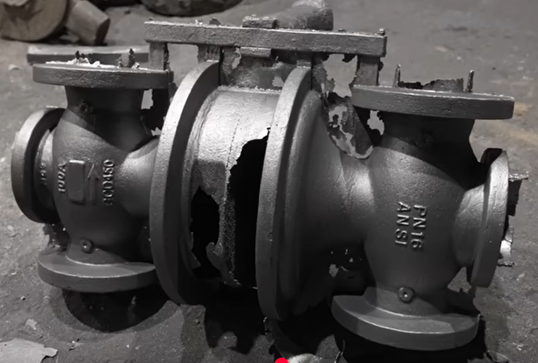
Casting obtained after mold collapsing
Cleaned casting
Raw casting
L05 SUPPORTING
Additional lecture material and closing slides
Lecture 5. Source slide 4. No explicit rating in the notes.
82
Notes:
Priority: SUPPORTING. Topic: Additional lecture material and closing slides.
Lecture 5. Source slide 4. No explicit rating in the notes.
Priority source: MP - Notes (MUJStella).pdf.
Original deck: Lecture 5 Gating System - Copy.pptx.

Slide 83
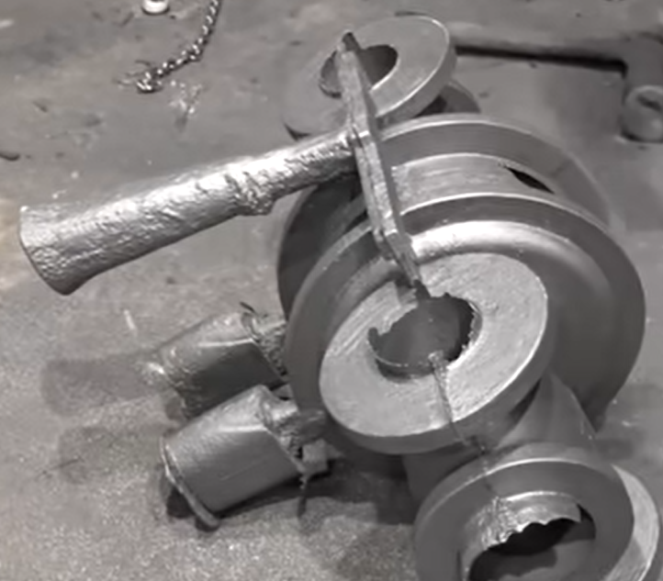
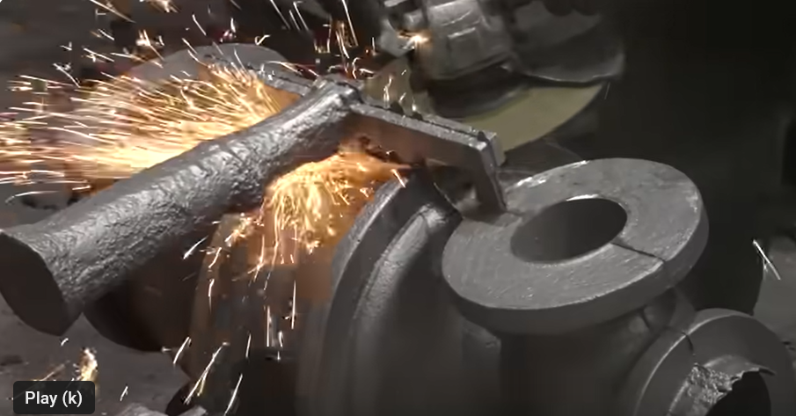
Green Sand Molding Steps
Removal of gates and riser from Casting
Casting with gates and riser
L05 SUPPORTING
Additional lecture material and closing slides
Lecture 5. Source slide 5. No explicit rating in the notes.
83
Notes:
Priority: SUPPORTING. Topic: Additional lecture material and closing slides.
Lecture 5. Source slide 5. No explicit rating in the notes.
Priority source: MP - Notes (MUJStella).pdf.
Original deck: Lecture 5 Gating System - Copy.pptx.

Slide 84
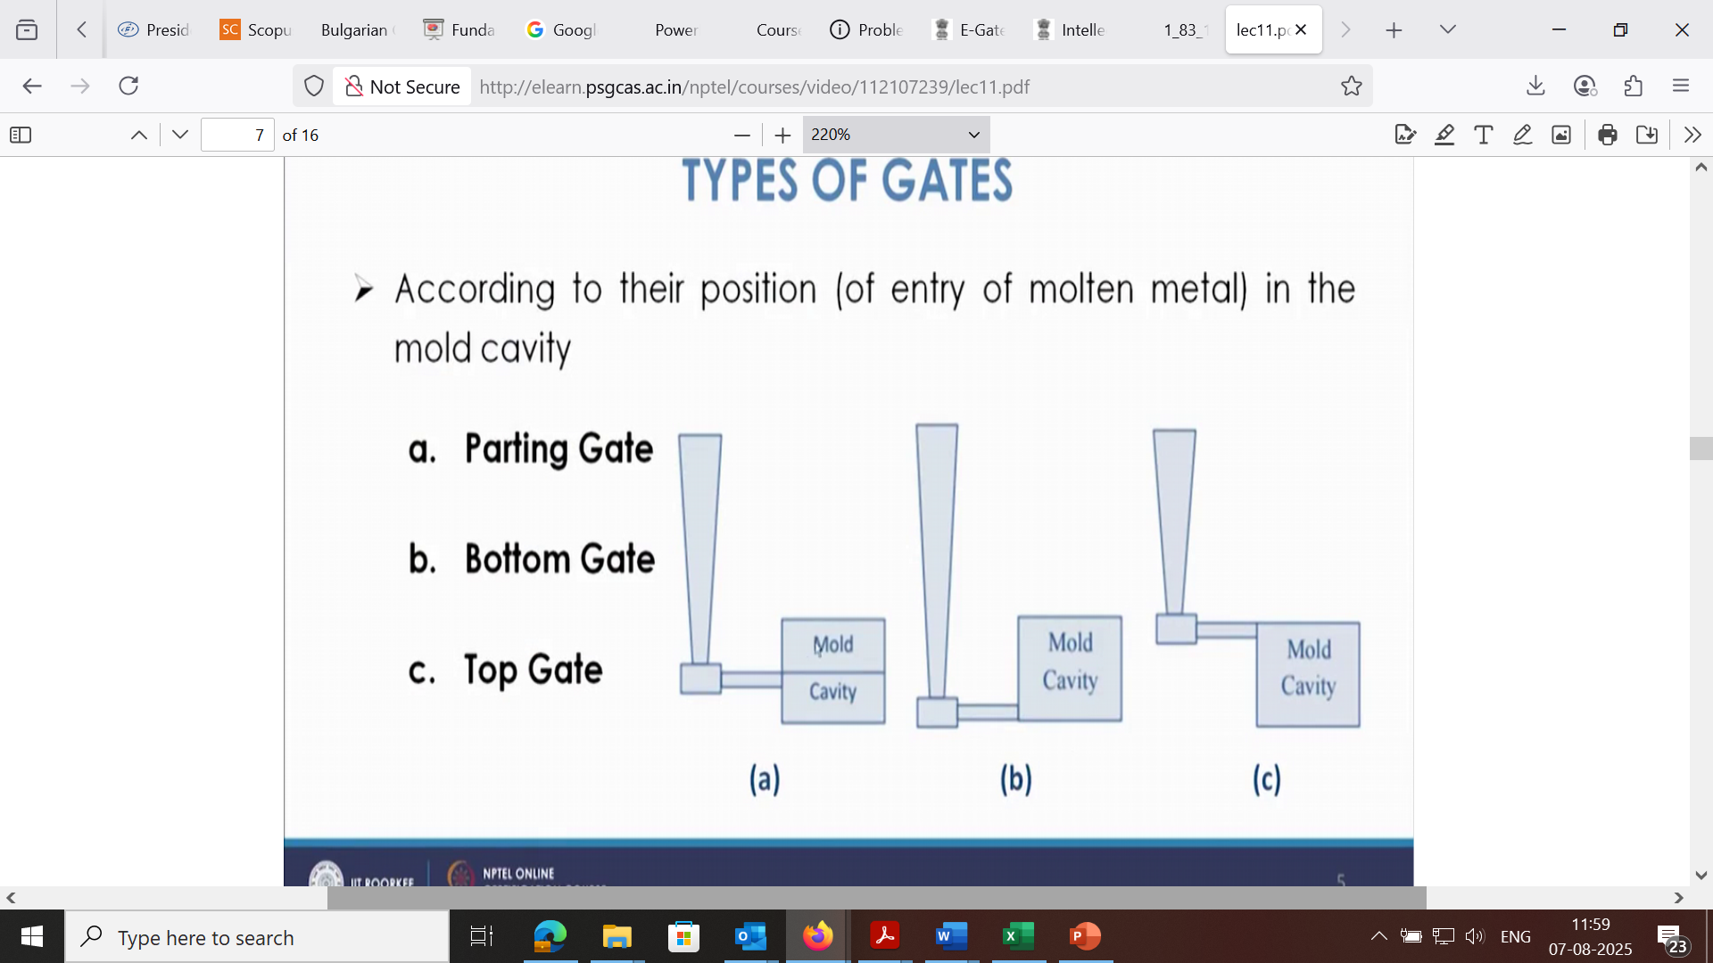
Types of gate
Top Gate:
Molten metal enters the mold cavity from the top. This method is simple but can cause turbulence and erosion.
L05 SUPPORTING
Additional lecture material and closing slides
Lecture 5. Source slide 10. No explicit rating in the notes.
84
Notes:
Priority: SUPPORTING. Topic: Additional lecture material and closing slides.
Lecture 5. Source slide 10. No explicit rating in the notes.
Priority source: MP - Notes (MUJStella).pdf.
Original deck: Lecture 5 Gating System - Copy.pptx.

Slide 85
Types of gates
Bottom Gate:
Molten metal enters the mold cavity from the bottom. This can lead to temperature variations within the casting, with the bottom being hotter and the top cooler.
L05 SUPPORTING
Additional lecture material and closing slides
Lecture 5. Source slide 11. No explicit rating in the notes.
85
Notes:
Priority: SUPPORTING. Topic: Additional lecture material and closing slides.
Lecture 5. Source slide 11. No explicit rating in the notes.
Priority source: MP - Notes (MUJStella).pdf.
Original deck: Lecture 5 Gating System - Copy.pptx.

Slide 86
Types of gate
Parting Line Gate:
Molten metal enters the mold cavity at the parting line, where the two halves of the mold meet. It's a simple and cost-effective method, but can be prone to erosion and dross formation
L05 SUPPORTING
Additional lecture material and closing slides
Lecture 5. Source slide 12. No explicit rating in the notes.
86
Notes:
Priority: SUPPORTING. Topic: Additional lecture material and closing slides.
Lecture 5. Source slide 12. No explicit rating in the notes.
Priority source: MP - Notes (MUJStella).pdf.
Original deck: Lecture 5 Gating System - Copy.pptx.

Slide 87
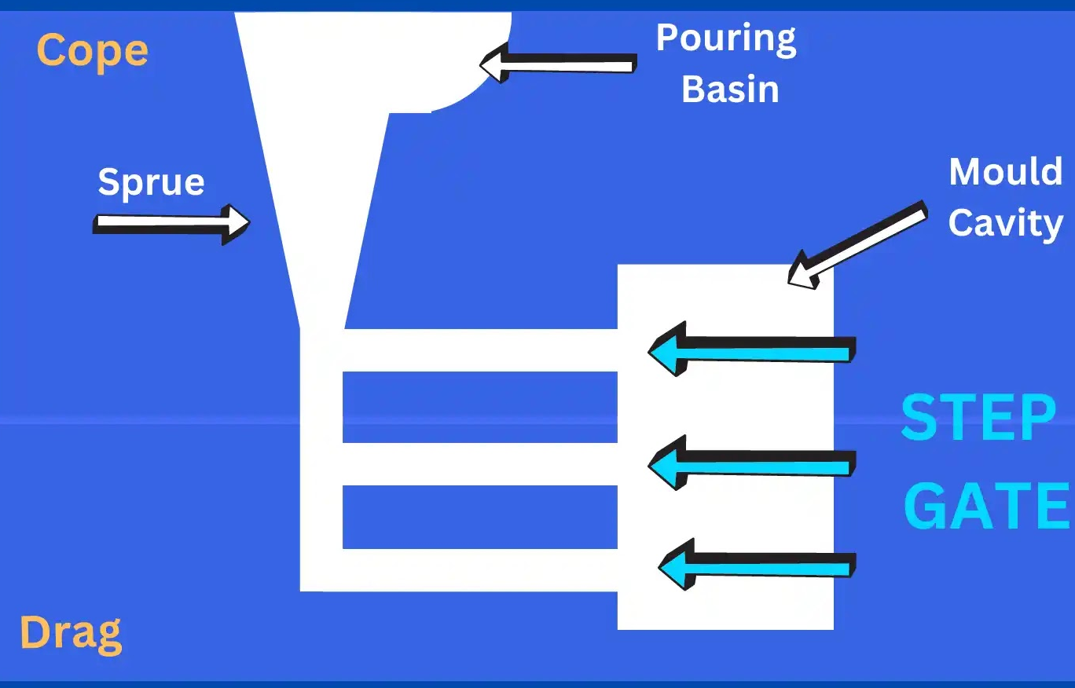
Types of gate
Step Gate:
A step gate is used in the sand casting process for producing heavy casting of large size.
A step gate is used when the molten metal requirement is large and metal needs to fill the mould cavity in steps using the gate.
L05 SUPPORTING
Additional lecture material and closing slides
Lecture 5. Source slide 13. No explicit rating in the notes.
87
Notes:
Priority: SUPPORTING. Topic: Additional lecture material and closing slides.
Lecture 5. Source slide 13. No explicit rating in the notes.
Priority source: MP - Notes (MUJStella).pdf.
Original deck: Lecture 5 Gating System - Copy.pptx.

Slide 88
88
L05 SUPPORTING
Additional lecture material and closing slides
Lecture 5. Source slide 16. No explicit rating in the notes.
88
Notes:
Priority: SUPPORTING. Topic: Additional lecture material and closing slides.
Lecture 5. Source slide 16. No explicit rating in the notes.
Priority source: MP - Notes (MUJStella).pdf.
Original deck: Lecture 5 Gating System - Copy.pptx.

Slide 89
Casting Methods: Die Casting
Centrifugal Casting
Lecture 6
89
L06 LECTURE
Die and centrifugal casting
Lecture 6. Source slide 1. Lecture title.
89
Notes:
Priority: INTRO. Topic: Die and centrifugal casting.
Lecture 6. Source slide 1. Lecture title.
Priority source: MP - Notes (MUJStella).pdf.
Original deck: Lecture 6 Die Centrifugal casting - Copy.pptx.
Die casting comparison: WARM on PDF p. 2, HOT on p. 11. Metal choice is a POSSIBLE subquestion.

Slide 90
Lecture 6
Die and centrifugal casting
HOT
Hot- versus cold-chamber die casting; Centrifugal casting: process and advantages (PDF pp. 2, 11)
WARM
No separately rated slide block in this lecture.
POSSIBLE
No separately rated slide block in this lecture.
SUPPORTING
Other source material, references and closing slides
Die casting comparison: WARM on PDF p. 2, HOT on p. 11. Metal choice is a POSSIBLE subquestion.
Manufacturing Processes / MP - Notes (MUJStella)
Notes:
Source lecture: C:\Users\agam7\Documents\Obsidian\MUJ\MP (3)\Lectures\Lecture 6 Die Centrifugal casting - Copy.pptx
Priority source: MP - Notes (MUJStella).pdf.
HOT: Hot- versus cold-chamber die casting. Source slides 2, 3, 4, 5, 6, 8. PDF pages 11.
HOT: Centrifugal casting: process and advantages. Source slides 11, 12, 13, 14, 15. PDF pages 2, 11.
SUPPORTING: Additional lecture material and closing slides. Source slides 7, 9, 10, 16. PDF pages not explicitly rated.
Die casting comparison: WARM on PDF p. 2, HOT on p. 11. Metal choice is a POSSIBLE subquestion.

Slide 91
Hot Chamber die casting
Good for low temperature (approx. 650°C)
Faster than cold chamber machines
Cycle times must be short to minimize metal contamination
Metal starts in a heated cylinder
A piston forces metal into the die
The piston retracts, and draws metal in
Metal: Lead, Tin, Zinc
91
L06 HOT
Hot- versus cold-chamber die casting
Lecture 6. Source slide 2. Notes PDF pp. 11. POSSIBLE: metal selection.
91
Notes:
Priority: HOT. Topic: Hot- versus cold-chamber die casting.
Lecture 6. Source slide 2. Notes PDF pp. 11. POSSIBLE: metal selection.
Priority source: MP - Notes (MUJStella).pdf.
Original deck: Lecture 6 Die Centrifugal casting - Copy.pptx.
Die casting comparison: WARM on PDF p. 2, HOT on p. 11. Metal choice is a POSSIBLE subquestion.

Slide 92
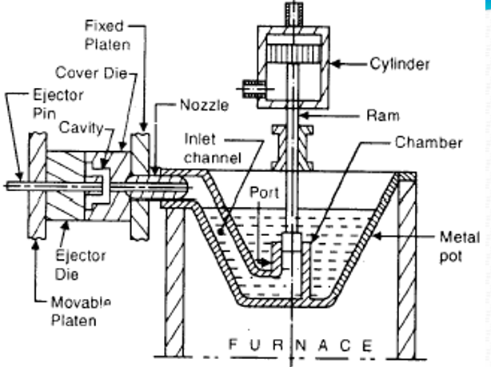
Hot Chamber die casting
92
L06 HOT
Hot- versus cold-chamber die casting
Lecture 6. Source slide 3. Notes PDF pp. 11.
92
Notes:
Priority: HOT. Topic: Hot- versus cold-chamber die casting.
Lecture 6. Source slide 3. Notes PDF pp. 11.
Priority source: MP - Notes (MUJStella).pdf.
Original deck: Lecture 6 Die Centrifugal casting - Copy.pptx.
Die casting comparison: WARM on PDF p. 2, HOT on p. 11. Metal choice is a POSSIBLE subquestion.

Slide 93
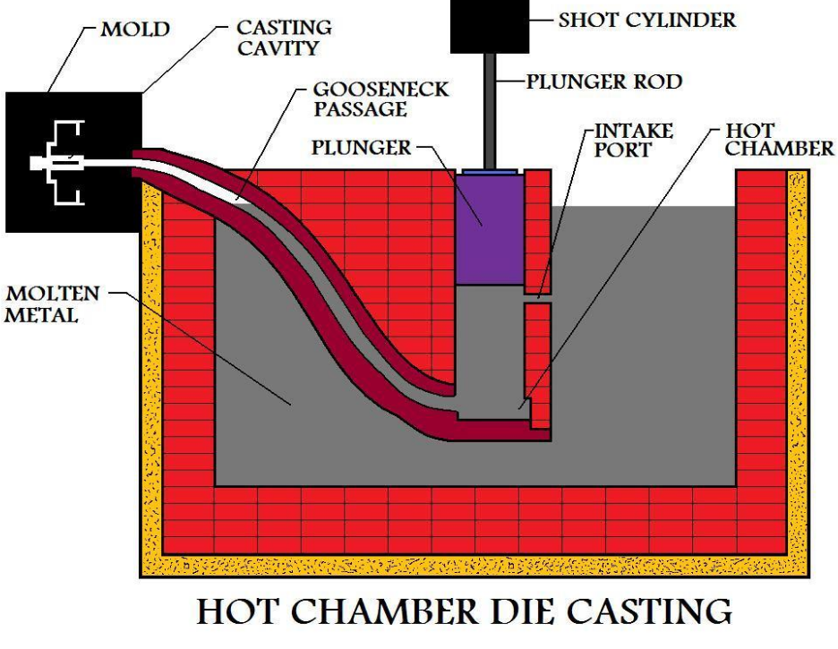
Hot Chamber die casting
93
L06 HOT
Hot- versus cold-chamber die casting
Lecture 6. Source slide 4. Notes PDF pp. 11.
93
Notes:
Priority: HOT. Topic: Hot- versus cold-chamber die casting.
Lecture 6. Source slide 4. Notes PDF pp. 11.
Priority source: MP - Notes (MUJStella).pdf.
Original deck: Lecture 6 Die Centrifugal casting - Copy.pptx.
Die casting comparison: WARM on PDF p. 2, HOT on p. 11. Metal choice is a POSSIBLE subquestion.

Slide 94
Cold Chamber die casting
Casts high melting point metals ( > 700°C)
High pressures used
Metal is heated in a separate crucible
Metal is ladled into a cold chamber
The metal is rapidly forced into the mold before it cools
Copper, Brass and Aluminum can cast.
94
L06 HOT
Hot- versus cold-chamber die casting
Lecture 6. Source slide 5. Notes PDF pp. 11.
94
Notes:
Priority: HOT. Topic: Hot- versus cold-chamber die casting.
Lecture 6. Source slide 5. Notes PDF pp. 11.
Priority source: MP - Notes (MUJStella).pdf.
Original deck: Lecture 6 Die Centrifugal casting - Copy.pptx.
Die casting comparison: WARM on PDF p. 2, HOT on p. 11. Metal choice is a POSSIBLE subquestion.

Slide 95
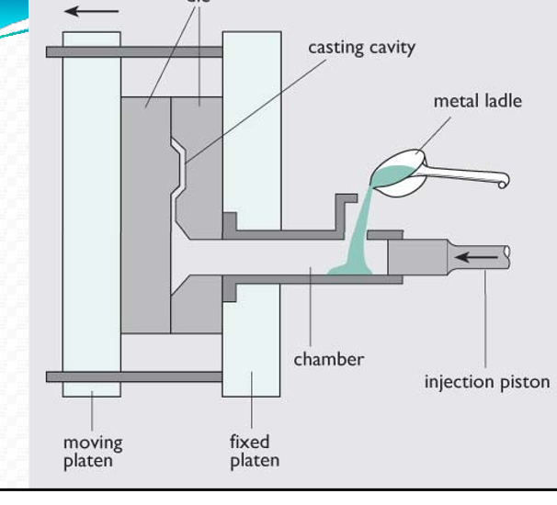
Cold Chamber die casting
95
L06 HOT
Hot- versus cold-chamber die casting
Lecture 6. Source slide 6. Notes PDF pp. 11.
95
Notes:
Priority: HOT. Topic: Hot- versus cold-chamber die casting.
Lecture 6. Source slide 6. Notes PDF pp. 11.
Priority source: MP - Notes (MUJStella).pdf.
Original deck: Lecture 6 Die Centrifugal casting - Copy.pptx.
Die casting comparison: WARM on PDF p. 2, HOT on p. 11. Metal choice is a POSSIBLE subquestion.

Slide 96

Summary Table for Hot and Cold Chamber die casting
L06 HOT
Hot- versus cold-chamber die casting
Lecture 6. Source slide 8. Notes PDF pp. 11.
96
Notes:
Priority: HOT. Topic: Hot- versus cold-chamber die casting.
Lecture 6. Source slide 8. Notes PDF pp. 11.
Priority source: MP - Notes (MUJStella).pdf.
Original deck: Lecture 6 Die Centrifugal casting - Copy.pptx.
Die casting comparison: WARM on PDF p. 2, HOT on p. 11. Metal choice is a POSSIBLE subquestion.

Slide 97
Centrifugal casting
Centrifugal casting is a metal casting process that utilizes centrifugal force to distribute molten metal into a rotating mold, producing cylindrical or symmetrical parts. This method is particularly effective for creating pipes, tubes, and other components with rotational symmetry, leveraging the force of rotation to ensure uniform metal distribution and potentially reduced defects.
97
L06 HOT
Centrifugal casting: process and advantages
Lecture 6. Source slide 11. Notes PDF pp. 2, 11.
97
Notes:
Priority: HOT. Topic: Centrifugal casting: process and advantages.
Lecture 6. Source slide 11. Notes PDF pp. 2, 11.
Priority source: MP - Notes (MUJStella).pdf.
Original deck: Lecture 6 Die Centrifugal casting - Copy.pptx.
Die casting comparison: WARM on PDF p. 2, HOT on p. 11. Metal choice is a POSSIBLE subquestion.

Slide 98

Centrifugal casting
98
L06 HOT
Centrifugal casting: process and advantages
Lecture 6. Source slide 12. Notes PDF pp. 2, 11.
98
Notes:
Priority: HOT. Topic: Centrifugal casting: process and advantages.
Lecture 6. Source slide 12. Notes PDF pp. 2, 11.
Priority source: MP - Notes (MUJStella).pdf.
Original deck: Lecture 6 Die Centrifugal casting - Copy.pptx.
Die casting comparison: WARM on PDF p. 2, HOT on p. 11. Metal choice is a POSSIBLE subquestion.

Slide 99
Centrifugal casting
Process:
Molten metal is introduced into a rotating metal die,
metal, or graphite mould, and held against the mould wall by centrifugal force until it is solidified
A mold is set up and rotated along a vertical (rpm is reasonable), or horizontal (200‐1000 rpm is reasonable) axis.
The mold is coated with a refractory coating.
During cooling lower density impurities will tend to rise towards the center of rotation.
99
L06 HOT
Centrifugal casting: process and advantages
Lecture 6. Source slide 13. Notes PDF pp. 2, 11.
99
Notes:
Priority: HOT. Topic: Centrifugal casting: process and advantages.
Lecture 6. Source slide 13. Notes PDF pp. 2, 11.
Priority source: MP - Notes (MUJStella).pdf.
Original deck: Lecture 6 Die Centrifugal casting - Copy.pptx.
Die casting comparison: WARM on PDF p. 2, HOT on p. 11. Metal choice is a POSSIBLE subquestion.

Slide 100

Centrifugal casting
100
L06 HOT
Centrifugal casting: process and advantages
Lecture 6. Source slide 14. Notes PDF pp. 2, 11.
100
Notes:
Priority: HOT. Topic: Centrifugal casting: process and advantages.
Lecture 6. Source slide 14. Notes PDF pp. 2, 11.
Priority source: MP - Notes (MUJStella).pdf.
Original deck: Lecture 6 Die Centrifugal casting - Copy.pptx.
Die casting comparison: WARM on PDF p. 2, HOT on p. 11. Metal choice is a POSSIBLE subquestion.

Slide 101

Centrifugal casting
101
L06 HOT
Centrifugal casting: process and advantages
Lecture 6. Source slide 15. Notes PDF pp. 2, 11.
101
Notes:
Priority: HOT. Topic: Centrifugal casting: process and advantages.
Lecture 6. Source slide 15. Notes PDF pp. 2, 11.
Priority source: MP - Notes (MUJStella).pdf.
Original deck: Lecture 6 Die Centrifugal casting - Copy.pptx.
Die casting comparison: WARM on PDF p. 2, HOT on p. 11. Metal choice is a POSSIBLE subquestion.

Slide 102
Cold Chamber die casting
Extremely smooth surfaces (1 µm)
Excellent dimensional accuracy
Rapid production rate
Better mechanical properties compared to sand casting
Intricate parts possible
L06 SUPPORTING
Additional lecture material and closing slides
Lecture 6. Source slide 7. No explicit rating in the notes.
102
Notes:
Priority: SUPPORTING. Topic: Additional lecture material and closing slides.
Lecture 6. Source slide 7. No explicit rating in the notes.
Priority source: MP - Notes (MUJStella).pdf.
Original deck: Lecture 6 Die Centrifugal casting - Copy.pptx.
Die casting comparison: WARM on PDF p. 2, HOT on p. 11. Metal choice is a POSSIBLE subquestion.

Slide 103
Die casting
High initial die cost
Limited to high‐fluidity nonferrous metals
Part size is limited
Porosity may be a problem
Some scrap in sprues, runners, and flash, but this can be directly recycled
103
L06 SUPPORTING
Additional lecture material and closing slides
Lecture 6. Source slide 9. No explicit rating in the notes.
103
Notes:
Priority: SUPPORTING. Topic: Additional lecture material and closing slides.
Lecture 6. Source slide 9. No explicit rating in the notes.
Priority source: MP - Notes (MUJStella).pdf.
Original deck: Lecture 6 Die Centrifugal casting - Copy.pptx.
Die casting comparison: WARM on PDF p. 2, HOT on p. 11. Metal choice is a POSSIBLE subquestion.

Slide 104
Die casting
Applications
Carburetors
Automotive parts
Bathroom fixtures
Toys
Common metals
Alloys of aluminum, zinc, magnesium, and lead Also possible with alloys of copper and tin.
104
L06 SUPPORTING
Additional lecture material and closing slides
Lecture 6. Source slide 10. No explicit rating in the notes.
104
Notes:
Priority: SUPPORTING. Topic: Additional lecture material and closing slides.
Lecture 6. Source slide 10. No explicit rating in the notes.
Priority source: MP - Notes (MUJStella).pdf.
Original deck: Lecture 6 Die Centrifugal casting - Copy.pptx.
Die casting comparison: WARM on PDF p. 2, HOT on p. 11. Metal choice is a POSSIBLE subquestion.

Slide 105
105
L06 SUPPORTING
Additional lecture material and closing slides
Lecture 6. Source slide 16. No explicit rating in the notes.
105
Notes:
Priority: SUPPORTING. Topic: Additional lecture material and closing slides.
Lecture 6. Source slide 16. No explicit rating in the notes.
Priority source: MP - Notes (MUJStella).pdf.
Original deck: Lecture 6 Die Centrifugal casting - Copy.pptx.
Die casting comparison: WARM on PDF p. 2, HOT on p. 11. Metal choice is a POSSIBLE subquestion.

Slide 106
Casting Methods: Investment Casting
Lecture 7
106
L07 LECTURE
Investment casting
Lecture 7. Source slide 1. Lecture title.
106
Notes:
Priority: INTRO. Topic: Investment casting.
Lecture 7. Source slide 1. Lecture title.
Priority source: MP - Notes (MUJStella).pdf.
Original deck: Lecture 7 Investment casting - Copy.pptx.
Ceramic shell preheating is a POSSIBLE subquestion within the WARM process sequence (PDF p. 11).

Slide 107
Lecture 7
Investment casting
HOT
No separately rated slide block in this lecture.
WARM
Investment casting process, shapes and materials (PDF pp. 2, 11)
POSSIBLE
No separately rated slide block in this lecture.
SUPPORTING
Other source material, references and closing slides
Ceramic shell preheating is a POSSIBLE subquestion within the WARM process sequence (PDF p. 11).
Manufacturing Processes / MP - Notes (MUJStella)
Notes:
Source lecture: C:\Users\agam7\Documents\Obsidian\MUJ\MP (3)\Lectures\Lecture 7 Investment casting - Copy.pptx
Priority source: MP - Notes (MUJStella).pdf.
WARM: Investment casting process, shapes and materials. Source slides 2, 3, 4, 5, 6, 7, 8. PDF pages 2, 11.
SUPPORTING: Additional lecture material and closing slides. Source slides 9. PDF pages not explicitly rated.
Ceramic shell preheating is a POSSIBLE subquestion within the WARM process sequence (PDF p. 11).

Slide 108

Investment casting
108
L07 WARM
Investment casting process, shapes and materials
Lecture 7. Source slide 2. Notes PDF pp. 2, 11.
108
Notes:
Priority: WARM. Topic: Investment casting process, shapes and materials.
Lecture 7. Source slide 2. Notes PDF pp. 2, 11.
Priority source: MP - Notes (MUJStella).pdf.
Original deck: Lecture 7 Investment casting - Copy.pptx.
Ceramic shell preheating is a POSSIBLE subquestion within the WARM process sequence (PDF p. 11).

Slide 109
Investment casting
Investment casting requires the use of a metal die, wax, ceramic slurry, furnace, molten metal, and any machines needed for sandblasting, cutting, or grinding.
Investment casting, also known as lost-wax casting, is a versatile manufacturing process used across numerous industries to create intricate, high-precision parts. It is particularly well-suited for applications requiring complex geometries, tight tolerances, and smooth surface finishes.
109
L07 WARM
Investment casting process, shapes and materials
Lecture 7. Source slide 3. Notes PDF pp. 2, 11.
109
Notes:
Priority: WARM. Topic: Investment casting process, shapes and materials.
Lecture 7. Source slide 3. Notes PDF pp. 2, 11.
Priority source: MP - Notes (MUJStella).pdf.
Original deck: Lecture 7 Investment casting - Copy.pptx.
Ceramic shell preheating is a POSSIBLE subquestion within the WARM process sequence (PDF p. 11).

Slide 110
Investment casting: Process
The process steps include the following:
Pattern creation: The wax patterns are typically injection molded into a metal die and are formed as one piece and some time special designs made. Cores may be used to form any internal features on the pattern.
Mold creation: This "pattern tree" is dipped into a slurry of fine ceramic
particles, coated with more coarse particles, and then dried to form a ceramic shell around the patterns and gating system. This process is repeated until the shell is thick enough to withstand the pressure of molten metal it will encounter.
110
L07 WARM
Investment casting process, shapes and materials
Lecture 7. Source slide 4. Notes PDF pp. 2, 11.
110
Notes:
Priority: WARM. Topic: Investment casting process, shapes and materials.
Lecture 7. Source slide 4. Notes PDF pp. 2, 11.
Priority source: MP - Notes (MUJStella).pdf.
Original deck: Lecture 7 Investment casting - Copy.pptx.
Ceramic shell preheating is a POSSIBLE subquestion within the WARM process sequence (PDF p. 11).

Slide 111
Investment casting: Process
Lost wax: The shell is then placed into an oven and the wax is melted out leaving a hollow ceramic shell that acts as a one-piece mold, hence the name "lost wax" casting.
Pouring: The mold is preheated in a furnace to approximately 1000°C (1832°F) and the molten metal is poured from a ladle into the gating system of the mold, filling the mold cavity..
Cooling: After the mold has been filled, the molten metal is allowed to cool and solidify into the shape of the final casting. Cooling time depends on the thickness of the part, thickness of the mold, and the material used.
111
L07 WARM
Investment casting process, shapes and materials
Lecture 7. Source slide 5. Notes PDF pp. 2, 11. POSSIBLE: shell preheating.
111
Notes:
Priority: WARM. Topic: Investment casting process, shapes and materials.
Lecture 7. Source slide 5. Notes PDF pp. 2, 11. POSSIBLE: shell preheating.
Priority source: MP - Notes (MUJStella).pdf.
Original deck: Lecture 7 Investment casting - Copy.pptx.
Ceramic shell preheating is a POSSIBLE subquestion within the WARM process sequence (PDF p. 11).

Slide 112
Investment casting: Process
Casting removal: After the molten metal has cooled, the mold can be broken and the casting removed. The ceramic mold is typically broken using water jets, but several other methods also used. Once removed, the parts are separated from the gating system by either sawing, grinding or cold breaking (using liquid nitrogen).
Finishing: Often times, finishing operations such as grinding or sandblasting are used to smooth the part at the gates. Heat treatment is also sometimes used to harden the final part.
112
L07 WARM
Investment casting process, shapes and materials
Lecture 7. Source slide 6. Notes PDF pp. 2, 11.
112
Notes:
Priority: WARM. Topic: Investment casting process, shapes and materials.
Lecture 7. Source slide 6. Notes PDF pp. 2, 11.
Priority source: MP - Notes (MUJStella).pdf.
Original deck: Lecture 7 Investment casting - Copy.pptx.
Ceramic shell preheating is a POSSIBLE subquestion within the WARM process sequence (PDF p. 11).

Slide 113
Investment casting: Shapes
Thin-walled: Complex shapes
Solid: Cylindrical
Solid: Cubic
Solid: Complex shapes
Thin-walled: Cylindrical
Thin-walled: Cubic
113
L07 WARM
Investment casting process, shapes and materials
Lecture 7. Source slide 7. Notes PDF pp. 2, 11.
113
Notes:
Priority: WARM. Topic: Investment casting process, shapes and materials.
Lecture 7. Source slide 7. Notes PDF pp. 2, 11.
Priority source: MP - Notes (MUJStella).pdf.
Original deck: Lecture 7 Investment casting - Copy.pptx.
Ceramic shell preheating is a POSSIBLE subquestion within the WARM process sequence (PDF p. 11).

Slide 114
Investment casting: Materials
Part size: Weight: 0.02 oz - 500 lb
Materials:
Alloy Steel Carbon Steel
Stainless Steel Aluminum
Copper Nickel
Cast Iron Lead
Magnesium Tin
Titanium Zinc
114
L07 WARM
Investment casting process, shapes and materials
Lecture 7. Source slide 8. Notes PDF pp. 2, 11.
114
Notes:
Priority: WARM. Topic: Investment casting process, shapes and materials.
Lecture 7. Source slide 8. Notes PDF pp. 2, 11.
Priority source: MP - Notes (MUJStella).pdf.
Original deck: Lecture 7 Investment casting - Copy.pptx.
Ceramic shell preheating is a POSSIBLE subquestion within the WARM process sequence (PDF p. 11).

Slide 115
115
L07 SUPPORTING
Additional lecture material and closing slides
Lecture 7. Source slide 9. No explicit rating in the notes.
115
Notes:
Priority: SUPPORTING. Topic: Additional lecture material and closing slides.
Lecture 7. Source slide 9. No explicit rating in the notes.
Priority source: MP - Notes (MUJStella).pdf.
Original deck: Lecture 7 Investment casting - Copy.pptx.
Ceramic shell preheating is a POSSIBLE subquestion within the WARM process sequence (PDF p. 11).

Slide 116
Welding: Concept and Classification
Lecture 8
116
L08 LECTURE
Welding concepts and classification
Lecture 8. Source slide 1. Lecture title.
116
Notes:
Priority: INTRO. Topic: Welding concepts and classification.
Lecture 8. Source slide 1. Lecture title.
Priority source: MP - Notes (MUJStella).pdf.
Original deck: Lecture 8 Welding Concept and Classification - Copy.pptx.
The PDF rates flux functions HOT (p. 12). The supplied flux slides are in Lecture 10.

Slide 117
Lecture 8
Welding concepts and classification
HOT
No separately rated slide block in this lecture.
WARM
Welding definition, classification and energy sources; Welding defects and causes (PDF pp. 2, 12)
POSSIBLE
Weld zones and heat-affected zone (PDF pp. 12)
SUPPORTING
Other source material, references and closing slides
The PDF rates flux functions HOT (p. 12). The supplied flux slides are in Lecture 10.
Manufacturing Processes / MP - Notes (MUJStella)
Notes:
Source lecture: C:\Users\agam7\Documents\Obsidian\MUJ\MP (3)\Lectures\Lecture 8 Welding Concept and Classification - Copy.pptx
Priority source: MP - Notes (MUJStella).pdf.
WARM: Welding definition, classification and energy sources. Source slides 2, 3, 4, 5, 6. PDF pages 2, 12.
WARM: Welding defects and causes. Source slides 11, 12, 13, 14, 15. PDF pages 12.
POSSIBLE: Weld zones and heat-affected zone. Source slides 7, 8. PDF pages 12.
SUPPORTING: Additional lecture material and closing slides. Source slides 9, 10, 16, 17. PDF pages not explicitly rated.
The PDF rates flux functions HOT (p. 12). The supplied flux slides are in Lecture 10.

Slide 118
Introduction to Welding
Welding is a materials joining process in which two or more parts are coalesced at their contacting surfaces by suitable application of heat and /or pressure.
Some welding processes are accomplished only by heat, no pressure is required; some processes require both heat and pressure; remaining only pressure, with no external heat.
Some welding processes require filler material to facilitate coalescence.
The assembly of joined parts by welding is called a weldment.
118
L08 WARM
Welding definition, classification and energy sources
Lecture 8. Source slide 2. Notes PDF pp. 2, 12.
118
Notes:
Priority: WARM. Topic: Welding definition, classification and energy sources.
Lecture 8. Source slide 2. Notes PDF pp. 2, 12.
Priority source: MP - Notes (MUJStella).pdf.
Original deck: Lecture 8 Welding Concept and Classification - Copy.pptx.
The PDF rates flux functions HOT (p. 12). The supplied flux slides are in Lecture 10.

Slide 119

Classification of Metal joining Processes
Classification of Metal Joining Processes [1] Contd…
119
L08 WARM
Welding definition, classification and energy sources
Lecture 8. Source slide 3. Notes PDF pp. 2, 12.
119
Notes:
Priority: WARM. Topic: Welding definition, classification and energy sources.
Lecture 8. Source slide 3. Notes PDF pp. 2, 12.
Priority source: MP - Notes (MUJStella).pdf.
Original deck: Lecture 8 Welding Concept and Classification - Copy.pptx.
The PDF rates flux functions HOT (p. 12). The supplied flux slides are in Lecture 10.

Slide 120

Classification of Metal joining Processes
Classification of Metal Joining Processes [1] Contd…
120
L08 WARM
Welding definition, classification and energy sources
Lecture 8. Source slide 4. Notes PDF pp. 2, 12.
120
Notes:
Priority: WARM. Topic: Welding definition, classification and energy sources.
Lecture 8. Source slide 4. Notes PDF pp. 2, 12.
Priority source: MP - Notes (MUJStella).pdf.
Original deck: Lecture 8 Welding Concept and Classification - Copy.pptx.
The PDF rates flux functions HOT (p. 12). The supplied flux slides are in Lecture 10.

Slide 121
Classification of Metal joining Processes
Classification of Metal Joining Processes [1] Contd…
Cold Welding
Pressure Welding
Ultrasonic Welding
Explosive Welding
121
L08 WARM
Welding definition, classification and energy sources
Lecture 8. Source slide 5. Notes PDF pp. 2, 12.
121
Notes:
Priority: WARM. Topic: Welding definition, classification and energy sources.
Lecture 8. Source slide 5. Notes PDF pp. 2, 12.
Priority source: MP - Notes (MUJStella).pdf.
Original deck: Lecture 8 Welding Concept and Classification - Copy.pptx.
The PDF rates flux functions HOT (p. 12). The supplied flux slides are in Lecture 10.

Slide 122
Sources of Energy in Welding Processes
Chemical energy: Gas welding, explosive welding, Thermit welding
Mechanical energy: Friction welding, Ultrasonic welding
Electrical energy: Arc welding, Resistance welding
Radiation energy: Laser beam welding, Electron beam welding
122
L08 WARM
Welding definition, classification and energy sources
Lecture 8. Source slide 6. Notes PDF pp. 2, 12.
122
Notes:
Priority: WARM. Topic: Welding definition, classification and energy sources.
Lecture 8. Source slide 6. Notes PDF pp. 2, 12.
Priority source: MP - Notes (MUJStella).pdf.
Original deck: Lecture 8 Welding Concept and Classification - Copy.pptx.
The PDF rates flux functions HOT (p. 12). The supplied flux slides are in Lecture 10.

Slide 123
Welding Defects
Common welding defects are:
Slag Inclusion
Undercut
Porosity
Incomplete fusion
Weld overlap
Underfill
Weld Spatter
Incomplete weld penetration
123
L08 WARM
Welding defects and causes
Lecture 8. Source slide 11. Notes PDF pp. 12.
123
Notes:
Priority: WARM. Topic: Welding defects and causes.
Lecture 8. Source slide 11. Notes PDF pp. 12.
Priority source: MP - Notes (MUJStella).pdf.
Original deck: Lecture 8 Welding Concept and Classification - Copy.pptx.
The PDF rates flux functions HOT (p. 12). The supplied flux slides are in Lecture 10.

Slide 124


Welding Defects
Slag Inclusion
Causes: Insufficient Current, Slow Travel Speed
Elimination: Proper Current, Appropriate Travel Speed
Repair: Removed by Grinding
Undercut
Causes: High current, Improper electrode angle, Long arc length
Elimination: Appropriate current, Training to operator
Repair: Use smaller electrode
124
L08 WARM
Welding defects and causes
Lecture 8. Source slide 12. Notes PDF pp. 12.
124
Notes:
Priority: WARM. Topic: Welding defects and causes.
Lecture 8. Source slide 12. Notes PDF pp. 12.
Priority source: MP - Notes (MUJStella).pdf.
Original deck: Lecture 8 Welding Concept and Classification - Copy.pptx.
The PDF rates flux functions HOT (p. 12). The supplied flux slides are in Lecture 10.

Slide 125


Welding Defects
Porosity
Causes: Release of trapped gases
Elimination: Cleaning of the surface and ends
Repair: Removed by Grinding
Incomplete fusion
Causes: Low current, Fast travel speed, Short arc gap
Elimination: Appropriate current & travel speed.
Repair: Remove and reweld
125
L08 WARM
Welding defects and causes
Lecture 8. Source slide 13. Notes PDF pp. 12.
125
Notes:
Priority: WARM. Topic: Welding defects and causes.
Lecture 8. Source slide 13. Notes PDF pp. 12.
Priority source: MP - Notes (MUJStella).pdf.
Original deck: Lecture 8 Welding Concept and Classification - Copy.pptx.
The PDF rates flux functions HOT (p. 12). The supplied flux slides are in Lecture 10.

Slide 126


Welding Defects
Weld overlap
Causes: Untrained operator, Steep electrode angle, Faster travel speed
Elimination: Appropriate welding technique
Repair: Removed by Grinding
Underfill
Causes: Faster travel speed, improper welding technique
Elimination: Use stripper beads before cover pass
Repair: Clean and fill by welding
126
L08 WARM
Welding defects and causes
Lecture 8. Source slide 14. Notes PDF pp. 12.
126
Notes:
Priority: WARM. Topic: Welding defects and causes.
Lecture 8. Source slide 14. Notes PDF pp. 12.
Priority source: MP - Notes (MUJStella).pdf.
Original deck: Lecture 8 Welding Concept and Classification - Copy.pptx.
The PDF rates flux functions HOT (p. 12). The supplied flux slides are in Lecture 10.

Slide 127


Welding Defects
Weld spatter
Causes: High arc current, Magnetic arc blow
Elimination: Reduce arc current, shorten arc length
Repair: Removed by Grinding
Incomplete weld penetration
Causes: Low current, fast travel speed, short arc length
Elimination: appropriate current, travel speed and electrode
Repair: Clean and reweld
127
L08 WARM
Welding defects and causes
Lecture 8. Source slide 15. Notes PDF pp. 12.
127
Notes:
Priority: WARM. Topic: Welding defects and causes.
Lecture 8. Source slide 15. Notes PDF pp. 12.
Priority source: MP - Notes (MUJStella).pdf.
Original deck: Lecture 8 Welding Concept and Classification - Copy.pptx.
The PDF rates flux functions HOT (p. 12). The supplied flux slides are in Lecture 10.

Slide 128


Zones at The Weld Area
Zones at the weld area [2]
128
L08 POSSIBLE
Weld zones and heat-affected zone
Lecture 8. Source slide 7. Notes PDF pp. 12.
128
Notes:
Priority: POSSIBLE. Topic: Weld zones and heat-affected zone.
Lecture 8. Source slide 7. Notes PDF pp. 12.
Priority source: MP - Notes (MUJStella).pdf.
Original deck: Lecture 8 Welding Concept and Classification - Copy.pptx.
The PDF rates flux functions HOT (p. 12). The supplied flux slides are in Lecture 10.

Slide 129
Zones at the Weld Area
The fusion zone consists of a mixture of filler metal and base metal that have completely melted. This zone is characterized by a high degree of homogeneity among the component metals that have been melted during welding.
The weld interface zone is a narrow boundary that separates the fusion zone from the heat-affected zone. The interface consists of a thin band of base metal that was melted or partially melted (localized melting within the grains) during the welding process but then immediately solidified before any mixing with the metal in the fusion zone
The heat-affected zone (HAZ). The metal in this zone has experienced temperatures that are below its melting point, yet high enough to cause microstructural changes in the solid metal.
129
L08 POSSIBLE
Weld zones and heat-affected zone
Lecture 8. Source slide 8. Notes PDF pp. 12.
129
Notes:
Priority: POSSIBLE. Topic: Weld zones and heat-affected zone.
Lecture 8. Source slide 8. Notes PDF pp. 12.
Priority source: MP - Notes (MUJStella).pdf.
Original deck: Lecture 8 Welding Concept and Classification - Copy.pptx.
The PDF rates flux functions HOT (p. 12). The supplied flux slides are in Lecture 10.

Slide 130

Types of Welding Joints
130
L08 SUPPORTING
Additional lecture material and closing slides
Lecture 8. Source slide 9. No explicit rating in the notes.
130
Notes:
Priority: SUPPORTING. Topic: Additional lecture material and closing slides.
Lecture 8. Source slide 9. No explicit rating in the notes.
Priority source: MP - Notes (MUJStella).pdf.
Original deck: Lecture 8 Welding Concept and Classification - Copy.pptx.
The PDF rates flux functions HOT (p. 12). The supplied flux slides are in Lecture 10.

Slide 131

Types of Welding Joints
131
L08 SUPPORTING
Additional lecture material and closing slides
Lecture 8. Source slide 10. No explicit rating in the notes.
131
Notes:
Priority: SUPPORTING. Topic: Additional lecture material and closing slides.
Lecture 8. Source slide 10. No explicit rating in the notes.
Priority source: MP - Notes (MUJStella).pdf.
Original deck: Lecture 8 Welding Concept and Classification - Copy.pptx.
The PDF rates flux functions HOT (p. 12). The supplied flux slides are in Lecture 10.

Slide 132
References / Further Readings
[1] Ghosh, A. & Mallik, A.K.; Joining processes, Manufacturing Science, Latest edition.
[2] https://fractory.com/heat-affected-zone-causes-effects-reduction/
[3] Kalpakjian, S & Schmid, S,; Manufacturing Processes for Engineering Materials, Latest edition.
132
L08 SUPPORTING
Additional lecture material and closing slides
Lecture 8. Source slide 16. No explicit rating in the notes.
132
Notes:
Priority: SUPPORTING. Topic: Additional lecture material and closing slides.
Lecture 8. Source slide 16. No explicit rating in the notes.
Priority source: MP - Notes (MUJStella).pdf.
Original deck: Lecture 8 Welding Concept and Classification - Copy.pptx.
The PDF rates flux functions HOT (p. 12). The supplied flux slides are in Lecture 10.

Slide 133
133
L08 SUPPORTING
Additional lecture material and closing slides
Lecture 8. Source slide 17. No explicit rating in the notes.
133
Notes:
Priority: SUPPORTING. Topic: Additional lecture material and closing slides.
Lecture 8. Source slide 17. No explicit rating in the notes.
Priority source: MP - Notes (MUJStella).pdf.
Original deck: Lecture 8 Welding Concept and Classification - Copy.pptx.
The PDF rates flux functions HOT (p. 12). The supplied flux slides are in Lecture 10.

Slide 134
Gas Welding and Types of Flame
Lecture 9
134
L09 LECTURE
Gas welding and flames
Lecture 9. Source slide 1. Lecture title.
134
Notes:
Priority: INTRO. Topic: Gas welding and flames.
Lecture 9. Source slide 1. Lecture title.
Priority source: MP - Notes (MUJStella).pdf.
Original deck: Lecture 9 Gas Welding and types of flame - Copy.pptx.
Oxidizing flame versus steel is a WARM subquestion within the HOT flame topic (PDF p. 13).

Slide 135
Lecture 9
Gas welding and flames
HOT
Gas welding flames and their characteristics (PDF pp. 2, 13)
WARM
Oxy-acetylene welding equipment (PDF pp. 13)
POSSIBLE
Gas cutting and its operation (PDF pp. 13)
SUPPORTING
Other source material, references and closing slides
Oxidizing flame versus steel is a WARM subquestion within the HOT flame topic (PDF p. 13).
Manufacturing Processes / MP - Notes (MUJStella)
Notes:
Source lecture: C:\Users\agam7\Documents\Obsidian\MUJ\MP (3)\Lectures\Lecture 9 Gas Welding and types of flame - Copy.pptx
Priority source: MP - Notes (MUJStella).pdf.
HOT: Gas welding flames and their characteristics. Source slides 7, 8, 9, 10. PDF pages 2, 13.
WARM: Oxy-acetylene welding equipment. Source slides 2, 3, 4, 5, 6. PDF pages 13.
POSSIBLE: Gas cutting and its operation. Source slides 12, 13. PDF pages 13.
SUPPORTING: Additional lecture material and closing slides. Source slides 11, 14, 15. PDF pages not explicitly rated.
Oxidizing flame versus steel is a WARM subquestion within the HOT flame topic (PDF p. 13).

Slide 136
Oxy Acetylene Gas Welding
In oxy – acetylene welding heat is generated as a result of chemical reaction. The primary combustion process occurs in the inner core of the flame involves the following reaction:
This reaction consists of the further burning of both the hydrogen and the carbon monoxide and produces about two-thirds of the total heat.
The temperatures developed in the flame is 3300°C approx.
136
L09 HOT
Gas welding flames and their characteristics
Lecture 9. Source slide 7. Notes PDF pp. 2, 13.
136
Notes:
Priority: HOT. Topic: Gas welding flames and their characteristics.
Lecture 9. Source slide 7. Notes PDF pp. 2, 13.
Priority source: MP - Notes (MUJStella).pdf.
Original deck: Lecture 9 Gas Welding and types of flame - Copy.pptx.
Oxidizing flame versus steel is a WARM subquestion within the HOT flame topic (PDF p. 13).

Slide 137

Types of Gas Welding Flames
Types of gas welding flames [3]
137
L09 HOT
Gas welding flames and their characteristics
Lecture 9. Source slide 8. Notes PDF pp. 2, 13.
137
Notes:
Priority: HOT. Topic: Gas welding flames and their characteristics.
Lecture 9. Source slide 8. Notes PDF pp. 2, 13.
Priority source: MP - Notes (MUJStella).pdf.
Original deck: Lecture 9 Gas Welding and types of flame - Copy.pptx.
Oxidizing flame versus steel is a WARM subquestion within the HOT flame topic (PDF p. 13).

Slide 138
Types of Gas Welding Flames
Neutral Flame:
When equal amount of Oxygen and Acetylene are mixed and burnt at the outlet of welding torch, A neutral flame is obtained. As in fig of previous slide this type of flame is made of two sharply defined zones i.e. inner white flame cone and outer envelope of blue colour.
Carburizing Flame:
This flame is consists of three zones the inner cone, an outer envelope as same in case of neutral flamed and middle zone surrounds inner cone extended to outer envelope. It’s size increases with increased quantity of Acetylene.
138
L09 HOT
Gas welding flames and their characteristics
Lecture 9. Source slide 9. Notes PDF pp. 2, 13.
138
Notes:
Priority: HOT. Topic: Gas welding flames and their characteristics.
Lecture 9. Source slide 9. Notes PDF pp. 2, 13.
Priority source: MP - Notes (MUJStella).pdf.
Original deck: Lecture 9 Gas Welding and types of flame - Copy.pptx.
Oxidizing flame versus steel is a WARM subquestion within the HOT flame topic (PDF p. 13).

Slide 139
Types of Gas Welding Flames
Oxidizing Flame:
Excess mount of the Oxygen in the mixture will produce this flame. Oxygen to Acetylene ratio varies between1.15 to 1.50. The inner cone is relatively shorter and excess oxygen turns the flame to light blue colour. It burns with a harsh sound.
139
L09 HOT
Gas welding flames and their characteristics
Lecture 9. Source slide 10. Notes PDF pp. 2, 13. WARM: oxidizing flame vs steel.
139
Notes:
Priority: HOT. Topic: Gas welding flames and their characteristics.
Lecture 9. Source slide 10. Notes PDF pp. 2, 13. WARM: oxidizing flame vs steel.
Priority source: MP - Notes (MUJStella).pdf.
Original deck: Lecture 9 Gas Welding and types of flame - Copy.pptx.
Oxidizing flame versus steel is a WARM subquestion within the HOT flame topic (PDF p. 13).

Slide 140
Gas Welding Equipment
Gas cylinders
Hose pipes and valves
Cylinder pressure gauge
Outlet pressure gauge
Pressure regulators
Blow pipe or torch and spark lighter
Welding screens & goggles
Gloves and apron
Wire brush, trolley, chipping hammer
140
L09 WARM
Oxy-acetylene welding equipment
Lecture 9. Source slide 2. Notes PDF pp. 13.
140
Notes:
Priority: WARM. Topic: Oxy-acetylene welding equipment.
Lecture 9. Source slide 2. Notes PDF pp. 13.
Priority source: MP - Notes (MUJStella).pdf.
Original deck: Lecture 9 Gas Welding and types of flame - Copy.pptx.
Oxidizing flame versus steel is a WARM subquestion within the HOT flame topic (PDF p. 13).

Slide 141

Gas Welding Equipment
Gas welding equipment [3]
141
L09 WARM
Oxy-acetylene welding equipment
Lecture 9. Source slide 3. Notes PDF pp. 13.
141
Notes:
Priority: WARM. Topic: Oxy-acetylene welding equipment.
Lecture 9. Source slide 3. Notes PDF pp. 13.
Priority source: MP - Notes (MUJStella).pdf.
Original deck: Lecture 9 Gas Welding and types of flame - Copy.pptx.
Oxidizing flame versus steel is a WARM subquestion within the HOT flame topic (PDF p. 13).

Slide 142
Gas Welding Equipment: Gas Cylinders & Regulators
Gas Cylinders:
Oxygen gas cylinder is painted black colour and acetylene cylinder in maroon or red colour. Oxygen is filled at pressure to 2000 PSI.
Acetylene is kept dissolved in acetone in Maroon Cylinder. It is highly recommended that for safety reasons acetylene cylinder should not be exposed to higher temperature. Both the cylinders are made with different types of threads (Left hand and Right hand).
Pressure Regulators:
Each cylinder is fitted with Pressure regulator that maintains supply pressure at a constant value. Supply pressure can be controlled and maintained to different values as required.
142
L09 WARM
Oxy-acetylene welding equipment
Lecture 9. Source slide 4. Notes PDF pp. 13.
142
Notes:
Priority: WARM. Topic: Oxy-acetylene welding equipment.
Lecture 9. Source slide 4. Notes PDF pp. 13.
Priority source: MP - Notes (MUJStella).pdf.
Original deck: Lecture 9 Gas Welding and types of flame - Copy.pptx.
Oxidizing flame versus steel is a WARM subquestion within the HOT flame topic (PDF p. 13).

Slide 143
Gas Welding Equipment: Pressure gauges & Valves
Pressure Gauge:
Pressure gauge measures the pressure with respect to the atmospheric pressure. Two pressure gauges are mounted on each of the cylinders. One for cylinder pressure and second for supply pressure.
Hose Pipes & Control Valves:
Hose pipes are used to carry gases from their respective cylinders to blow pipe. The Colour codes of hose pipe are same as cylinders. Hose pipes are made of good quality rubber for long life. Each cylinder is mounted with valves to control the flow of oxygen and acetylene separately, to get desired flame.
143
L09 WARM
Oxy-acetylene welding equipment
Lecture 9. Source slide 5. Notes PDF pp. 13.
143
Notes:
Priority: WARM. Topic: Oxy-acetylene welding equipment.
Lecture 9. Source slide 5. Notes PDF pp. 13.
Priority source: MP - Notes (MUJStella).pdf.
Original deck: Lecture 9 Gas Welding and types of flame - Copy.pptx.
Oxidizing flame versus steel is a WARM subquestion within the HOT flame topic (PDF p. 13).

Slide 144

Gas Welding Equipment: Torch
Gas welding torches are low pressure torches and Gas cutting torches are high pressure torches.
Both the gases are mixed in a chamber of the torch and then flow out through the nozzle and burnt by spark lighter.
Gas cutting torch has holes for flow of mixture of gases at the periphery and a separate oxygen flow hole at the centre.
Gas welding torch [3]
144
L09 WARM
Oxy-acetylene welding equipment
Lecture 9. Source slide 6. Notes PDF pp. 13.
144
Notes:
Priority: WARM. Topic: Oxy-acetylene welding equipment.
Lecture 9. Source slide 6. Notes PDF pp. 13.
Priority source: MP - Notes (MUJStella).pdf.
Original deck: Lecture 9 Gas Welding and types of flame - Copy.pptx.
Oxidizing flame versus steel is a WARM subquestion within the HOT flame topic (PDF p. 13).

Slide 145
Gas Cutting
Gas cutting or flame cutting is an exothermic oxidation of the steel being cut.
The material is preheated by an oxy-fuel gas flame around 900°C.
The gas cutting nozzle has an outer ring of holes through which the preheating gas mixture is delivered and a central hole through which only oxygen gas flows.
The exothermic oxidation of steel forms a fluid slag of iron oxide and the metal section is pierced. Molten metal carried away from the cut by the oxygen stream leaving a cut. Movement of the cutting torch across the work piece cuts a continuous slot.
Usually steel sections up to 300 mm thick are easily cut.
145
L09 POSSIBLE
Gas cutting and its operation
Lecture 9. Source slide 12. Notes PDF pp. 13.
145
Notes:
Priority: POSSIBLE. Topic: Gas cutting and its operation.
Lecture 9. Source slide 12. Notes PDF pp. 13.
Priority source: MP - Notes (MUJStella).pdf.
Original deck: Lecture 9 Gas Welding and types of flame - Copy.pptx.
Oxidizing flame versus steel is a WARM subquestion within the HOT flame topic (PDF p. 13).

Slide 146



Gas Cutting Torch and Operation
Gas cutting torch and operation
146
L09 POSSIBLE
Gas cutting and its operation
Lecture 9. Source slide 13. Notes PDF pp. 13.
146
Notes:
Priority: POSSIBLE. Topic: Gas cutting and its operation.
Lecture 9. Source slide 13. Notes PDF pp. 13.
Priority source: MP - Notes (MUJStella).pdf.
Original deck: Lecture 9 Gas Welding and types of flame - Copy.pptx.
Oxidizing flame versus steel is a WARM subquestion within the HOT flame topic (PDF p. 13).

Slide 147

Gas Welding Process
Schematic diagram of Gas welding process [1]
147
L09 SUPPORTING
Additional lecture material and closing slides
Lecture 9. Source slide 11. No explicit rating in the notes.
147
Notes:
Priority: SUPPORTING. Topic: Additional lecture material and closing slides.
Lecture 9. Source slide 11. No explicit rating in the notes.
Priority source: MP - Notes (MUJStella).pdf.
Original deck: Lecture 9 Gas Welding and types of flame - Copy.pptx.
Oxidizing flame versus steel is a WARM subquestion within the HOT flame topic (PDF p. 13).

Slide 148
References / Further Readings
[1] Ghosh, A. & Mallik, A.K.; Joining processes, Manufacturing Science, Latest edition.
[2] https://www.sciencedirect.com/topics/engineering/gas-welding
[3] Kalpakjian, S & Schmid, S,; Manufacturing Processes for Engineering Materials, Latest edition.
148
L09 SUPPORTING
Additional lecture material and closing slides
Lecture 9. Source slide 14. No explicit rating in the notes.
148
Notes:
Priority: SUPPORTING. Topic: Additional lecture material and closing slides.
Lecture 9. Source slide 14. No explicit rating in the notes.
Priority source: MP - Notes (MUJStella).pdf.
Original deck: Lecture 9 Gas Welding and types of flame - Copy.pptx.
Oxidizing flame versus steel is a WARM subquestion within the HOT flame topic (PDF p. 13).

Slide 149
149
L09 SUPPORTING
Additional lecture material and closing slides
Lecture 9. Source slide 15. No explicit rating in the notes.
149
Notes:
Priority: SUPPORTING. Topic: Additional lecture material and closing slides.
Lecture 9. Source slide 15. No explicit rating in the notes.
Priority source: MP - Notes (MUJStella).pdf.
Original deck: Lecture 9 Gas Welding and types of flame - Copy.pptx.
Oxidizing flame versus steel is a WARM subquestion within the HOT flame topic (PDF p. 13).

Slide 150
Electric Arc Welding
SMAW
Submerged Arc Welding
Lecture 10
150
L10 LECTURE
Arc welding, SMAW and SAW
Lecture 10. Source slide 1. Lecture title.
150
Notes:
Priority: INTRO. Topic: Arc welding, SMAW and SAW.
Lecture 10. Source slide 1. Lecture title.
Priority source: MP - Notes (MUJStella).pdf.
Original deck: Lecture 10 Electric Arc SMAW Submerged - Copy.pptx.
Polarity: POSSIBLE on p. 2, WARM on p. 15. Flux functions are HOT on p. 12, coating functions WARM on p. 15.

Slide 151
Lecture 10
Arc welding, SMAW and SAW
HOT
Flux, electrode coatings and their functions; Submerged arc welding: equipment and process (PDF pp. 2, 12, 15)
WARM
Straight and reversed DC polarity (PDF pp. 15)
POSSIBLE
SMAW introduction, equipment and electrode types (PDF pp. 15)
SUPPORTING
Other source material, references and closing slides
Polarity: POSSIBLE on p. 2, WARM on p. 15. Flux functions are HOT on p. 12, coating functions WARM on p. 15.
Manufacturing Processes / MP - Notes (MUJStella)
Notes:
Source lecture: C:\Users\agam7\Documents\Obsidian\MUJ\MP (3)\Lectures\Lecture 10 Electric Arc SMAW Submerged - Copy.pptx
Priority source: MP - Notes (MUJStella).pdf.
HOT: Flux, electrode coatings and their functions. Source slides 8, 9, 10. PDF pages 12, 15.
HOT: Submerged arc welding: equipment and process. Source slides 13, 14, 15. PDF pages 2, 15.
WARM: Straight and reversed DC polarity. Source slides 6. PDF pages 15.
POSSIBLE: SMAW introduction, equipment and electrode types. Source slides 2, 3, 4, 5, 7. PDF pages 15.
SUPPORTING: Additional lecture material and closing slides. Source slides 11, 12, 16, 17. PDF pages not explicitly rated.
Polarity: POSSIBLE on p. 2, WARM on p. 15. Flux functions are HOT on p. 12, coating functions WARM on p. 15.

Slide 152
Coated Electrodes
Electrode is coated with flux.
The common ingredients act as flux which help in slag formation are asbestos, mica, silica, fluorspar, titanium dioxide, magnesium oxide, calcium oxide, manganese oxide, alumina, ferrous oxide, calcium fluoride and silicates of potassium & sodium.
Some of the above contents are used as per the required properties in the weld.
Ingredients used to produce reducing atmosphere are cellulose, dalomine, wood flour, starch. Iron powder provides higher deposition rate. Manganese oxide and potassium silicate and titanate are the alloying elements and stabilizers.
152
L10 HOT
Flux, electrode coatings and their functions
Lecture 10. Source slide 8. Notes PDF pp. 12, 15. WARM: coating functions.
152
Notes:
Priority: HOT. Topic: Flux, electrode coatings and their functions.
Lecture 10. Source slide 8. Notes PDF pp. 12, 15. WARM: coating functions.
Priority source: MP - Notes (MUJStella).pdf.
Original deck: Lecture 10 Electric Arc SMAW Submerged - Copy.pptx.
Polarity: POSSIBLE on p. 2, WARM on p. 15. Flux functions are HOT on p. 12, coating functions WARM on p. 15.

Slide 153
Merits of Flux on Electrodes
Develops reducing atmosphere and prevents oxidation.
Forms separable slag from metal impurities.
Establishes arc stability.
Improves bead appearance.
Avoid weld spatter.
Provides necessary alloying elements to the weld pool.
153
L10 HOT
Flux, electrode coatings and their functions
Lecture 10. Source slide 9. Notes PDF pp. 12, 15. WARM: coating functions.
153
Notes:
Priority: HOT. Topic: Flux, electrode coatings and their functions.
Lecture 10. Source slide 9. Notes PDF pp. 12, 15. WARM: coating functions.
Priority source: MP - Notes (MUJStella).pdf.
Original deck: Lecture 10 Electric Arc SMAW Submerged - Copy.pptx.
Polarity: POSSIBLE on p. 2, WARM on p. 15. Flux functions are HOT on p. 12, coating functions WARM on p. 15.

Slide 154
Types of Flux Coating
Cellulose coating:
Good penetration, CO and Hydrogen generate during process makes joint brittle.
Rutile coating:
More Titanium Dioxide as compared to first one.
Iron oxide coating:
Less gas produced, protection by slag.
Basic or low Hydrogen generating content coating:
Calcium carbonate and calcium fluoride produce CO + CO_{2,} short arc length is maintained for protection.
154
L10 HOT
Flux, electrode coatings and their functions
Lecture 10. Source slide 10. Notes PDF pp. 12, 15. WARM: coating types.
154
Notes:
Priority: HOT. Topic: Flux, electrode coatings and their functions.
Lecture 10. Source slide 10. Notes PDF pp. 12, 15. WARM: coating types.
Priority source: MP - Notes (MUJStella).pdf.
Original deck: Lecture 10 Electric Arc SMAW Submerged - Copy.pptx.
Polarity: POSSIBLE on p. 2, WARM on p. 15. Flux functions are HOT on p. 12, coating functions WARM on p. 15.

Slide 155

Submerged Arc Welding Equipment
Schematic diagram of Submerged Arc Welding [2]
155
L10 HOT
Submerged arc welding: equipment and process
Lecture 10. Source slide 13. Notes PDF pp. 2, 15.
155
Notes:
Priority: HOT. Topic: Submerged arc welding: equipment and process.
Lecture 10. Source slide 13. Notes PDF pp. 2, 15.
Priority source: MP - Notes (MUJStella).pdf.
Original deck: Lecture 10 Electric Arc SMAW Submerged - Copy.pptx.
Polarity: POSSIBLE on p. 2, WARM on p. 15. Flux functions are HOT on p. 12, coating functions WARM on p. 15.

Slide 156

Submerged Arc Welding Process
Schematic diagram of Submerged Arc Welding [1]
156
L10 HOT
Submerged arc welding: equipment and process
Lecture 10. Source slide 14. Notes PDF pp. 2, 15.
156
Notes:
Priority: HOT. Topic: Submerged arc welding: equipment and process.
Lecture 10. Source slide 14. Notes PDF pp. 2, 15.
Priority source: MP - Notes (MUJStella).pdf.
Original deck: Lecture 10 Electric Arc SMAW Submerged - Copy.pptx.
Polarity: POSSIBLE on p. 2, WARM on p. 15. Flux functions are HOT on p. 12, coating functions WARM on p. 15.

Slide 157
Submerged Arc Welding
Flux contains Calcium Oxide, Calcium Fluoride and Silica sintered to form coarse powder.
Flux powder is spread on the joint to be weld.
Metal Electrode is fed into this flux.
Flux melts and cover the weld bead.
AC and DC is used with current rating 200 to 2000 amps.
Used to weld thick sheets.
157
L10 HOT
Submerged arc welding: equipment and process
Lecture 10. Source slide 15. Notes PDF pp. 2, 15.
157
Notes:
Priority: HOT. Topic: Submerged arc welding: equipment and process.
Lecture 10. Source slide 15. Notes PDF pp. 2, 15.
Priority source: MP - Notes (MUJStella).pdf.
Original deck: Lecture 10 Electric Arc SMAW Submerged - Copy.pptx.
Polarity: POSSIBLE on p. 2, WARM on p. 15. Flux functions are HOT on p. 12, coating functions WARM on p. 15.

Slide 158
Polarity in DC Welding
Straight Polarity:
Electrode is made negative pole and workpiece is made positive pole.
Two third of the total heat is generated at positive pole and only one third at negative pole.
Reversed Polarity:
Electrode is made positive pole and workpiece is made negative pole.
Polarity is decided according to the requirement of heat at either pole.
158
L10 WARM
Straight and reversed DC polarity
Lecture 10. Source slide 6. Notes PDF pp. 15.
158
Notes:
Priority: WARM. Topic: Straight and reversed DC polarity.
Lecture 10. Source slide 6. Notes PDF pp. 15.
Priority source: MP - Notes (MUJStella).pdf.
Original deck: Lecture 10 Electric Arc SMAW Submerged - Copy.pptx.
Polarity: POSSIBLE on p. 2, WARM on p. 15. Flux functions are HOT on p. 12, coating functions WARM on p. 15.

Slide 159
Introduction to Arc Welding
Processes fall under Arc Welding:
SMAW
GTAW
GMAW
Submerged Arc Welding
SMAW:
It is also known as Manual arc welding, it is simple portable and inexpensive, suitable for almost all kinds of materials, can be used in hard to assessible areas and has low initial cost.
159
L10 POSSIBLE
SMAW introduction, equipment and electrode types
Lecture 10. Source slide 2. Notes PDF pp. 15.
159
Notes:
Priority: POSSIBLE. Topic: SMAW introduction, equipment and electrode types.
Lecture 10. Source slide 2. Notes PDF pp. 15.
Priority source: MP - Notes (MUJStella).pdf.
Original deck: Lecture 10 Electric Arc SMAW Submerged - Copy.pptx.
Polarity: POSSIBLE on p. 2, WARM on p. 15. Flux functions are HOT on p. 12, coating functions WARM on p. 15.

Slide 160


Introduction to Arc Welding
Arc welding equipment and process [3]
Weld bead
160
L10 POSSIBLE
SMAW introduction, equipment and electrode types
Lecture 10. Source slide 3. Notes PDF pp. 15.
160
Notes:
Priority: POSSIBLE. Topic: SMAW introduction, equipment and electrode types.
Lecture 10. Source slide 3. Notes PDF pp. 15.
Priority source: MP - Notes (MUJStella).pdf.
Original deck: Lecture 10 Electric Arc SMAW Submerged - Copy.pptx.
Polarity: POSSIBLE on p. 2, WARM on p. 15. Flux functions are HOT on p. 12, coating functions WARM on p. 15.

Slide 161



Arc Welding Equipment
Welding machine / transfer (AC)
Electrode holder
Cables
Chipping hammer
Wire brush
Flux coated electrode
Welding shields
Goggles
Gloves
Apron
1.Electrode Sketch
2. Electrode holder
3 Electrode.
161
L10 POSSIBLE
SMAW introduction, equipment and electrode types
Lecture 10. Source slide 4. Notes PDF pp. 15.
161
Notes:
Priority: POSSIBLE. Topic: SMAW introduction, equipment and electrode types.
Lecture 10. Source slide 4. Notes PDF pp. 15.
Priority source: MP - Notes (MUJStella).pdf.
Original deck: Lecture 10 Electric Arc SMAW Submerged - Copy.pptx.
Polarity: POSSIBLE on p. 2, WARM on p. 15. Flux functions are HOT on p. 12, coating functions WARM on p. 15.

Slide 162
Arc Welding Equipment
Both AC and DC are used for welding.
AC machines is a transformer which convert the supply to low voltage and high current. AC is recommended for ferrous metal.
For AC welding power is required at 80 to 110 volt and 50 to 300 ampere.
For DC welding normally power is required at 8 to 25 volts and 50 ampere.
162
L10 POSSIBLE
SMAW introduction, equipment and electrode types
Lecture 10. Source slide 5. Notes PDF pp. 15.
162
Notes:
Priority: POSSIBLE. Topic: SMAW introduction, equipment and electrode types.
Lecture 10. Source slide 5. Notes PDF pp. 15.
Priority source: MP - Notes (MUJStella).pdf.
Original deck: Lecture 10 Electric Arc SMAW Submerged - Copy.pptx.
Polarity: POSSIBLE on p. 2, WARM on p. 15. Flux functions are HOT on p. 12, coating functions WARM on p. 15.

Slide 163
Arc Welding Electrode
Welding Electrodes:
Consumable electrodes and non-consumable electrodes.
Consumable electrodes provide filler metal.
Consumable electrodes are of two types i.e. coated and bare electrodes.
Bare electrodes are used in case of gas shielded welding.
Additional filler metal is required for non-consumable electrode (GTAW).
163
L10 POSSIBLE
SMAW introduction, equipment and electrode types
Lecture 10. Source slide 7. Notes PDF pp. 15.
163
Notes:
Priority: POSSIBLE. Topic: SMAW introduction, equipment and electrode types.
Lecture 10. Source slide 7. Notes PDF pp. 15.
Priority source: MP - Notes (MUJStella).pdf.
Original deck: Lecture 10 Electric Arc SMAW Submerged - Copy.pptx.
Polarity: POSSIBLE on p. 2, WARM on p. 15. Flux functions are HOT on p. 12, coating functions WARM on p. 15.

Slide 164
Other Welding Equipment
Connecting Cables Welding:
The cable used to connect electrode holder with power source it is flexible enough to facilitate easy movement of electrode. The cable is provided with good insulation coating and can bear high current.
Welding Shield:
Welding shield is used for the protection of eyes of the welder from ultraviolet radiations which may cause permanent damage to eyes.
Chipping Hammer:
Chipping hammer is also used to remove slag coating to clean the joint.
164
L10 SUPPORTING
Additional lecture material and closing slides
Lecture 10. Source slide 11. No explicit rating in the notes.
164
Notes:
Priority: SUPPORTING. Topic: Additional lecture material and closing slides.
Lecture 10. Source slide 11. No explicit rating in the notes.
Priority source: MP - Notes (MUJStella).pdf.
Original deck: Lecture 10 Electric Arc SMAW Submerged - Copy.pptx.
Polarity: POSSIBLE on p. 2, WARM on p. 15. Flux functions are HOT on p. 12, coating functions WARM on p. 15.

Slide 165
Arc Welding Control Parameters
Work angle
Travel angle
Arc length
Travel speed
165
L10 SUPPORTING
Additional lecture material and closing slides
Lecture 10. Source slide 12. No explicit rating in the notes.
165
Notes:
Priority: SUPPORTING. Topic: Additional lecture material and closing slides.
Lecture 10. Source slide 12. No explicit rating in the notes.
Priority source: MP - Notes (MUJStella).pdf.
Original deck: Lecture 10 Electric Arc SMAW Submerged - Copy.pptx.
Polarity: POSSIBLE on p. 2, WARM on p. 15. Flux functions are HOT on p. 12, coating functions WARM on p. 15.

Slide 166
References / Further Readings
[1] Ghosh, A. & Mallik, A.K.; Joining processes, Manufacturing Science, Latest edition.
[2] Lecture 19: https://drive.google.com/file/d/16o4wOavcwCZW9tFDZPvAkRmMzdt_NfeQ/view
[3] Kalpakjian, S & Schmid, S,; Manufacturing Processes for Engineering Materials, Latest edition.
[4] Lecture 14 & 15: https://nptel.ac.in/courses/112/107/112107089/
166
L10 SUPPORTING
Additional lecture material and closing slides
Lecture 10. Source slide 16. No explicit rating in the notes.
166
Notes:
Priority: SUPPORTING. Topic: Additional lecture material and closing slides.
Lecture 10. Source slide 16. No explicit rating in the notes.
Priority source: MP - Notes (MUJStella).pdf.
Original deck: Lecture 10 Electric Arc SMAW Submerged - Copy.pptx.
Polarity: POSSIBLE on p. 2, WARM on p. 15. Flux functions are HOT on p. 12, coating functions WARM on p. 15.

Slide 167
167
L10 SUPPORTING
Additional lecture material and closing slides
Lecture 10. Source slide 17. No explicit rating in the notes.
167
Notes:
Priority: SUPPORTING. Topic: Additional lecture material and closing slides.
Lecture 10. Source slide 17. No explicit rating in the notes.
Priority source: MP - Notes (MUJStella).pdf.
Original deck: Lecture 10 Electric Arc SMAW Submerged - Copy.pptx.
Polarity: POSSIBLE on p. 2, WARM on p. 15. Flux functions are HOT on p. 12, coating functions WARM on p. 15.

Slide 168
Resistance Welding
Lecture 11
168
L11 LECTURE
Resistance welding
Lecture 11. Source slide 1. Lecture title.
168
Notes:
Priority: INTRO. Topic: Resistance welding.
Lecture 11. Source slide 1. Lecture title.
Priority source: MP - Notes (MUJStella).pdf.
Original deck: Lecture 11 Resistance welding.pptx.
Within the HOT methods topic: spot/seam and projection comparisons are WARM. Seam electrodes are POSSIBLE (p. 17).

Slide 169
Lecture 11
Resistance welding
HOT
Resistance welding principle and equipment; Resistance welding methods: spot, seam, projection and butt (PDF pp. 2, 17)
WARM
No separately rated slide block in this lecture.
POSSIBLE
No separately rated slide block in this lecture.
SUPPORTING
Other source material, references and closing slides
Within the HOT methods topic: spot/seam and projection comparisons are WARM. Seam electrodes are POSSIBLE (p. 17).
Manufacturing Processes / MP - Notes (MUJStella)
Notes:
Source lecture: C:\Users\agam7\Documents\Obsidian\MUJ\MP (3)\Lectures\Lecture 11 Resistance welding.pptx
Priority source: MP - Notes (MUJStella).pdf.
HOT: Resistance welding principle and equipment. Source slides 2, 3, 4. PDF pages 17.
HOT: Resistance welding methods: spot, seam, projection and butt. Source slides 5, 6, 7, 8, 9, 10, 11, 12, 13. PDF pages 2, 17.
SUPPORTING: Additional lecture material and closing slides. Source slides 14, 15. PDF pages not explicitly rated.
Within the HOT methods topic: spot/seam and projection comparisons are WARM. Seam electrodes are POSSIBLE (p. 17).

Slide 170
Principle of Resistance Welding
Working principle of resistance welding:
The heat is generated of because of electric resistance. Heat is generated when current flows through resistance. The generated heat will depend on material’s resistance, applied current, conditions of a surface, and applied time period of current. Variants of resistance welding such as spot, seam, protection, flash butt and upset butt work this same principle.
Pressure is also applied.
170
L11 HOT
Resistance welding principle and equipment
Lecture 11. Source slide 2. Notes PDF pp. 17.
170
Notes:
Priority: HOT. Topic: Resistance welding principle and equipment.
Lecture 11. Source slide 2. Notes PDF pp. 17.
Priority source: MP - Notes (MUJStella).pdf.
Original deck: Lecture 11 Resistance welding.pptx.
Within the HOT methods topic: spot/seam and projection comparisons are WARM. Seam electrodes are POSSIBLE (p. 17).

Slide 171

Principle of Resistance Welding
171
L11 HOT
Resistance welding principle and equipment
Lecture 11. Source slide 3. Notes PDF pp. 17.
171
Notes:
Priority: HOT. Topic: Resistance welding principle and equipment.
Lecture 11. Source slide 3. Notes PDF pp. 17.
Priority source: MP - Notes (MUJStella).pdf.
Original deck: Lecture 11 Resistance welding.pptx.
Within the HOT methods topic: spot/seam and projection comparisons are WARM. Seam electrodes are POSSIBLE (p. 17).

Slide 172
Resistance Welding Equipment
Principal elements of resistance welding:
Welding transformer, electrical circuits connected with electrodes and current regulator.
A mechanical system consisting of a machine structure and mechanisms to hold the electrode and apply the welding pressure.
The control equipment to control the current magnitude and time.
172
L11 HOT
Resistance welding principle and equipment
Lecture 11. Source slide 4. Notes PDF pp. 17.
172
Notes:
Priority: HOT. Topic: Resistance welding principle and equipment.
Lecture 11. Source slide 4. Notes PDF pp. 17.
Priority source: MP - Notes (MUJStella).pdf.
Original deck: Lecture 11 Resistance welding.pptx.
Within the HOT methods topic: spot/seam and projection comparisons are WARM. Seam electrodes are POSSIBLE (p. 17).

Slide 173



Resistance Welding Equipment (Spot Welding)
Resistance welding equipment Ex. spot welding [2]
173
L11 HOT
Resistance welding methods: spot, seam, projection and butt
Lecture 11. Source slide 5. Notes PDF pp. 2, 17.
173
Notes:
Priority: HOT. Topic: Resistance welding methods: spot, seam, projection and butt.
Lecture 11. Source slide 5. Notes PDF pp. 2, 17.
Priority source: MP - Notes (MUJStella).pdf.
Original deck: Lecture 11 Resistance welding.pptx.
Within the HOT methods topic: spot/seam and projection comparisons are WARM. Seam electrodes are POSSIBLE (p. 17).

Slide 174
Spot Welding Process
174
L11 HOT
Resistance welding methods: spot, seam, projection and butt
Lecture 11. Source slide 6. Notes PDF pp. 2, 17.
174
Notes:
Priority: HOT. Topic: Resistance welding methods: spot, seam, projection and butt.
Lecture 11. Source slide 6. Notes PDF pp. 2, 17.
Priority source: MP - Notes (MUJStella).pdf.
Original deck: Lecture 11 Resistance welding.pptx.
Within the HOT methods topic: spot/seam and projection comparisons are WARM. Seam electrodes are POSSIBLE (p. 17).

Slide 175

Seam Welding Process
In this process disk type electrodes are used.
Produce continuous type of welding between two sheets.
Disk are made up of cupper and current is applied through it
Current is applied in pulse form in time intervals
Disks are rotate continuously so that metal sheets moves forward.
To manufacture seam welded pipes
L11 HOT
Resistance welding methods: spot, seam, projection and butt
Lecture 11. Source slide 7. Notes PDF pp. 2, 17. WARM: spot/seam; POSSIBLE: electrodes.
175
Notes:
Priority: HOT. Topic: Resistance welding methods: spot, seam, projection and butt.
Lecture 11. Source slide 7. Notes PDF pp. 2, 17. WARM: spot/seam; POSSIBLE: electrodes.
Priority source: MP - Notes (MUJStella).pdf.
Original deck: Lecture 11 Resistance welding.pptx.
Within the HOT methods topic: spot/seam and projection comparisons are WARM. Seam electrodes are POSSIBLE (p. 17).

Slide 176

Projection Welding Process
It is modification of spot welding. Where one of the sheet is provided with projections and other is plane. These projections are in circular form.
There diameter is equal to thickness of plate.
During this process sheets to welded are kept between electrodes which made of cupper.
Current and pressure is get concentrated at projection areas during process.
Pressure is applied by upper
movable electrode and lower
is fixed .
By passing current these
projections get melted and
welding is done.
L11 HOT
Resistance welding methods: spot, seam, projection and butt
Lecture 11. Source slide 8. Notes PDF pp. 2, 17. WARM: projection vs spot.
176
Notes:
Priority: HOT. Topic: Resistance welding methods: spot, seam, projection and butt.
Lecture 11. Source slide 8. Notes PDF pp. 2, 17. WARM: projection vs spot.
Priority source: MP - Notes (MUJStella).pdf.
Original deck: Lecture 11 Resistance welding.pptx.
Within the HOT methods topic: spot/seam and projection comparisons are WARM. Seam electrodes are POSSIBLE (p. 17).

Slide 177

Flash Butt Welding Process
177
L11 HOT
Resistance welding methods: spot, seam, projection and butt
Lecture 11. Source slide 9. Notes PDF pp. 2, 17.
177
Notes:
Priority: HOT. Topic: Resistance welding methods: spot, seam, projection and butt.
Lecture 11. Source slide 9. Notes PDF pp. 2, 17.
Priority source: MP - Notes (MUJStella).pdf.
Original deck: Lecture 11 Resistance welding.pptx.
Within the HOT methods topic: spot/seam and projection comparisons are WARM. Seam electrodes are POSSIBLE (p. 17).

Slide 178
Flash Butt Welding Process
In flash welding (FW), normally used for butt joints, the two surfaces to be joined are brought into contact or near contact and electric current is applied to heat the surfaces to the melting point, after which the surfaces are forced together to form the weld.
In addition to resistance heating, some arcing occurs (called flashing, hence the name of the welding process)between the faying surfaces, so flash welding is sometimes classified in the arc welding group.
Current is usually stopped during upsetting.
178
L11 HOT
Resistance welding methods: spot, seam, projection and butt
Lecture 11. Source slide 10. Notes PDF pp. 2, 17.
178
Notes:
Priority: HOT. Topic: Resistance welding methods: spot, seam, projection and butt.
Lecture 11. Source slide 10. Notes PDF pp. 2, 17.
Priority source: MP - Notes (MUJStella).pdf.
Original deck: Lecture 11 Resistance welding.pptx.
Within the HOT methods topic: spot/seam and projection comparisons are WARM. Seam electrodes are POSSIBLE (p. 17).

Slide 179


Upset Butt Welding Process
179
L11 HOT
Resistance welding methods: spot, seam, projection and butt
Lecture 11. Source slide 11. Notes PDF pp. 2, 17.
179
Notes:
Priority: HOT. Topic: Resistance welding methods: spot, seam, projection and butt.
Lecture 11. Source slide 11. Notes PDF pp. 2, 17.
Priority source: MP - Notes (MUJStella).pdf.
Original deck: Lecture 11 Resistance welding.pptx.
Within the HOT methods topic: spot/seam and projection comparisons are WARM. Seam electrodes are POSSIBLE (p. 17).

Slide 180

Upset Butt Welding Process
180
L11 HOT
Resistance welding methods: spot, seam, projection and butt
Lecture 11. Source slide 12. Notes PDF pp. 2, 17.
180
Notes:
Priority: HOT. Topic: Resistance welding methods: spot, seam, projection and butt.
Lecture 11. Source slide 12. Notes PDF pp. 2, 17.
Priority source: MP - Notes (MUJStella).pdf.
Original deck: Lecture 11 Resistance welding.pptx.
Within the HOT methods topic: spot/seam and projection comparisons are WARM. Seam electrodes are POSSIBLE (p. 17).

Slide 181
Upset Butt Welding Process
Upset welding (UW) is similar to flash welding except that in UW the faying surfaces are pressed together during heating and upsetting.
• In flash welding, the heating and pressing steps are separated during the cycle.
• Heating in UW is accomplished entirely by electrical resistance at the contacting surfaces; no arcing occurs.
• When the faying surfaces have been heated to a suitable temperature below the melting point, the force pressing the parts together is increased to cause upsetting and coalescence in the contact region.
• Thus, upset welding is not a fusion-welding process in the same sense as the other welding processes we have discussed.
181
L11 HOT
Resistance welding methods: spot, seam, projection and butt
Lecture 11. Source slide 13. Notes PDF pp. 2, 17.
181
Notes:
Priority: HOT. Topic: Resistance welding methods: spot, seam, projection and butt.
Lecture 11. Source slide 13. Notes PDF pp. 2, 17.
Priority source: MP - Notes (MUJStella).pdf.
Original deck: Lecture 11 Resistance welding.pptx.
Within the HOT methods topic: spot/seam and projection comparisons are WARM. Seam electrodes are POSSIBLE (p. 17).

Slide 182
References / Further Readings
[1] Ghosh, A. & Mallik, A.K.; Joining processes, Manufacturing Science, Latest edition.
[2] http://mewelding.com/resistance-welding-equipment/
[3] Kalpakjian, S & Schmid, S,; Manufacturing Processes for Engineering Materials, Latest edition.
182
L11 SUPPORTING
Additional lecture material and closing slides
Lecture 11. Source slide 14. No explicit rating in the notes.
182
Notes:
Priority: SUPPORTING. Topic: Additional lecture material and closing slides.
Lecture 11. Source slide 14. No explicit rating in the notes.
Priority source: MP - Notes (MUJStella).pdf.
Original deck: Lecture 11 Resistance welding.pptx.
Within the HOT methods topic: spot/seam and projection comparisons are WARM. Seam electrodes are POSSIBLE (p. 17).

Slide 183
183
L11 SUPPORTING
Additional lecture material and closing slides
Lecture 11. Source slide 15. No explicit rating in the notes.
183
Notes:
Priority: SUPPORTING. Topic: Additional lecture material and closing slides.
Lecture 11. Source slide 15. No explicit rating in the notes.
Priority source: MP - Notes (MUJStella).pdf.
Original deck: Lecture 11 Resistance welding.pptx.
Within the HOT methods topic: spot/seam and projection comparisons are WARM. Seam electrodes are POSSIBLE (p. 17).

Slide 184
Soldering and Brazing
Lecture 12
184
L12 LECTURE
Soldering and brazing
Lecture 12. Source slide 1. Lecture title.
184
Notes:
Priority: INTRO. Topic: Soldering and brazing.
Lecture 12. Source slide 1. Lecture title.
Priority source: MP - Notes (MUJStella).pdf.
Original deck: Lecture 12 Soldering and brazing.pptx.
Comparison: WARM on p. 2, HOT on p. 18. Capillary action is POSSIBLE within the brazing process.

Slide 185
Lecture 12
Soldering and brazing
HOT
Brazing versus soldering (PDF pp. 18)
WARM
Soldering flux and process; Brazing process, methods and equipment; Welding versus brazing and soldering (PDF pp. 2, 18)
POSSIBLE
Soft solder composition and temperature (PDF pp. 18)
SUPPORTING
Other source material, references and closing slides
Comparison: WARM on p. 2, HOT on p. 18. Capillary action is POSSIBLE within the brazing process.
Manufacturing Processes / MP - Notes (MUJStella)
Notes:
Source lecture: C:\Users\agam7\Documents\Obsidian\MUJ\MP (3)\Lectures\Lecture 12 Soldering and brazing.pptx
Priority source: MP - Notes (MUJStella).pdf.
HOT: Brazing versus soldering. Source slides 15. PDF pages 18.
WARM: Soldering flux and process. Source slides 7, 8. PDF pages 18.
WARM: Brazing process, methods and equipment. Source slides 9, 10, 11, 12, 13, 14. PDF pages 18.
WARM: Welding versus brazing and soldering. Source slides 16. PDF pages 2, 18.
POSSIBLE: Soft solder composition and temperature. Source slides 6. PDF pages 18.
SUPPORTING: Additional lecture material and closing slides. Source slides 2, 3, 4, 5, 17, 18. PDF pages not explicitly rated.
Comparison: WARM on p. 2, HOT on p. 18. Capillary action is POSSIBLE within the brazing process.

Slide 186
Distinguish between brazing and soldering
Brazing | Soldering
Melting point of the filler material is above 450⁰C | Melting point of the filler material is below 450⁰C
Dissimilar metals can be joined easily | Preferably similar metals can be joined
Good surface finish | Does not yield a good surface finish
Stronger joints | Less stronger joints
L12 HOT
Brazing versus soldering
Lecture 12. Source slide 15. Notes PDF pp. 18.
186
Notes:
Priority: HOT. Topic: Brazing versus soldering.
Lecture 12. Source slide 15. Notes PDF pp. 18.
Priority source: MP - Notes (MUJStella).pdf.
Original deck: Lecture 12 Soldering and brazing.pptx.
Comparison: WARM on p. 2, HOT on p. 18. Capillary action is POSSIBLE within the brazing process.

Slide 187
Soldering Process
1. Preparation:
Clean the surfaces: Ensure the metal surfaces to be joined are free from oil, dirt, or oxidation by cleaning them with a solvent, fine sandpaper, or steel wool.
Position components: Place the components or parts to be joined in their correct positions.
2. Apply Flux:
Clean and protect: Apply a flux pen or paste to the joint area. Flux removes any remaining oxide layers from the metal surfaces and prevents new ones from forming during heating, ensuring the solder will flow properly and create a good connection.
3. Heat the Joint:
Heat the joint not the solder: Touch the heated tip of the soldering iron to the surfaces to be joined for a few seconds to bring them to soldering temperature. The goal is to transfer heat to the metals so they can melt the solder.
187
L12 WARM
Soldering flux and process
Lecture 12. Source slide 7. Notes PDF pp. 18.
187
Notes:
Priority: WARM. Topic: Soldering flux and process.
Lecture 12. Source slide 7. Notes PDF pp. 18.
Priority source: MP - Notes (MUJStella).pdf.
Original deck: Lecture 12 Soldering and brazing.pptx.
Comparison: WARM on p. 2, HOT on p. 18. Capillary action is POSSIBLE within the brazing process.

Slide 188
Soldering Process
4. Apply Solder:
Melt the solder: While the joint remains hot, bring the solder wire into contact with the heated joint. The heat from the joint will melt the solder, not the iron.
Allow to flow: The molten solder will flow into the joint, forming a strong bond with the metal parts.
5. Finish the Joint:
Cool and solidify: Remove the iron and the solder wire and allow the joint to cool and solidify.
Clean the residue: Once cooled, use a damp sponge or cotton swab to clean any remaining flux residue from the connection
188
L12 WARM
Soldering flux and process
Lecture 12. Source slide 8. Notes PDF pp. 18.
188
Notes:
Priority: WARM. Topic: Soldering flux and process.
Lecture 12. Source slide 8. Notes PDF pp. 18.
Priority source: MP - Notes (MUJStella).pdf.
Original deck: Lecture 12 Soldering and brazing.pptx.
Comparison: WARM on p. 2, HOT on p. 18. Capillary action is POSSIBLE within the brazing process.

Slide 189



Brazing
189
L12 WARM
Brazing process, methods and equipment
Lecture 12. Source slide 9. Notes PDF pp. 18.
189
Notes:
Priority: WARM. Topic: Brazing process, methods and equipment.
Lecture 12. Source slide 9. Notes PDF pp. 18.
Priority source: MP - Notes (MUJStella).pdf.
Original deck: Lecture 12 Soldering and brazing.pptx.
Comparison: WARM on p. 2, HOT on p. 18. Capillary action is POSSIBLE within the brazing process.

Slide 190
Brazing
A method of joining two similar or dissimilar metals using a special fusible alloy.
Brazing temperature is the range above the solidus temperature (where the filler metal begins to melt) and below the melting points of the base metals being joined. Generally, this ranges from approximately 450°C (842°F) to 1200°C (2192°F).
L12 WARM
Brazing process, methods and equipment
Lecture 12. Source slide 10. Notes PDF pp. 18. POSSIBLE: capillary action.
190
Notes:
Priority: WARM. Topic: Brazing process, methods and equipment.
Lecture 12. Source slide 10. Notes PDF pp. 18. POSSIBLE: capillary action.
Priority source: MP - Notes (MUJStella).pdf.
Original deck: Lecture 12 Soldering and brazing.pptx.
Comparison: WARM on p. 2, HOT on p. 18. Capillary action is POSSIBLE within the brazing process.

Slide 191
Brazing Heat Sources (Types of Brazing)
Torch Brazing: Uses a torch, often oxy-acetylene or propane, to heat the joint.
Induction Brazing: Employs an induction coil to generate heat in the workpieces.
Furnace Brazing: Involves placing the assembly in a furnace to heat it evenly.
Resistance Brazing: Utilizes electrical resistance to create heat at the joint.
191
L12 WARM
Brazing process, methods and equipment
Lecture 12. Source slide 11. Notes PDF pp. 18.
191
Notes:
Priority: WARM. Topic: Brazing process, methods and equipment.
Lecture 12. Source slide 11. Notes PDF pp. 18.
Priority source: MP - Notes (MUJStella).pdf.
Original deck: Lecture 12 Soldering and brazing.pptx.
Comparison: WARM on p. 2, HOT on p. 18. Capillary action is POSSIBLE within the brazing process.

Slide 192
Brazing Equipment
Brazing Torch: A handheld tool for torch brazing.
Brazing Machine: Used in induction or resistance brazing processes.
Nozzle Set: Assorted nozzles for torches to control the flame.
Lighter/Spark Lighter: A spark lighter for igniting torches.
Gas Regulators & Hoses: For controlling the gas flow in an oxy-acetylene setup.
Personal Protective Equipment (PPE)
Brazing Goggles: To protect the eyes from sparks and fumes.
Welding Gloves: To shield hands from the heat and potential sparks.
Protective Clothing: Such as leather aprons to protect the body.
192
L12 WARM
Brazing process, methods and equipment
Lecture 12. Source slide 12. Notes PDF pp. 18.
192
Notes:
Priority: WARM. Topic: Brazing process, methods and equipment.
Lecture 12. Source slide 12. Notes PDF pp. 18.
Priority source: MP - Notes (MUJStella).pdf.
Original deck: Lecture 12 Soldering and brazing.pptx.
Comparison: WARM on p. 2, HOT on p. 18. Capillary action is POSSIBLE within the brazing process.

Slide 193
Brazing Process
1. Cleaning: Thoroughly clean the components to remove oxides, grease, and other contaminants, as they can cause weak or brittle joints.
2. Joint Design: Create a joint with a precise, small gap (typically 0.05-0.2 mm) to facilitate capillary action for the filler metal.
3. Fluxing: Apply a flux to prevent oxidation during heating and to promote wetting, allowing the filler metal to spread evenly.
4. Heating: Heat the assembled parts to a temperature just above the filler metal's melting point but below the melting point of the base metals.
193
L12 WARM
Brazing process, methods and equipment
Lecture 12. Source slide 13. Notes PDF pp. 18. POSSIBLE: joint gap.
193
Notes:
Priority: WARM. Topic: Brazing process, methods and equipment.
Lecture 12. Source slide 13. Notes PDF pp. 18. POSSIBLE: joint gap.
Priority source: MP - Notes (MUJStella).pdf.
Original deck: Lecture 12 Soldering and brazing.pptx.
Comparison: WARM on p. 2, HOT on p. 18. Capillary action is POSSIBLE within the brazing process.

Slide 194
Brazing Process
5. Applying Filler Metal: Introduce the filler metal into the joint. It will melt and be drawn into the gap between the base metals by capillary action.
6. Cooling: Allow the assembly to cool, which solidifies the filler metal and creates a permanent, metallurgical bond.
7. Post-Brazing: Clean any remaining flux residue from the joint.
194
L12 WARM
Brazing process, methods and equipment
Lecture 12. Source slide 14. Notes PDF pp. 18. POSSIBLE: capillary action.
194
Notes:
Priority: WARM. Topic: Brazing process, methods and equipment.
Lecture 12. Source slide 14. Notes PDF pp. 18. POSSIBLE: capillary action.
Priority source: MP - Notes (MUJStella).pdf.
Original deck: Lecture 12 Soldering and brazing.pptx.
Comparison: WARM on p. 2, HOT on p. 18. Capillary action is POSSIBLE within the brazing process.

Slide 195
Comparison of Soldering, brazing and welding
Soldering, Brazing | Welding
No direct melting of the base metals being joined | Direct melting of the base metals being joined
Useful for joining similar & dissimilar metals | Useful for joining similar metals
Brazing alloy and the solder have low melting points than the metals to be joined | Welding alloy has high melting point than the metals to be joined
Filler materials are solder and brazing alloy | Welding rod is used as filler material
L12 WARM
Welding versus brazing and soldering
Lecture 12. Source slide 16. Notes PDF pp. 2, 18.
195
Notes:
Priority: WARM. Topic: Welding versus brazing and soldering.
Lecture 12. Source slide 16. Notes PDF pp. 2, 18.
Priority source: MP - Notes (MUJStella).pdf.
Original deck: Lecture 12 Soldering and brazing.pptx.
Comparison: WARM on p. 2, HOT on p. 18. Capillary action is POSSIBLE within the brazing process.

Slide 196
Soldering Types
Soft solder: Alloy of lead (37 %) and tin (63%)
  Melting temperature, 150 – 350⁰C
Hard solder: Alloy of copper , tin and silver
  Soldering temperature, 600 – 900⁰C
  Used for stronger joints
Flux: Zinc Chloride
Clean the joint surfaces & to prevent oxidation
L12 POSSIBLE
Soft solder composition and temperature
Lecture 12. Source slide 6. Notes PDF pp. 18.
196
Notes:
Priority: POSSIBLE. Topic: Soft solder composition and temperature.
Lecture 12. Source slide 6. Notes PDF pp. 18.
Priority source: MP - Notes (MUJStella).pdf.
Original deck: Lecture 12 Soldering and brazing.pptx.
Comparison: WARM on p. 2, HOT on p. 18. Capillary action is POSSIBLE within the brazing process.

Slide 197




Soldering
197
L12 SUPPORTING
Additional lecture material and closing slides
Lecture 12. Source slide 2. No explicit rating in the notes.
197
Notes:
Priority: SUPPORTING. Topic: Additional lecture material and closing slides.
Lecture 12. Source slide 2. No explicit rating in the notes.
Priority source: MP - Notes (MUJStella).pdf.
Original deck: Lecture 12 Soldering and brazing.pptx.
Comparison: WARM on p. 2, HOT on p. 18. Capillary action is POSSIBLE within the brazing process.

Slide 198
Soldering
A method of uniting two thin metal pieces using a dissimilar metal or an alloy by the application of heat
L12 SUPPORTING
Additional lecture material and closing slides
Lecture 12. Source slide 3. No explicit rating in the notes.
198
Notes:
Priority: SUPPORTING. Topic: Additional lecture material and closing slides.
Lecture 12. Source slide 3. No explicit rating in the notes.
Priority source: MP - Notes (MUJStella).pdf.
Original deck: Lecture 12 Soldering and brazing.pptx.
Comparison: WARM on p. 2, HOT on p. 18. Capillary action is POSSIBLE within the brazing process.

Slide 199

Soldering equipment
199
L12 SUPPORTING
Additional lecture material and closing slides
Lecture 12. Source slide 4. No explicit rating in the notes.
199
Notes:
Priority: SUPPORTING. Topic: Additional lecture material and closing slides.
Lecture 12. Source slide 4. No explicit rating in the notes.
Priority source: MP - Notes (MUJStella).pdf.
Original deck: Lecture 12 Soldering and brazing.pptx.
Comparison: WARM on p. 2, HOT on p. 18. Capillary action is POSSIBLE within the brazing process.

Slide 200
Soldering Equipment
Soldering Iron/Station: The heart of the operation, providing the heat to melt the solder. Soldering stations offer temperature control and can be more versatile.
Solder Wire: The fusible metal alloy that creates the bond.
Soldering Iron Stand: A safe place to rest the hot soldering iron when not in use.
Wet Sponge: Used to clean the soldering iron tip of excess solder and oxidation.
Desoldering Tools: Tools like desoldering wick or a solder sucker help remove excess solder or correct mistakes.
200
L12 SUPPORTING
Additional lecture material and closing slides
Lecture 12. Source slide 5. No explicit rating in the notes.
200
Notes:
Priority: SUPPORTING. Topic: Additional lecture material and closing slides.
Lecture 12. Source slide 5. No explicit rating in the notes.
Priority source: MP - Notes (MUJStella).pdf.
Original deck: Lecture 12 Soldering and brazing.pptx.
Comparison: WARM on p. 2, HOT on p. 18. Capillary action is POSSIBLE within the brazing process.

Slide 201
References / Further Readings
[1] Ghosh, A. & Mallik, A.K.; Joining processes, Manufacturing Science, Latest edition.
[2] http://mewelding.com/resistance-welding-equipment/
[3] Kalpakjian, S & Schmid, S,; Manufacturing Processes for Engineering Materials, Latest edition.
201
L12 SUPPORTING
Additional lecture material and closing slides
Lecture 12. Source slide 17. No explicit rating in the notes.
201
Notes:
Priority: SUPPORTING. Topic: Additional lecture material and closing slides.
Lecture 12. Source slide 17. No explicit rating in the notes.
Priority source: MP - Notes (MUJStella).pdf.
Original deck: Lecture 12 Soldering and brazing.pptx.
Comparison: WARM on p. 2, HOT on p. 18. Capillary action is POSSIBLE within the brazing process.

Slide 202
202
L12 SUPPORTING
Additional lecture material and closing slides
Lecture 12. Source slide 18. No explicit rating in the notes.
202
Notes:
Priority: SUPPORTING. Topic: Additional lecture material and closing slides.
Lecture 12. Source slide 18. No explicit rating in the notes.
Priority source: MP - Notes (MUJStella).pdf.
Original deck: Lecture 12 Soldering and brazing.pptx.
Comparison: WARM on p. 2, HOT on p. 18. Capillary action is POSSIBLE within the brazing process.

Slide 203
Lecture 13
Metal Forming: The Basic Concepts
L13 LECTURE
Metal forming basics
Lecture 13. Source slide 1. Lecture title.
203
Notes:
Priority: INTRO. Topic: Metal forming basics.
Lecture 13. Source slide 1. Lecture title.
Priority source: MP - Notes (MUJStella).pdf.
Original deck: Lecture 13 Metal Forming Process Introduction and Basics.pptx.
Plastic deformation is a POSSIBLE subquestion within the WARM metal-forming definition (PDF p. 3).

Slide 204
Lecture 13
Metal forming basics
HOT
Hot working versus cold working (PDF pp. 2)
WARM
Metal forming and bulk/sheet classification (PDF pp. 20)
POSSIBLE
Warm working (PDF pp. 20)
SUPPORTING
Other source material, references and closing slides
Plastic deformation is a POSSIBLE subquestion within the WARM metal-forming definition (PDF p. 3).
Manufacturing Processes / MP - Notes (MUJStella)
Notes:
Source lecture: C:\Users\agam7\Documents\Obsidian\MUJ\MP (3)\Lectures\Lecture 13 Metal Forming Process Introduction and Basics.pptx
Priority source: MP - Notes (MUJStella).pdf.
HOT: Hot working versus cold working. Source slides 6, 7, 8. PDF pages 2.
WARM: Metal forming and bulk/sheet classification. Source slides 2, 3, 4, 5, 10, 11. PDF pages 20.
POSSIBLE: Warm working. Source slides 9. PDF pages 20.
SUPPORTING: Additional lecture material and closing slides. Source slides 12. PDF pages not explicitly rated.
Plastic deformation is a POSSIBLE subquestion within the WARM metal-forming definition (PDF p. 3).

Slide 205

Bulk Forming Processes: Hot Working and Cold Working
Hot Working Processes:
The bulk deformation process occurs above the recrystallization temperature.
Strength and hardness decrease because of recrystallization
The deformation process is carried out at a higher temperature, but lower than the melting temperature (0.5 T_{m} to 0.75 T_{m})
New crystals are formed due to recrystallization, which are strain-free
No residual stresses.
Surface finish is not good.
Less force is required.
L13 HOT
Hot working versus cold working
Lecture 13. Source slide 6. Notes PDF pp. 2.
205
Notes:
Priority: HOT. Topic: Hot working versus cold working.
Lecture 13. Source slide 6. Notes PDF pp. 2.
Priority source: MP - Notes (MUJStella).pdf.
Original deck: Lecture 13 Metal Forming Process Introduction and Basics.pptx.
Plastic deformation is a POSSIBLE subquestion within the WARM metal-forming definition (PDF p. 3).

Slide 206
Hot Working Processes:
Advantages:
(1) significant plastic deformation can be given to the sample,
(2) significant change in workpiece shape,
(3) lower forces are required,
(4) materials with premature failure can be hot formed,
(5) absence of strengthening due to work hardening.
Disadvantages:
shorter tool life,
poor surface finish,
lower dimensional accuracy,
sample surface oxidation
L13 HOT
Hot working versus cold working
Lecture 13. Source slide 7. Notes PDF pp. 2.
206
Notes:
Priority: HOT. Topic: Hot working versus cold working.
Lecture 13. Source slide 7. Notes PDF pp. 2.
Priority source: MP - Notes (MUJStella).pdf.
Original deck: Lecture 13 Metal Forming Process Introduction and Basics.pptx.
Plastic deformation is a POSSIBLE subquestion within the WARM metal-forming definition (PDF p. 3).

Slide 207

Cold Working Processes:
The bulk deformation process occurs below the recrystallization temperature.
Strain hardening leads to an increase in strength and hardness.
Ductility decreases.
Internal/residual stresses set up in the material.
No new crystal forms.
Surface finish can be achieved.
More force and power are required.
L13 HOT
Hot working versus cold working
Lecture 13. Source slide 8. Notes PDF pp. 2.
207
Notes:
Priority: HOT. Topic: Hot working versus cold working.
Lecture 13. Source slide 8. Notes PDF pp. 2.
Priority source: MP - Notes (MUJStella).pdf.
Original deck: Lecture 13 Metal Forming Process Introduction and Basics.pptx.
Plastic deformation is a POSSIBLE subquestion within the WARM metal-forming definition (PDF p. 3).

Slide 208


Metal Forming Process
Metal Forming Process: A Fabrication process in which parts/components are produced by subjecting the material to heavy plastic deformation.
L13 WARM
Metal forming and bulk/sheet classification
Lecture 13. Source slide 2. Notes PDF pp. 20. POSSIBLE: plastic deformation.
208
Notes:
Priority: WARM. Topic: Metal forming and bulk/sheet classification.
Lecture 13. Source slide 2. Notes PDF pp. 20. POSSIBLE: plastic deformation.
Priority source: MP - Notes (MUJStella).pdf.
Original deck: Lecture 13 Metal Forming Process Introduction and Basics.pptx.
Plastic deformation is a POSSIBLE subquestion within the WARM metal-forming definition (PDF p. 3).

Slide 209
Different Metal Forming Processes
L13 WARM
Metal forming and bulk/sheet classification
Lecture 13. Source slide 3. Notes PDF pp. 20.
209
Notes:
Priority: WARM. Topic: Metal forming and bulk/sheet classification.
Lecture 13. Source slide 3. Notes PDF pp. 20.
Priority source: MP - Notes (MUJStella).pdf.
Original deck: Lecture 13 Metal Forming Process Introduction and Basics.pptx.
Plastic deformation is a POSSIBLE subquestion within the WARM metal-forming definition (PDF p. 3).

Slide 210

Bulk Forming Processes (1)
Bulk forming: It is a severe deformation process that results in a significant shape change.
The surface area-to-volume ratio of the work is relatively small. Mostly done in hot working conditions.
Rolling: In this process, the workpiece in the form of a slab or plate is compressed between two rotating rolls in the thickness direction, so that the thickness is reduced. The rotating rolls draw the slab into the gap and compress it. The final product is in the form of a sheet.
Forging: The workpiece is compressed between two dies containing shaped contours. The die shapes are imparted to the final part.
Forging
Rolling
L13 WARM
Metal forming and bulk/sheet classification
Lecture 13. Source slide 4. Notes PDF pp. 20.
210
Notes:
Priority: WARM. Topic: Metal forming and bulk/sheet classification.
Lecture 13. Source slide 4. Notes PDF pp. 20.
Priority source: MP - Notes (MUJStella).pdf.
Original deck: Lecture 13 Metal Forming Process Introduction and Basics.pptx.
Plastic deformation is a POSSIBLE subquestion within the WARM metal-forming definition (PDF p. 3).

Slide 211

Bulk Forming Processes (2)
Extrusion: In this, the workpiece is compressed or pushed into the die opening to take the shape of the die hole as its cross-section.
Wire or rod drawing: similar to extrusion, except that the workpiece is pulled through the die opening to take the cross-section.
Wire drawing
Extrusion
L13 WARM
Metal forming and bulk/sheet classification
Lecture 13. Source slide 5. Notes PDF pp. 20.
211
Notes:
Priority: WARM. Topic: Metal forming and bulk/sheet classification.
Lecture 13. Source slide 5. Notes PDF pp. 20.
Priority source: MP - Notes (MUJStella).pdf.
Original deck: Lecture 13 Metal Forming Process Introduction and Basics.pptx.
Plastic deformation is a POSSIBLE subquestion within the WARM metal-forming definition (PDF p. 3).

Slide 212

Sheet Metal Forming Processes (1)
Sheet metal forming involves forming and cutting operations performed on metal sheets, strips, and coils.
The surface area-to-volume ratio of the starting metal is relatively high.
Punches and dies are used as tools to deform the sheets.
Bending: The sheet material is strained by a punch to give a bend shape (angle shape) usually in a straight axis.
Bending
L13 WARM
Metal forming and bulk/sheet classification
Lecture 13. Source slide 10. Notes PDF pp. 20.
212
Notes:
Priority: WARM. Topic: Metal forming and bulk/sheet classification.
Lecture 13. Source slide 10. Notes PDF pp. 20.
Priority source: MP - Notes (MUJStella).pdf.
Original deck: Lecture 13 Metal Forming Process Introduction and Basics.pptx.
Plastic deformation is a POSSIBLE subquestion within the WARM metal-forming definition (PDF p. 3).

Slide 213

Sheet Metal Forming Processes (2)
Deep (or cup) drawing: Forming a flat metal sheet into a hollow or concave shape, such as a cup, is achieved by stretching the metal in specific regions.
A blank holder is used to clamp the blank against the die, while the punch pushes into the sheet metal. The sheet is drawn into the die hole, taking the shape of the cavity.
Shearing: Cutting of sheets by shearing action.
Deep drawing
shearing
L13 WARM
Metal forming and bulk/sheet classification
Lecture 13. Source slide 11. Notes PDF pp. 20.
213
Notes:
Priority: WARM. Topic: Metal forming and bulk/sheet classification.
Lecture 13. Source slide 11. Notes PDF pp. 20.
Priority source: MP - Notes (MUJStella).pdf.
Original deck: Lecture 13 Metal Forming Process Introduction and Basics.pptx.
Plastic deformation is a POSSIBLE subquestion within the WARM metal-forming definition (PDF p. 3).

Slide 214
Warm Working Process
In this case, forming is performed at temperatures just above room temperature but below the recrystallization temperature.
The working temperature is taken to be 0.3 T_{m,} where T_{m} is the melting point of the workpiece.
Advantages:
(1) Enhanced plastic deformation properties,
(2) Lower forces required,
(3) Intricate work geometries are possible,
(4) Annealing stages can be reduced.
L13 POSSIBLE
Warm working
Lecture 13. Source slide 9. Notes PDF pp. 20.
214
Notes:
Priority: POSSIBLE. Topic: Warm working.
Lecture 13. Source slide 9. Notes PDF pp. 20.
Priority source: MP - Notes (MUJStella).pdf.
Original deck: Lecture 13 Metal Forming Process Introduction and Basics.pptx.
Plastic deformation is a POSSIBLE subquestion within the WARM metal-forming definition (PDF p. 3).

Slide 215
215
L13 SUPPORTING
Additional lecture material and closing slides
Lecture 13. Source slide 12. No explicit rating in the notes.
215
Notes:
Priority: SUPPORTING. Topic: Additional lecture material and closing slides.
Lecture 13. Source slide 12. No explicit rating in the notes.
Priority source: MP - Notes (MUJStella).pdf.
Original deck: Lecture 13 Metal Forming Process Introduction and Basics.pptx.
Plastic deformation is a POSSIBLE subquestion within the WARM metal-forming definition (PDF p. 3).

Slide 216
Lecture 14
The Bulk Forming Processes: Forging
L14 LECTURE
Forging
Lecture 14. Source slide 1. Lecture title.
216
Notes:
Priority: INTRO. Topic: Forging.
Lecture 14. Source slide 1. Lecture title.
Priority source: MP - Notes (MUJStella).pdf.
Original deck: Lecture 14 Forging Process.pptx.
The PDF rates forging applications POSSIBLE (p. 22). Other forging background has no explicit rating.

Slide 217
Lecture 14
Forging
HOT
No separately rated slide block in this lecture.
WARM
Open-die and impression-die forging (PDF pp. 22)
POSSIBLE
Forging principle and applications (PDF pp. 22)
SUPPORTING
Other source material, references and closing slides
The PDF rates forging applications POSSIBLE (p. 22). Other forging background has no explicit rating.
Manufacturing Processes / MP - Notes (MUJStella)
Notes:
Source lecture: C:\Users\agam7\Documents\Obsidian\MUJ\MP (3)\Lectures\Lecture 14 Forging Process.pptx
Priority source: MP - Notes (MUJStella).pdf.
WARM: Open-die and impression-die forging. Source slides 4, 5. PDF pages 22.
POSSIBLE: Forging principle and applications. Source slides 2. PDF pages 22.
SUPPORTING: Additional lecture material and closing slides. Source slides 3, 6, 7. PDF pages not explicitly rated.
The PDF rates forging applications POSSIBLE (p. 22). Other forging background has no explicit rating.

Slide 218

Open Die Forging
A simple example of open die forging is the compression of a billet between two flat die halves, which is like a compression test. This is also known as upsetting or upset forging.
Under ideal conditions, where there is no friction between the billet and die surfaces, homogeneous deformation occurs. In this, the diameter increases uniformly throughout its height.
Start of compression Partial compression
Completed compression
L14 WARM
Open-die and impression-die forging
Lecture 14. Source slide 4. Notes PDF pp. 22.
218
Notes:
Priority: WARM. Topic: Open-die and impression-die forging.
Lecture 14. Source slide 4. Notes PDF pp. 22.
Priority source: MP - Notes (MUJStella).pdf.
Original deck: Lecture 14 Forging Process.pptx.
The PDF rates forging applications POSSIBLE (p. 22). Other forging background has no explicit rating.

Slide 219

Impression Die (Closed Die) Forging
Closed die forging, called impression die forging, is performed in dies which has the impression that will be imparted to the workpiece through forming.
In the intermediate stage, the initial billet deforms partially, giving a bulged shape.
During the die full closure, the impression is fully filled with the deformed billet and further moves out of the impression to form flash.
In a multi-stage operation, separate die cavities are required for shape change.
In the final stage, actual shape modification is observed. When drop forging is used, several blows of the hammer may be required for each step.
Example: Coining
Starting stage
Intermediate stage
Final stage with flash formation
L14 WARM
Open-die and impression-die forging
Lecture 14. Source slide 5. Notes PDF pp. 22.
219
Notes:
Priority: WARM. Topic: Open-die and impression-die forging.
Lecture 14. Source slide 5. Notes PDF pp. 22.
Priority source: MP - Notes (MUJStella).pdf.
Original deck: Lecture 14 Forging Process.pptx.
The PDF rates forging applications POSSIBLE (p. 22). Other forging background has no explicit rating.

Slide 220

Forging Process
A deformation process in which the workpiece is compressed between two dies, using either impact load or hydraulic load (or gradual load) to deform it.
It is used to make a variety of high-strength components for automotive, aerospace, and other applications. The components include engine crankshafts, connecting rods, gears, aircraft structural components, jet engine turbine parts, etc.
L14 POSSIBLE
Forging principle and applications
Lecture 14. Source slide 2. Notes PDF pp. 22.
220
Notes:
Priority: POSSIBLE. Topic: Forging principle and applications.
Lecture 14. Source slide 2. Notes PDF pp. 22.
Priority source: MP - Notes (MUJStella).pdf.
Original deck: Lecture 14 Forging Process.pptx.
The PDF rates forging applications POSSIBLE (p. 22). Other forging background has no explicit rating.

Slide 221


Classifications of Forging
Based on temperature:
(a) cold forging, (b) warm forging, and (c) hot forging
Based on presses:
(a) impact load => forging hammer; (b) gradual pressure => forging press
Based on the type of forming:
(a) Open die forging, (b) impression die forging, (c) flashless forging
Open die forging
Impression die forging
Flashless forging
L14 SUPPORTING
Additional lecture material and closing slides
Lecture 14. Source slide 3. No explicit rating in the notes.
221
Notes:
Priority: SUPPORTING. Topic: Additional lecture material and closing slides.
Lecture 14. Source slide 3. No explicit rating in the notes.
Priority source: MP - Notes (MUJStella).pdf.
Original deck: Lecture 14 Forging Process.pptx.
The PDF rates forging applications POSSIBLE (p. 22). Other forging background has no explicit rating.

Slide 222

Flashless Forging
Flashless forging: the most important thing is that the workpiece volume must equal the space in the die cavity within a very close tolerance.
If the starting billet size is too large, excessive pressures will cause damage to the die and press. If the billet size is too small, the cavity will not be filled.
Three stages of Flash Forging
Suitable to make simple and symmetrical part geometries, and to work with materials such as Al, Mg, and their alloys.
L14 SUPPORTING
Additional lecture material and closing slides
Lecture 14. Source slide 6. No explicit rating in the notes.
222
Notes:
Priority: SUPPORTING. Topic: Additional lecture material and closing slides.
Lecture 14. Source slide 6. No explicit rating in the notes.
Priority source: MP - Notes (MUJStella).pdf.
Original deck: Lecture 14 Forging Process.pptx.
The PDF rates forging applications POSSIBLE (p. 22). Other forging background has no explicit rating.

Slide 223
223
L14 SUPPORTING
Additional lecture material and closing slides
Lecture 14. Source slide 7. No explicit rating in the notes.
223
Notes:
Priority: SUPPORTING. Topic: Additional lecture material and closing slides.
Lecture 14. Source slide 7. No explicit rating in the notes.
Priority source: MP - Notes (MUJStella).pdf.
Original deck: Lecture 14 Forging Process.pptx.
The PDF rates forging applications POSSIBLE (p. 22). Other forging background has no explicit rating.

Slide 224
Lecture 15
The Bulk Forming Processes: Rolling
L15 LECTURE
Rolling
Lecture 15. Source slide 1. Lecture title.
224
Notes:
Priority: INTRO. Topic: Rolling.
Lecture 15. Source slide 1. Lecture title.
Priority source: MP - Notes (MUJStella).pdf.
Original deck: Lecture 15a_Rolling Process.pptx.

Slide 225
Lecture 15
Rolling
HOT
Rolling process, products, mills and applications (PDF pp. 2, 22)
WARM
No separately rated slide block in this lecture.
POSSIBLE
No separately rated slide block in this lecture.
SUPPORTING
Other source material, references and closing slides
Manufacturing Processes / MP - Notes (MUJStella)
Notes:
Source lecture: C:\Users\agam7\Documents\Obsidian\MUJ\MP (3)\Lectures\Lecture 15a_Rolling Process.pptx
Priority source: MP - Notes (MUJStella).pdf.
HOT: Rolling process, products, mills and applications. Source slides 2, 3, 4, 5, 6, 7. PDF pages 2, 22.
SUPPORTING: Additional lecture material and closing slides. Source slides 8. PDF pages not explicitly rated.

Slide 226

Rolling Process
Rolling is a metal forming process in which the thickness of the work is reduced by compressive forces exerted by rolls rotating in opposite directions.
Important terminologies:
Bloom: It has a square cross-section, 150 mm x 150 mm or more.
Slab: It is rolled from an ingot or a bloom and has a rectangular cross-section of 250 mm width or more and a thickness of 40 mm or more.
Billet: It is rolled from a bloom and has a square cross-section, with dimensions of 40 mm on a side or more.
Flat rolling
L15 HOT
Rolling process, products, mills and applications
Lecture 15. Source slide 2. Notes PDF pp. 2, 22.
226
Notes:
Priority: HOT. Topic: Rolling process, products, mills and applications.
Lecture 15. Source slide 2. Notes PDF pp. 2, 22.
Priority source: MP - Notes (MUJStella).pdf.
Original deck: Lecture 15a_Rolling Process.pptx.

Slide 227

Rolling Process and Applications
Blooms are rolled into structural shapes like rails for railroad tracks.
Billets are rolled into bars or rods. They become raw materials for machining, wire drawing, forging, and extrusion, among other processes.
Slabs are rolled into plates, sheets, and strips. Hot-rolled plates are commonly used in shipbuilding, bridges, boilers, and welded structures for various heavy machinery, as well as in the production of many other products.
The plates and sheets are further reduced in thickness by cold rolling to strengthen the metal and permit a tighter tolerance on thickness.
L15 HOT
Rolling process, products, mills and applications
Lecture 15. Source slide 3. Notes PDF pp. 2, 22.
227
Notes:
Priority: HOT. Topic: Rolling process, products, mills and applications.
Lecture 15. Source slide 3. Notes PDF pp. 2, 22.
Priority source: MP - Notes (MUJStella).pdf.
Original deck: Lecture 15a_Rolling Process.pptx.

Slide 228

Rolling Mills
Two High Rolling Mill
This type of rolling mill consists of two rolls rotating in opposite directions.
Roll diameters: 0.6 to 1.4 m
Types: either reversing or non-reversing.
Non-reversing mill: rolls rotate only in one direction, and the slab always moves from the entry to the exit side.
Reversing mill: direction of roll rotation is reversed, after each pass, so that the slab can be passed through in both directions. This permits continuous reductions to be made through the same pairs of rolls.
L15 HOT
Rolling process, products, mills and applications
Lecture 15. Source slide 4. Notes PDF pp. 2, 22.
228
Notes:
Priority: HOT. Topic: Rolling process, products, mills and applications.
Lecture 15. Source slide 4. Notes PDF pp. 2, 22.
Priority source: MP - Notes (MUJStella).pdf.
Original deck: Lecture 15a_Rolling Process.pptx.

Slide 229

Three High Rolling Mills
For a single pass, two rolls are used.
The roll direction can not be changed.
The top two rolls are used for the first reduction, and the sheet is shifted to the bottom two rolls, and further reduction is done.
Disadvantage: an automated mechanism is required to shift the slab
L15 HOT
Rolling process, products, mills and applications
Lecture 15. Source slide 5. Notes PDF pp. 2, 22.
229
Notes:
Priority: HOT. Topic: Rolling process, products, mills and applications.
Lecture 15. Source slide 5. Notes PDF pp. 2, 22.
Priority source: MP - Notes (MUJStella).pdf.
Original deck: Lecture 15a_Rolling Process.pptx.

Slide 230

Four High Rolling Mill
This consists of two small rolls for thickness reduction and two large backing rolls to support the small rolls.
The small rolls will reduce the roll force required as the roll-sheet contact area will be reduced.
The large backing rolls are required to reduce the elastic deflection of small rolls when the sheet passes between them.
Four high rolling mills
L15 HOT
Rolling process, products, mills and applications
Lecture 15. Source slide 6. Notes PDF pp. 2, 22.
230
Notes:
Priority: HOT. Topic: Rolling process, products, mills and applications.
Lecture 15. Source slide 6. Notes PDF pp. 2, 22.
Priority source: MP - Notes (MUJStella).pdf.
Original deck: Lecture 15a_Rolling Process.pptx.

Slide 231


Cluster Rolling Mills uses small rolls for rolling purposes
Tandem Rolling Mill
Consists of a series of rolling stations of the order of 8 to 10.
In each station, thickness reduction is given to the sheet. With each rolling station, the work velocity increases.
Fully used in industry practice, along with the continuous casting operation.
Results in a reduction in floor space and shorter manufacturing lead time.
L15 HOT
Rolling process, products, mills and applications
Lecture 15. Source slide 7. Notes PDF pp. 2, 22.
231
Notes:
Priority: HOT. Topic: Rolling process, products, mills and applications.
Lecture 15. Source slide 7. Notes PDF pp. 2, 22.
Priority source: MP - Notes (MUJStella).pdf.
Original deck: Lecture 15a_Rolling Process.pptx.

Slide 232
232
L15 SUPPORTING
Additional lecture material and closing slides
Lecture 15. Source slide 8. No explicit rating in the notes.
232
Notes:
Priority: SUPPORTING. Topic: Additional lecture material and closing slides.
Lecture 15. Source slide 8. No explicit rating in the notes.
Priority source: MP - Notes (MUJStella).pdf.
Original deck: Lecture 15a_Rolling Process.pptx.

Slide 233
Lecture 16
The Bulk Forming Processes: Extrusion
L16 LECTURE
Extrusion
Lecture 16. Source slide 1. Lecture title.
233
Notes:
Priority: INTRO. Topic: Extrusion.
Lecture 16. Source slide 1. Lecture title.
Priority source: MP - Notes (MUJStella).pdf.
Original deck: Lecture 16a_ Extrusion.pptx.
Wire drawing versus extrusion is WARM (PDF p. 2). Drawing slides are in Lecture 17.

Slide 234
Lecture 16
Extrusion
HOT
No separately rated slide block in this lecture.
WARM
Extrusion principle, direct and indirect extrusion (PDF pp. 2, 22)
POSSIBLE
No separately rated slide block in this lecture.
SUPPORTING
Other source material, references and closing slides
Wire drawing versus extrusion is WARM (PDF p. 2). Drawing slides are in Lecture 17.
Manufacturing Processes / MP - Notes (MUJStella)
Notes:
Source lecture: C:\Users\agam7\Documents\Obsidian\MUJ\MP (3)\Lectures\Lecture 16a_ Extrusion.pptx
Priority source: MP - Notes (MUJStella).pdf.
WARM: Extrusion principle, direct and indirect extrusion. Source slides 2, 3, 4. PDF pages 2, 22.
SUPPORTING: Additional lecture material and closing slides. Source slides 5, 6, 7, 8. PDF pages not explicitly rated.
Wire drawing versus extrusion is WARM (PDF p. 2). Drawing slides are in Lecture 17.

Slide 235

Extrusion
Extrusion: a bulk forming process in which the work metal is forced or compressed to flow through a die hole to produce a desired cross-sectional shape.
Example: squeezing toothpaste from a toothpaste tube.
Advantages :
A variety of shapes are possible, especially using hot extrusion
Grain structure and strength properties are enhanced in cold and warm extrusion
Close tolerances are possible, mainly in cold extrusion
L16 WARM
Extrusion principle, direct and indirect extrusion
Lecture 16. Source slide 2. Notes PDF pp. 2, 22.
235
Notes:
Priority: WARM. Topic: Extrusion principle, direct and indirect extrusion.
Lecture 16. Source slide 2. Notes PDF pp. 2, 22.
Priority source: MP - Notes (MUJStella).pdf.
Original deck: Lecture 16a_ Extrusion.pptx.
Wire drawing versus extrusion is WARM (PDF p. 2). Drawing slides are in Lecture 17.

Slide 236


Types of Extrusion
Direct or forward extrusion
A metal billet is first loaded into a container having die holes.
A ram compresses the material, forcing it to flow through the die holes.
Some extra portion of the billet will be present at the end of the process that cannot be extruded and is called the butt.
It is separated from the product by cutting it just beyond the exit
Hollow sections like tubes can be made using direct extrusion.
The starting billet is prepared with a hole parallel to its axis.
As the billet is compressed, the material will flow through the gap between the mandrel and the die opening.
Making hollow shapes using direct extrusion
L16 WARM
Extrusion principle, direct and indirect extrusion
Lecture 16. Source slide 3. Notes PDF pp. 2, 22.
236
Notes:
Priority: WARM. Topic: Extrusion principle, direct and indirect extrusion.
Lecture 16. Source slide 3. Notes PDF pp. 2, 22.
Priority source: MP - Notes (MUJStella).pdf.
Original deck: Lecture 16a_ Extrusion.pptx.
Wire drawing versus extrusion is WARM (PDF p. 2). Drawing slides are in Lecture 17.

Slide 237

Types of Extrusion
Indirect Extrusion
In this type, the die is mounted to the ram and not on the container.
As the ram compresses the metal, it flows through the die hole on the ram side, which is in the opposite direction to the movement of the ram.
There is no relative motion between the billet and the container; there is no friction at the interface, and hence the ram force is lower than in direct extrusion.
Indirect extrusion: solid billet and hollow billet
Limitations: lower rigidity of the hollow ram, difficulty in supporting the extruded product at the exit
L16 WARM
Extrusion principle, direct and indirect extrusion
Lecture 16. Source slide 4. Notes PDF pp. 2, 22.
237
Notes:
Priority: WARM. Topic: Extrusion principle, direct and indirect extrusion.
Lecture 16. Source slide 4. Notes PDF pp. 2, 22.
Priority source: MP - Notes (MUJStella).pdf.
Original deck: Lecture 16a_ Extrusion.pptx.
Wire drawing versus extrusion is WARM (PDF p. 2). Drawing slides are in Lecture 17.

Slide 238


Other Extrusion Processes
Impact Extrusion:
It is performed at higher speeds and shorter strokes. The billet is extruded through the die by impact pressure and not just by applying pressure.
Impacting can be carried out as forward extrusion, backward extrusion, or a combination of these.
Forward extrusion
Backward extrusion
Combined extrusion
L16 SUPPORTING
Additional lecture material and closing slides
Lecture 16. Source slide 5. No explicit rating in the notes.
238
Notes:
Priority: SUPPORTING. Topic: Additional lecture material and closing slides.
Lecture 16. Source slide 5. No explicit rating in the notes.
Priority source: MP - Notes (MUJStella).pdf.
Original deck: Lecture 16a_ Extrusion.pptx.
Wire drawing versus extrusion is WARM (PDF p. 2). Drawing slides are in Lecture 17.

Slide 239
Impact Extrusion
Impact extrusion is carried out as cold forming.
Very thin walls are possible by the backward impact extrusion method.
Examples: making toothpaste tubes, battery cases.
Advantages of Impact Extrusion:
large reductions and high production rates
L16 SUPPORTING
Additional lecture material and closing slides
Lecture 16. Source slide 6. No explicit rating in the notes.
239
Notes:
Priority: SUPPORTING. Topic: Additional lecture material and closing slides.
Lecture 16. Source slide 6. No explicit rating in the notes.
Priority source: MP - Notes (MUJStella).pdf.
Original deck: Lecture 16a_ Extrusion.pptx.
Wire drawing versus extrusion is WARM (PDF p. 2). Drawing slides are in Lecture 17.

Slide 240

Hydrostatic Extrusion
In hydrostatic extrusion, the billet is surrounded with fluid inside the container, and the forward motion of the ram pressurizes the fluid.
There is no friction inside the container because of the fluid, and friction is minimized at the die opening. If used at high temperatures, special fluids and procedures must be followed.
In the absence of friction, hydrostatic pressure on the work increases the material’s ductility.
This process can be used on metals that would be too brittle for conventional extrusion methods.
This process is also applicable for ductile metals, and here, high reduction ratios are possible.
The billet must be formed with a taper at one end to fit tightly into the die entry angle.
Hydrostatic extrusion
L16 SUPPORTING
Additional lecture material and closing slides
Lecture 16. Source slide 7. No explicit rating in the notes.
240
Notes:
Priority: SUPPORTING. Topic: Additional lecture material and closing slides.
Lecture 16. Source slide 7. No explicit rating in the notes.
Priority source: MP - Notes (MUJStella).pdf.
Original deck: Lecture 16a_ Extrusion.pptx.
Wire drawing versus extrusion is WARM (PDF p. 2). Drawing slides are in Lecture 17.

Slide 241
241
L16 SUPPORTING
Additional lecture material and closing slides
Lecture 16. Source slide 8. No explicit rating in the notes.
241
Notes:
Priority: SUPPORTING. Topic: Additional lecture material and closing slides.
Lecture 16. Source slide 8. No explicit rating in the notes.
Priority source: MP - Notes (MUJStella).pdf.
Original deck: Lecture 16a_ Extrusion.pptx.
Wire drawing versus extrusion is WARM (PDF p. 2). Drawing slides are in Lecture 17.

Slide 242
Lecture 17
Drawing and Sheet Metal Forming Processes
L17 LECTURE
Drawing and sheet metal forming
Lecture 17. Source slide 1. Lecture title.
242
Notes:
Priority: INTRO. Topic: Drawing and sheet metal forming.
Lecture 17. Source slide 1. Lecture title.
Priority source: MP - Notes (MUJStella).pdf.
Original deck: Lecture 17_ Drawing and Sheet Metal Forming.pptx.
Blank-holder purpose is a POSSIBLE subquestion within the WARM deep-drawing sequence (PDF p. 20).

Slide 243
Lecture 17
Drawing and sheet metal forming
HOT
Blanking and punching (PDF pp. 2)
WARM
Wire and bar drawing; Deep drawing and its stages (PDF pp. 2, 3, 20)
POSSIBLE
Tube drawing and mandrels; Bending and stretching (PDF pp. 20, 22)
SUPPORTING
Other source material, references and closing slides
Blank-holder purpose is a POSSIBLE subquestion within the WARM deep-drawing sequence (PDF p. 20).
Manufacturing Processes / MP - Notes (MUJStella)
Notes:
Source lecture: C:\Users\agam7\Documents\Obsidian\MUJ\MP (3)\Lectures\Lecture 17_ Drawing and Sheet Metal Forming.pptx
Priority source: MP - Notes (MUJStella).pdf.
HOT: Blanking and punching. Source slides 11, 12. PDF pages 2.
WARM: Wire and bar drawing. Source slides 2, 3, 4. PDF pages 2, 3.
WARM: Deep drawing and its stages. Source slides 15, 16, 17, 18. PDF pages 3, 20.
POSSIBLE: Tube drawing and mandrels. Source slides 5, 6. PDF pages 22.
POSSIBLE: Bending and stretching. Source slides 13, 14. PDF pages 20.
SUPPORTING: Additional lecture material and closing slides. Source slides 7, 8, 9, 10, 19. PDF pages not explicitly rated.
Blank-holder purpose is a POSSIBLE subquestion within the WARM deep-drawing sequence (PDF p. 20).

Slide 244

Blanking and Punching
Blanking - sheet metal cutting to separate a piece (called a blank) from the surrounding stock
Punching is a metal fabricating process that removes a scrap slug from the metal workpiece each time a punch enters the punching die.
This process leaves a hole in the metal workpiece
(a) Blanking and (b) punching.
L17 HOT
Blanking and punching
Lecture 17. Source slide 11. Notes PDF pp. 2.
244
Notes:
Priority: HOT. Topic: Blanking and punching.
Lecture 17. Source slide 11. Notes PDF pp. 2.
Priority source: MP - Notes (MUJStella).pdf.
Original deck: Lecture 17_ Drawing and Sheet Metal Forming.pptx.
Blank-holder purpose is a POSSIBLE subquestion within the WARM deep-drawing sequence (PDF p. 20).

Slide 245


Punching and Piercing
Punching tool
….
……..
Piercing tool
Bur
Punching
Piercing
Slug is cut and the bur is minimal
No slug is cut, only bur
L17 HOT
Blanking and punching
Lecture 17. Source slide 12. Notes PDF pp. 2.
245
Notes:
3. … This is not to say the punched material will not have a burr, but the pierced holes will have a significantly more pronounced bur
Priority: HOT. Topic: Blanking and punching.
Lecture 17. Source slide 12. Notes PDF pp. 2.
Priority source: MP - Notes (MUJStella).pdf.
Original deck: Lecture 17_ Drawing and Sheet Metal Forming.pptx.
Blank-holder purpose is a POSSIBLE subquestion within the WARM deep-drawing sequence (PDF p. 20).

Slide 246

Wire, Rod, Bar Drawing
In this bulk forming process, a wire, rod, or bar is pulled through a die hole, reducing its cross-sectional area.
Difference between wire drawing and rod drawing
Initial stock size:
The basic difference between bar drawing and wire drawing is the stock size that is used for forming.
Bar drawing is meant for large diameter bar and rod, while wire drawing is meant for small diameter stock.
Wire sizes of the order of 0.03 mm are produced in wire drawing.
Wire, rod, bar drawing
L17 WARM
Wire and bar drawing
Lecture 17. Source slide 2. Notes PDF pp. 2, 3.
246
Notes:
Priority: WARM. Topic: Wire and bar drawing.
Lecture 17. Source slide 2. Notes PDF pp. 2, 3.
Priority source: MP - Notes (MUJStella).pdf.
Original deck: Lecture 17_ Drawing and Sheet Metal Forming.pptx.
Blank-holder purpose is a POSSIBLE subquestion within the WARM deep-drawing sequence (PDF p. 20).

Slide 247

Operating Stages
Bar Drawing
Bar drawing is done as a single-stage operation, in which stock is pulled through one die opening.
The inlet bars are straight and not in the form of a coil, which limits the length of the work that can be drawn.
Drawing equipment
Drawing bar by draw bench
L17 WARM
Wire and bar drawing
Lecture 17. Source slide 3. Notes PDF pp. 2, 3.
247
Notes:
Priority: WARM. Topic: Wire and bar drawing.
Lecture 17. Source slide 3. Notes PDF pp. 2, 3.
Priority source: MP - Notes (MUJStella).pdf.
Original deck: Lecture 17_ Drawing and Sheet Metal Forming.pptx.
Blank-holder purpose is a POSSIBLE subquestion within the WARM deep-drawing sequence (PDF p. 20).

Slide 248

Wire Drawing
Wire is drawn from coils consisting of several hundred meters of wire and is drawn through a series of dies.
The number of dies varies between 4 and 12.
This is called ‘continuous drawing’ because of the long production runs that are achieved with the wire coils.
The segments can be butt-welded to the next to make the operation truly continuous.
Continuous drawing of wire
L17 WARM
Wire and bar drawing
Lecture 17. Source slide 4. Notes PDF pp. 2, 3.
248
Notes:
Priority: WARM. Topic: Wire and bar drawing.
Lecture 17. Source slide 4. Notes PDF pp. 2, 3.
Priority source: MP - Notes (MUJStella).pdf.
Original deck: Lecture 17_ Drawing and Sheet Metal Forming.pptx.
Blank-holder purpose is a POSSIBLE subquestion within the WARM deep-drawing sequence (PDF p. 20).

Slide 249
Drawing
Sheet metal forming to make cup‑shaped, box‑shaped, or other complex‑curved, hollow‑shaped parts
The sheet metal blank is positioned over the die cavity, and then the punch pushes the metal into the opening
Products: beverage cans, ammunition shells, automobile body panels
Also known as deep drawing (to distinguish it from wire and bar drawing)
L17 WARM
Deep drawing and its stages
Lecture 17. Source slide 15. Notes PDF pp. 3, 20.
249
Notes:
Priority: WARM. Topic: Deep drawing and its stages.
Lecture 17. Source slide 15. Notes PDF pp. 3, 20.
Priority source: MP - Notes (MUJStella).pdf.
Original deck: Lecture 17_ Drawing and Sheet Metal Forming.pptx.
Blank-holder purpose is a POSSIBLE subquestion within the WARM deep-drawing sequence (PDF p. 20).

Slide 250

Drawing
Difference between wire drawing & deep drawing?
(a) Drawing of cup‑shaped part: (1) before punch contacts work, (2) near end of stroke; (b) work-part: (1) starting blank, (2) drawn part.
L17 WARM
Deep drawing and its stages
Lecture 17. Source slide 16. Notes PDF pp. 3, 20. POSSIBLE: blank holder.
250
Notes:
Priority: WARM. Topic: Deep drawing and its stages.
Lecture 17. Source slide 16. Notes PDF pp. 3, 20. POSSIBLE: blank holder.
Priority source: MP - Notes (MUJStella).pdf.
Original deck: Lecture 17_ Drawing and Sheet Metal Forming.pptx.
Blank-holder purpose is a POSSIBLE subquestion within the WARM deep-drawing sequence (PDF p. 20).

Slide 251

Stages in Deep Drawing
Stage I: As the punch pushes the sheet, it is subjected to a bending operation. Bending of the sheet occurs over the punch corner and the die corner. The outside perimeter of the blank moves slightly inwards toward the cup center
Stage II: In this stage, the sheet region that was bent over the die corner will be straightened in the clearance region at this stage, so that it will become a cup wall region. In order to compensate for the presence of the sheet in the cup wall, more metal will be pulled from the sheet edge, i.e., more metal moves into the die opening.
Stage III: Friction between the sheet and the die, blank holder surfaces restrict the movement of the sheet into the die opening. The blank holding force also influences the movement. Lubricants or drawing compounds are generally used to reduce friction forces.
Stage I
Stage II
Stage III
L17 WARM
Deep drawing and its stages
Lecture 17. Source slide 17. Notes PDF pp. 3, 20.
251
Notes:
Priority: WARM. Topic: Deep drawing and its stages.
Lecture 17. Source slide 17. Notes PDF pp. 3, 20.
Priority source: MP - Notes (MUJStella).pdf.
Original deck: Lecture 17_ Drawing and Sheet Metal Forming.pptx.
Blank-holder purpose is a POSSIBLE subquestion within the WARM deep-drawing sequence (PDF p. 20).

Slide 252

Stages in Deep Drawing
Stage IV: Other than friction, compression occurs at the edge of the sheet. Since the perimeter is reduced, the sheet is squeezed into the die opening. Because volume remains constant, with a reduction in perimeter, thickening occurs at the edge.
In thin sheets, this is reflected in the form of wrinkling. This also occurs in the case of low blank holding force. If BHF is very small, wrinkling occurs. If it is high, it prevents the sheet from flowing properly toward the die hole, resulting in stretching and tearing of the sheet.
Stage V: The final cup part will have some thinning in the side wall.
Stage IV
Stage V
L17 WARM
Deep drawing and its stages
Lecture 17. Source slide 18. Notes PDF pp. 3, 20.
252
Notes:
Priority: WARM. Topic: Deep drawing and its stages.
Lecture 17. Source slide 18. Notes PDF pp. 3, 20.
Priority source: MP - Notes (MUJStella).pdf.
Original deck: Lecture 17_ Drawing and Sheet Metal Forming.pptx.
Blank-holder purpose is a POSSIBLE subquestion within the WARM deep-drawing sequence (PDF p. 20).

Slide 253

Tube Drawing
This operation is used to reduce the diameter or wall thickness of the seamless tubes and pipes.
Tube drawing can be done either with or without a mandrel.
Die
Tube
Rod
Pull force
Die
(b) Tube drawing without mandrel
(TUBE SINKING)
(a) Rod drawing
The simplest method uses no mandrel and is used for diameter reduction, called tube sinking.
But the inside diameter and wall thickness cannot be controlled. So, a mandrel is required.
L17 POSSIBLE
Tube drawing and mandrels
Lecture 17. Source slide 5. Notes PDF pp. 22.
253
Notes:
Priority: POSSIBLE. Topic: Tube drawing and mandrels.
Lecture 17. Source slide 5. Notes PDF pp. 22.
Priority source: MP - Notes (MUJStella).pdf.
Original deck: Lecture 17_ Drawing and Sheet Metal Forming.pptx.
Blank-holder purpose is a POSSIBLE subquestion within the WARM deep-drawing sequence (PDF p. 20).

Slide 254

Tube Drawing
Die
Tube
Using a fixed mandrel: In this case, a mandrel is attached to a long support bar to control the inside diameter and wall thickness during the operation. The length of the support bar restricts the length of the tube that can be drawn.
Mandrel
Tube drawing with fixed mandrel
Using a floating plug: As the name suggests, the mandrel floats inside the tube, and its shape is designed so that it finds a suitable position in the reduction zone of the die. There is no length restriction in this, as seen with the fixed mandrel.
Die
Tube
Pull force
Floating mandrel
(Tube drawing with floating mandrel
L17 POSSIBLE
Tube drawing and mandrels
Lecture 17. Source slide 6. Notes PDF pp. 22.
254
Notes:
Priority: POSSIBLE. Topic: Tube drawing and mandrels.
Lecture 17. Source slide 6. Notes PDF pp. 22.
Priority source: MP - Notes (MUJStella).pdf.
Original deck: Lecture 17_ Drawing and Sheet Metal Forming.pptx.
Blank-holder purpose is a POSSIBLE subquestion within the WARM deep-drawing sequence (PDF p. 20).

Slide 255

Types of Sheet Metal Bending
V‑bending - performed with a V‑shaped die
For low production
Performed on a brake press
V-dies are simple and inexpensive
V-bending
Edge bending - performed with a wiping die
For high production
Pressure pad required
Dies are more complicated and costly
Edge bending
L17 POSSIBLE
Bending and stretching
Lecture 17. Source slide 13. Notes PDF pp. 20.
255
Notes:
Priority: POSSIBLE. Topic: Bending and stretching.
Lecture 17. Source slide 13. Notes PDF pp. 20.
Priority source: MP - Notes (MUJStella).pdf.
Original deck: Lecture 17_ Drawing and Sheet Metal Forming.pptx.
Blank-holder purpose is a POSSIBLE subquestion within the WARM deep-drawing sequence (PDF p. 20).

Slide 256
Stretching during Bending
If the bend radius is small relative to the stock thickness, the metal tends to stretch during bending
Important to estimate the amount of stretching, so that the final part length can be obtained as the specified dimension
L17 POSSIBLE
Bending and stretching
Lecture 17. Source slide 14. Notes PDF pp. 20.
256
Notes:
Priority: POSSIBLE. Topic: Bending and stretching.
Lecture 17. Source slide 14. Notes PDF pp. 20.
Priority source: MP - Notes (MUJStella).pdf.
Original deck: Lecture 17_ Drawing and Sheet Metal Forming.pptx.
Blank-holder purpose is a POSSIBLE subquestion within the WARM deep-drawing sequence (PDF p. 20).

Slide 257

Sheet Metal Forming Operations
Sheet metal forming involves the plastic deformation of sheets.
Cutting
  Shearing to separate large sheets
  Blanking to cut part perimeters out of sheet metal
  Punching/ Piercing to make holes in sheet metal
Bending
  Straining sheet around a straight axis
Drawing
  Forming of sheet into convex or concave shapes
Shearing
L17 SUPPORTING
Additional lecture material and closing slides
Lecture 17. Source slide 7. No explicit rating in the notes.
257
Notes:
Priority: SUPPORTING. Topic: Additional lecture material and closing slides.
Lecture 17. Source slide 7. No explicit rating in the notes.
Priority source: MP - Notes (MUJStella).pdf.
Original deck: Lecture 17_ Drawing and Sheet Metal Forming.pptx.
Blank-holder purpose is a POSSIBLE subquestion within the WARM deep-drawing sequence (PDF p. 20).

Slide 258


Sheet Metal Cutting - Shearing
Shearing of sheet metal between two cutting edges: (1) just before the punch contact work;
(2) punch begins to push into work, causing plastic deformation;
L17 SUPPORTING
Additional lecture material and closing slides
Lecture 17. Source slide 8. No explicit rating in the notes.
258
Notes:
Priority: SUPPORTING. Topic: Additional lecture material and closing slides.
Lecture 17. Source slide 8. No explicit rating in the notes.
Priority source: MP - Notes (MUJStella).pdf.
Original deck: Lecture 17_ Drawing and Sheet Metal Forming.pptx.
Blank-holder purpose is a POSSIBLE subquestion within the WARM deep-drawing sequence (PDF p. 20).

Slide 259


Sheet Metal Cutting - Shearing
Shearing of sheet metal between two cutting edges:
(3) Punch compresses and penetrates into the work, causing a smooth cut surface;
(4) Fracture is initiated at the opposing cutting edges, which separate the sheet.
L17 SUPPORTING
Additional lecture material and closing slides
Lecture 17. Source slide 9. No explicit rating in the notes.
259
Notes:
Priority: SUPPORTING. Topic: Additional lecture material and closing slides.
Lecture 17. Source slide 9. No explicit rating in the notes.
Priority source: MP - Notes (MUJStella).pdf.
Original deck: Lecture 17_ Drawing and Sheet Metal Forming.pptx.
Blank-holder purpose is a POSSIBLE subquestion within the WARM deep-drawing sequence (PDF p. 20).

Slide 260

Shearing
Sheet metal cutting operation along a straight line between two cutting edges
Typically used to cut large sheets
Engagement of the entire blade into cutting requires higher forces.
Therefore, an inclined blade is used to reduce force and to improve the cut-edge.
Shearing operation: (a) side view of the shearing operation; (b) front view of power shears equipped with an inclined upper cutting blade.
L17 SUPPORTING
Additional lecture material and closing slides
Lecture 17. Source slide 10. No explicit rating in the notes.
260
Notes:
Engagement of entire blade into cutting need higher forces. Therefore, inclined blade is used to reduce force.
Priority: SUPPORTING. Topic: Additional lecture material and closing slides.
Lecture 17. Source slide 10. No explicit rating in the notes.
Priority source: MP - Notes (MUJStella).pdf.
Original deck: Lecture 17_ Drawing and Sheet Metal Forming.pptx.
Blank-holder purpose is a POSSIBLE subquestion within the WARM deep-drawing sequence (PDF p. 20).

Slide 261
L17 SUPPORTING
Additional lecture material and closing slides
Lecture 17. Source slide 19. No explicit rating in the notes.
261
Notes:
Priority: SUPPORTING. Topic: Additional lecture material and closing slides.
Lecture 17. Source slide 19. No explicit rating in the notes.
Priority source: MP - Notes (MUJStella).pdf.
Original deck: Lecture 17_ Drawing and Sheet Metal Forming.pptx.
Blank-holder purpose is a POSSIBLE subquestion within the WARM deep-drawing sequence (PDF p. 20).

Slide 262
Lecture 18
Machining: Principles of metal cutting
L18 LECTURE
Principles of metal cutting
Lecture 18. Source slide 1. Lecture title.
262
Notes:
Priority: INTRO. Topic: Principles of metal cutting.
Lecture 18. Source slide 1. Lecture title.
Priority source: MP - Notes (MUJStella).pdf.
Original deck: Lecture 18 Machining Principles of metal cutting.pptx.

Slide 263
Lecture 18
Principles of metal cutting
HOT
Orthogonal versus oblique machining (PDF pp. 23)
WARM
Chip formation, chip types and built-up edge (PDF pp. 23)
POSSIBLE
Machining definition, cutting speed and feed (PDF pp. 23)
SUPPORTING
Other source material, references and closing slides
Manufacturing Processes / MP - Notes (MUJStella)
Notes:
Source lecture: C:\Users\agam7\Documents\Obsidian\MUJ\MP (3)\Lectures\Lecture 18 Machining Principles of metal cutting.pptx
Priority source: MP - Notes (MUJStella).pdf.
HOT: Orthogonal versus oblique machining. Source slides 5, 6. PDF pages 23.
WARM: Chip formation, chip types and built-up edge. Source slides 8, 9, 10, 11, 12. PDF pages 23.
POSSIBLE: Machining definition, cutting speed and feed. Source slides 2, 3, 4. PDF pages 23.
SUPPORTING: Additional lecture material and closing slides. Source slides 7, 13. PDF pages not explicitly rated.

Slide 264
Types of machining processes
Oblique Machining | Orthogonal Machining
Cutting edge of the tool is inclined with normal to the cutting velocity | Cutting edge of the tool is perpendicular to the direction of cutting velocity
Cutting Forces act along all three directions i.e., x, y, and z axes | Cutting Forces act along x and z directions only i.e., no cutting force along y Direction
Examples: Turning, Milling, Drilling, Shaping | Examples: Sawing, Broaching, Parting off of Tube Wall
L18 HOT
Orthogonal versus oblique machining
Lecture 18. Source slide 5. Notes PDF pp. 23.
264
Notes:
Engagement of entire blade into cutting need higher forces. Therefore, inclined blade is used to reduce force.
Priority: HOT. Topic: Orthogonal versus oblique machining.
Lecture 18. Source slide 5. Notes PDF pp. 23.
Priority source: MP - Notes (MUJStella).pdf.
Original deck: Lecture 18 Machining Principles of metal cutting.pptx.

Slide 265
Types of machining processes
L18 HOT
Orthogonal versus oblique machining
Lecture 18. Source slide 6. Notes PDF pp. 23.
265
Notes:
Priority: HOT. Topic: Orthogonal versus oblique machining.
Lecture 18. Source slide 6. Notes PDF pp. 23.
Priority source: MP - Notes (MUJStella).pdf.
Original deck: Lecture 18 Machining Principles of metal cutting.pptx.

Slide 266
Chip formation mechanism
Chip formation is also influenced by type of work piece metal Cutting condition.
Four types of chips
Discontinuous chip
Continuous chip
Continuous chip with built up edge
Serrated / segmented chip
L18 WARM
Chip formation, chip types and built-up edge
Lecture 18. Source slide 8. Notes PDF pp. 23.
266
Notes:
Priority: WARM. Topic: Chip formation, chip types and built-up edge.
Lecture 18. Source slide 8. Notes PDF pp. 23.
Priority source: MP - Notes (MUJStella).pdf.
Original deck: Lecture 18 Machining Principles of metal cutting.pptx.

Slide 267
Discontinuous chips
Brittle work materials
Low cutting speeds
Large feed and depth of cut
High tool chip friction
L18 WARM
Chip formation, chip types and built-up edge
Lecture 18. Source slide 9. Notes PDF pp. 23.
267
Notes:
Priority: WARM. Topic: Chip formation, chip types and built-up edge.
Lecture 18. Source slide 9. Notes PDF pp. 23.
Priority source: MP - Notes (MUJStella).pdf.
Original deck: Lecture 18 Machining Principles of metal cutting.pptx.

Slide 268
Continuous chips
• Ductile work materials
• High cutting speeds
• Small feeds and depths
• Sharp cutting edge
• Low tool chip friction
L18 WARM
Chip formation, chip types and built-up edge
Lecture 18. Source slide 10. Notes PDF pp. 23.
268
Notes:
Priority: WARM. Topic: Chip formation, chip types and built-up edge.
Lecture 18. Source slide 10. Notes PDF pp. 23.
Priority source: MP - Notes (MUJStella).pdf.
Original deck: Lecture 18 Machining Principles of metal cutting.pptx.

Slide 269
Continuous chips with built up edge
• Ductile materials
• Low to medium cutting speeds
• Tool chip friction causes portions of chip to adhere to rake face
• BUE forms, then breaks off, cyclically
L18 WARM
Chip formation, chip types and built-up edge
Lecture 18. Source slide 11. Notes PDF pp. 23.
269
Notes:
Priority: WARM. Topic: Chip formation, chip types and built-up edge.
Lecture 18. Source slide 11. Notes PDF pp. 23.
Priority source: MP - Notes (MUJStella).pdf.
Original deck: Lecture 18 Machining Principles of metal cutting.pptx.

Slide 270
Serrated chips
• Semi continuous saw tooth appearance
• Cyclical chip forms with alternating high shear strain then low shear strain
•Associated with difficult to machine metals at high cutting speeds
L18 WARM
Chip formation, chip types and built-up edge
Lecture 18. Source slide 12. Notes PDF pp. 23.
270
Notes:
Priority: WARM. Topic: Chip formation, chip types and built-up edge.
Lecture 18. Source slide 12. Notes PDF pp. 23.
Priority source: MP - Notes (MUJStella).pdf.
Original deck: Lecture 18 Machining Principles of metal cutting.pptx.

Slide 271
What is Machining?
Machining: A subtractive process used to get desired shape, size, and finish by removing surplus material in the form of chips by a cutting tool and by providing suitable relative motion between the workpiece and cutting tool.
Cutting tool: Removes excess material through direct mechanical contact
Machine tool: Provides necessary relative motion between the work piece and tool
L18 POSSIBLE
Machining definition, cutting speed and feed
Lecture 18. Source slide 2. Notes PDF pp. 23.
271
Notes:
Priority: POSSIBLE. Topic: Machining definition, cutting speed and feed.
Lecture 18. Source slide 2. Notes PDF pp. 23.
Priority source: MP - Notes (MUJStella).pdf.
Original deck: Lecture 18 Machining Principles of metal cutting.pptx.

Slide 272
Sheet Metal Cutting - Shearing
Two relative motions (between work and tool) generally needed to produce surfaces
– Cutting speed: line generated by it is called generatrix: Primary cutting motion
– Feed speed: line generated by it is called directrix: Secondary cutting motion
L18 POSSIBLE
Machining definition, cutting speed and feed
Lecture 18. Source slide 3. Notes PDF pp. 23.
272
Notes:
Priority: POSSIBLE. Topic: Machining definition, cutting speed and feed.
Lecture 18. Source slide 3. Notes PDF pp. 23.
Priority source: MP - Notes (MUJStella).pdf.
Original deck: Lecture 18 Machining Principles of metal cutting.pptx.

Slide 273
Relative motions for surface generation
L18 POSSIBLE
Machining definition, cutting speed and feed
Lecture 18. Source slide 4. Notes PDF pp. 23.
273
Notes:
Priority: POSSIBLE. Topic: Machining definition, cutting speed and feed.
Lecture 18. Source slide 4. Notes PDF pp. 23.
Priority source: MP - Notes (MUJStella).pdf.
Original deck: Lecture 18 Machining Principles of metal cutting.pptx.

Slide 274
According to type of cutting tool: Machining Processes
Using SINGLE
Point Cutting Tools
Using MULTI
Point Cutting Tools
Using ABRASIVES
as Cutting Tools
➢ Turning
➢ Facing
➢ Necking
➢ Parting Off
➢ Boring
➢ Shaping
➢Planing
➢ Milling
➢ Drilling
➢ Reaming
➢ Knurling
➢ Tapping
➢ Hobbing
➢ Broaching
➢ Sawing
➢ Grinding
➢ Honing
➢ Lapping
➢ Super Finishing
➢ Polishing
➢ Buffing
L18 SUPPORTING
Additional lecture material and closing slides
Lecture 18. Source slide 7. No explicit rating in the notes.
274
Notes:
Priority: SUPPORTING. Topic: Additional lecture material and closing slides.
Lecture 18. Source slide 7. No explicit rating in the notes.
Priority source: MP - Notes (MUJStella).pdf.
Original deck: Lecture 18 Machining Principles of metal cutting.pptx.

Slide 275
L18 SUPPORTING
Additional lecture material and closing slides
Lecture 18. Source slide 13. No explicit rating in the notes.
275
Notes:
Priority: SUPPORTING. Topic: Additional lecture material and closing slides.
Lecture 18. Source slide 13. No explicit rating in the notes.
Priority source: MP - Notes (MUJStella).pdf.
Original deck: Lecture 18 Machining Principles of metal cutting.pptx.

Slide 276
Lecture 19
Cutting tools: materials and applications
L19 LECTURE
Cutting tool materials and applications
Lecture 19. Source slide 1. Lecture title.
276
Notes:
Priority: INTRO. Topic: Cutting tool materials and applications.
Lecture 19. Source slide 1. Lecture title.
Priority source: MP - Notes (MUJStella).pdf.
Original deck: Lecture 19 Cutting tools, materials and applications.pptx.

Slide 277
Lecture 19
Cutting tool materials and applications
HOT
No separately rated slide block in this lecture.
WARM
Cutting materials, HSS and cemented carbide; Machinability and influencing factors (PDF pp. 25)
POSSIBLE
Tool material properties and red hardness (PDF pp. 25)
SUPPORTING
Other source material, references and closing slides
Manufacturing Processes / MP - Notes (MUJStella)
Notes:
Source lecture: C:\Users\agam7\Documents\Obsidian\MUJ\MP (3)\Lectures\Lecture 19 Cutting tools, materials and applications.pptx
Priority source: MP - Notes (MUJStella).pdf.
WARM: Cutting materials, HSS and cemented carbide. Source slides 6, 8, 9. PDF pages 25.
WARM: Machinability and influencing factors. Source slides 11, 12, 13, 14. PDF pages 25.
POSSIBLE: Tool material properties and red hardness. Source slides 7. PDF pages 25.
SUPPORTING: Additional lecture material and closing slides. Source slides 2, 3, 4, 5, 10, 15, 16. PDF pages not explicitly rated.

Slide 278
Cutting-tool materials
Toolbits are generally made of seven materials
High-speed steel
Cast alloys
Cemented carbides
Ceramics
Cermets
Cubic Boron Nitride
Polycrystalline Diamond
L19 WARM
Cutting materials, HSS and cemented carbide
Lecture 19. Source slide 6. Notes PDF pp. 25.
278
Notes:
Priority: WARM. Topic: Cutting materials, HSS and cemented carbide.
Lecture 19. Source slide 6. Notes PDF pp. 25.
Priority source: MP - Notes (MUJStella).pdf.
Original deck: Lecture 19 Cutting tools, materials and applications.pptx.

Slide 279
2. High Speed Steels (HSS):
High carbon+ little amount Tungsten, Molybdenum, Cr, V & cobalt to increase
hardness, toughness, and wear resistance.
High operating temperatures up to 600 °C
Two types of HSS, i.e., T-type and M-type
Vanadium increases abrasion resistance, but a higher percentage will decrease grindability.
Chromium increases hardenability
Cobalt is added to HSS to increase red hardness.
3. Cast Cobalt Base Alloys:
It is a combination of W, Cr, carbon, and Cobalt which form an alloy with red hardness, wear resistance, and toughness. It is prepared by casting.
Used for machining Cast iron, alloy steels, non-ferrous metals, and super alloys
L19 WARM
Cutting materials, HSS and cemented carbide
Lecture 19. Source slide 8. Notes PDF pp. 25.
279
Notes:
Priority: WARM. Topic: Cutting materials, HSS and cemented carbide.
Lecture 19. Source slide 8. Notes PDF pp. 25.
Priority source: MP - Notes (MUJStella).pdf.
Original deck: Lecture 19 Cutting tools, materials and applications.pptx.

Slide 280
4. Cemented Carbides:
These are carbides of W, Titanium, and tantalum with a small amount of cobalt produced by means of the powder metallurgy route.
Two types, i.e, Straight Tungsten Carbide Cobalt Grade and Alloyed Tungsten Carbide Grade.
Alloyed Tungsten Carbide Grade: All grades of steel at 3 to 4 times faster than HSS
5. Ceramic Tools:
Aluminium Oxide, Silicon Carbide, Boron Carbide, Titanium Carbide, Titanium Boride
High speed, longer tool life, superior surface finish, and no coolant is required.
L19 WARM
Cutting materials, HSS and cemented carbide
Lecture 19. Source slide 9. Notes PDF pp. 25.
280
Notes:
Priority: WARM. Topic: Cutting materials, HSS and cemented carbide.
Lecture 19. Source slide 9. Notes PDF pp. 25.
Priority source: MP - Notes (MUJStella).pdf.
Original deck: Lecture 19 Cutting tools, materials and applications.pptx.

Slide 281
Machinability
Mainly concerned with workpiece material properties, not the tool properties. It depends on workpiece material properties, and good machinability means:
1. Low tool wear
2. Good surface finish produced
3. Low cutting forces
Machinability is defined as “THE EASE WITH WHICH A GIVEN WORKPIECCE MATERIAL CAN BE MACHINED WITH A SPECIFIED CUTTING TOOL.
L19 WARM
Machinability and influencing factors
Lecture 19. Source slide 11. Notes PDF pp. 25.
281
Notes:
Priority: WARM. Topic: Machinability and influencing factors.
Lecture 19. Source slide 11. Notes PDF pp. 25.
Priority source: MP - Notes (MUJStella).pdf.
Original deck: Lecture 19 Cutting tools, materials and applications.pptx.

Slide 282
Machinability…
Ease of machining or machinability characteristics of any tool-work pair is
to be judged by :
• magnitude of the cutting forces
• tool wear or tool life
• surface finish
• magnitude of cutting temperature
• chip forms
• Machinability will be considered desirably high when cutting forces, temperature, surface roughness, and tool wear are less, tool life is long, and chips are ideally uniform and short, enabling short chip-tool contact length and less friction.
L19 WARM
Machinability and influencing factors
Lecture 19. Source slide 12. Notes PDF pp. 25.
282
Notes:
Priority: WARM. Topic: Machinability and influencing factors.
Lecture 19. Source slide 12. Notes PDF pp. 25.
Priority source: MP - Notes (MUJStella).pdf.
Original deck: Lecture 19 Cutting tools, materials and applications.pptx.

Slide 283
Role of the properties of the work material on machinability
The work material properties that generally govern machinability to a varying extent are:
the basic nature – brittleness or ductility, etc.
microstructure
mechanical strength – fracture or yield
hardness
hot strength and hot hardness
work hardenability
thermal conductivity
chemical reactivity
stickiness / self-lubricity
L19 WARM
Machinability and influencing factors
Lecture 19. Source slide 13. Notes PDF pp. 25.
283
Notes:
Priority: WARM. Topic: Machinability and influencing factors.
Lecture 19. Source slide 13. Notes PDF pp. 25.
Priority source: MP - Notes (MUJStella).pdf.
Original deck: Lecture 19 Cutting tools, materials and applications.pptx.

Slide 284
Role of the properties of the work material on machinability
The work material properties that generally govern machinability to a varying extent are:
the basic nature – brittleness or ductility, etc.
microstructure
mechanical strength – fracture or yield
hardness
hot strength and hot hardness
work hardenability
thermal conductivity
chemical reactivity
stickiness / self-lubricity
L19 WARM
Machinability and influencing factors
Lecture 19. Source slide 14. Notes PDF pp. 25.
284
Notes:
Priority: WARM. Topic: Machinability and influencing factors.
Lecture 19. Source slide 14. Notes PDF pp. 25.
Priority source: MP - Notes (MUJStella).pdf.
Original deck: Lecture 19 Cutting tools, materials and applications.pptx.

Slide 285
Properties of cutting tool materials
1. Red hardness or Hot Hardness: It is the ability of a material to retain its hardness at high temperature
2. Wear resistance: It enables the cutting tool to retain its shape and cutting efficiency
3. Toughness: It relates to the ability of a material to resist shock or impact loads associated with interrupted cuts
Classification tool materials:
Carbon-Tool Steels:
➢ 0.6-1.5% carbon + little amount of Mn, Si, Cr, V to increase hardness.
➢ Low carbon varieties possess good toughness & shock resistance.
➢ High carbon varieties possess good abrasion resistance
L19 POSSIBLE
Tool material properties and red hardness
Lecture 19. Source slide 7. Notes PDF pp. 25.
285
Notes:
Priority: POSSIBLE. Topic: Tool material properties and red hardness.
Lecture 19. Source slide 7. Notes PDF pp. 25.
Priority source: MP - Notes (MUJStella).pdf.
Original deck: Lecture 19 Cutting tools, materials and applications.pptx.

Slide 286


Introduction
Design of a single-point cutting tool is an important aspect of tool engineering. This unit deals with the design of the tool shank, the design of the single-point cutting tool, and various forces involved during the machining of the workpiece.
The strength and rigidity of the tool are also taken into account while designing a single-point cutting tool.
L19 SUPPORTING
Additional lecture material and closing slides
Lecture 19. Source slide 2. No explicit rating in the notes.
286
Notes:
Priority: SUPPORTING. Topic: Additional lecture material and closing slides.
Lecture 19. Source slide 2. No explicit rating in the notes.
Priority source: MP - Notes (MUJStella).pdf.
Original deck: Lecture 19 Cutting tools, materials and applications.pptx.

Slide 287

Introduction…
Cutting tools perform the main machining operation.
It is a body having teeth or cutting edges on it.
They comprise single-point cutting tools or multipoint cutting tools.
Single-point cutting tool: This type of tool features an effective cutting edge that removes excess material from the workpiece along its length. These tools may be left-handed or right-handed.
L19 SUPPORTING
Additional lecture material and closing slides
Lecture 19. Source slide 3. No explicit rating in the notes.
287
Notes:
Priority: SUPPORTING. Topic: Additional lecture material and closing slides.
Lecture 19. Source slide 3. No explicit rating in the notes.
Priority source: MP - Notes (MUJStella).pdf.
Original deck: Lecture 19 Cutting tools, materials and applications.pptx.

Slide 288

Cutting tool geometry
Geometry comprises mainly of nose, rake face of the tool, flank, heel and shank etc. The nose is shaped as conical with different angles.
L19 SUPPORTING
Additional lecture material and closing slides
Lecture 19. Source slide 4. No explicit rating in the notes.
288
Notes:
Priority: SUPPORTING. Topic: Additional lecture material and closing slides.
Lecture 19. Source slide 4. No explicit rating in the notes.
Priority source: MP - Notes (MUJStella).pdf.
Original deck: Lecture 19 Cutting tools, materials and applications.pptx.

Slide 289
Needs of cutting tool materials
To meet the growing demands for high productivity, quality, and economy of
machining
• To enable effective and efficient machining of the exotic materials that are coming
up with the rapid and vast progress of science and technology
For precision and ultra-precision machining
For micro and even nano machining demanded by the day and the future.
The capability and overall performance of the cutting tools depend upon,
• The cutting tool materials
• The cutting tool geometry
• Proper selection and use of those tools
• The machining conditions and the environments
L19 SUPPORTING
Additional lecture material and closing slides
Lecture 19. Source slide 5. No explicit rating in the notes.
289
Notes:
Priority: SUPPORTING. Topic: Additional lecture material and closing slides.
Lecture 19. Source slide 5. No explicit rating in the notes.
Priority source: MP - Notes (MUJStella).pdf.
Original deck: Lecture 19 Cutting tools, materials and applications.pptx.

Slide 290
6. Diamond Tools:
More abrasion resistance
Used for turning grinding wheels
Used to produce a mirror surface finish.
Diamond abrasive belts are used to produce TV screens
Poly-crystalline diamond inserts are brazed into the cutting edges of circular saws for cutting construction materials like concrete, refractories, stone, etc.
L19 SUPPORTING
Additional lecture material and closing slides
Lecture 19. Source slide 10. No explicit rating in the notes.
290
Notes:
Priority: SUPPORTING. Topic: Additional lecture material and closing slides.
Lecture 19. Source slide 10. No explicit rating in the notes.
Priority source: MP - Notes (MUJStella).pdf.
Original deck: Lecture 19 Cutting tools, materials and applications.pptx.

Slide 291
Applications of cutting tool materials
Plain Carbon Steels: For cutting tools such as hand taps, threading dies, saws, etc.
High-speed steels: General-purpose tools like drills, milling cutters, broaches, etc.
Cast alloy: For a range of applications intermediate between high-speed steel and carbides
Carbides: For applications employing higher cutting speeds on machine tools having sufficient power.
Ceramics: For applications where the rigidity of the machine tool, tooling, and workpiece is extremely high and the workpiece configuration does not cause interrupted cutting.
Diamond tools: High volume production of precision components, where surface finish, geometrical, and dimensional accuracies is very high.
L19 SUPPORTING
Additional lecture material and closing slides
Lecture 19. Source slide 15. No explicit rating in the notes.
291
Notes:
Priority: SUPPORTING. Topic: Additional lecture material and closing slides.
Lecture 19. Source slide 15. No explicit rating in the notes.
Priority source: MP - Notes (MUJStella).pdf.
Original deck: Lecture 19 Cutting tools, materials and applications.pptx.

Slide 292
L19 SUPPORTING
Additional lecture material and closing slides
Lecture 19. Source slide 16. No explicit rating in the notes.
292
Notes:
Priority: SUPPORTING. Topic: Additional lecture material and closing slides.
Lecture 19. Source slide 16. No explicit rating in the notes.
Priority source: MP - Notes (MUJStella).pdf.
Original deck: Lecture 19 Cutting tools, materials and applications.pptx.

Slide 293
Lecture 20
Geometry of single point cutting tool
L20 LECTURE
Single-point cutting tool geometry
Lecture 20. Source slide 1. Lecture title.
293
Notes:
Priority: INTRO. Topic: Single-point cutting tool geometry.
Lecture 20. Source slide 1. Lecture title.
Priority source: MP - Notes (MUJStella).pdf.
Original deck: Lecture 20 Geometry of single point cutting tool.pptx.

Slide 294
Lecture 20
Single-point cutting tool geometry
HOT
Tool signature and its interpretation (PDF pp. 25)
WARM
Tool life, Taylor's equation and influencing factors (PDF pp. 25)
POSSIBLE
Tool geometry and cutting angles (PDF pp. 3)
SUPPORTING
Other source material, references and closing slides
Manufacturing Processes / MP - Notes (MUJStella)
Notes:
Source lecture: C:\Users\agam7\Documents\Obsidian\MUJ\MP (3)\Lectures\Lecture 20 Geometry of single point cutting tool.pptx
Priority source: MP - Notes (MUJStella).pdf.
HOT: Tool signature and its interpretation. Source slides 9, 10. PDF pages 25.
WARM: Tool life, Taylor's equation and influencing factors. Source slides 13, 14. PDF pages 25.
POSSIBLE: Tool geometry and cutting angles. Source slides 4, 5, 6, 7, 8. PDF pages 3.
SUPPORTING: Additional lecture material and closing slides. Source slides 2, 3, 11, 12, 15. PDF pages not explicitly rated.

Slide 295

Signature
The shape of a tool is specified in a special sequence, and this special sequence is called the tool signature. The tool signature is given below
Back rake angle
Side rake angle
Clearance or End relief angle
Side relief angle
End cutting-edge angle
Side cutting edge angle
Nose radius
L20 HOT
Tool signature and its interpretation
Lecture 20. Source slide 9. Notes PDF pp. 25.
295
Notes:
Engagement of entire blade into cutting need higher forces. Therefore, inclined blade is used to reduce force.
Priority: HOT. Topic: Tool signature and its interpretation.
Lecture 20. Source slide 9. Notes PDF pp. 25.
Priority source: MP - Notes (MUJStella).pdf.
Original deck: Lecture 20 Geometry of single point cutting tool.pptx.

Slide 296
Signature…
A typical tool signature of a single-point cutting tool is 0-7-6-8-15-16-0.8.
Here, this tool signature indicates that the tool has 0, 7, 6, 8,15, 16 degree back rake, side rake, end relief, side relief, end cutting edge, side cutting edge angle, and 0.8 mm nose radius.
L20 HOT
Tool signature and its interpretation
Lecture 20. Source slide 10. Notes PDF pp. 25.
296
Notes:
Engagement of entire blade into cutting need higher forces. Therefore, inclined blade is used to reduce force.
Priority: HOT. Topic: Tool signature and its interpretation.
Lecture 20. Source slide 10. Notes PDF pp. 25.
Priority source: MP - Notes (MUJStella).pdf.
Original deck: Lecture 20 Geometry of single point cutting tool.pptx.

Slide 297

TOOL LIFE
Useful life of a tool expressed in terms of time from the start of a cut to the termination point (defined by failure criterion). Sometimes also expressed in terms of the number of parts machined.
The tool failure criterion depends on
1. The requirements of the component being produced.
2. Type of Operation:
  • Roughing: force and power requirement.
  • Finishing : Surface finish & dimensional accuracy.
  TAYLOR’S TOOL LIFE EQUATION: $VT^{n}=C$
  Where, V: Cutting Speed, T=tool life (minutes), n =Exponent for conditions tested,
  C = Taylor’s constant
L20 WARM
Tool life, Taylor's equation and influencing factors
Lecture 20. Source slide 13. Notes PDF pp. 25.
297
Notes:
Priority: WARM. Topic: Tool life, Taylor's equation and influencing factors.
Lecture 20. Source slide 13. Notes PDF pp. 25.
Priority source: MP - Notes (MUJStella).pdf.
Original deck: Lecture 20 Geometry of single point cutting tool.pptx.

Slide 298
VARIABLES AFFECTING TOOL LIFE
• Cutting Conditions (V, d, f)
• Tool Geometry (all six angles, and nose radius)
• Workpiece Material
• Cutting fluid
• Machine tool and Workpiece region
• Tool Material
L20 WARM
Tool life, Taylor's equation and influencing factors
Lecture 20. Source slide 14. Notes PDF pp. 25.
298
Notes:
Priority: WARM. Topic: Tool life, Taylor's equation and influencing factors.
Lecture 20. Source slide 14. Notes PDF pp. 25.
Priority source: MP - Notes (MUJStella).pdf.
Original deck: Lecture 20 Geometry of single point cutting tool.pptx.

Slide 299



Tool Geometry
L20 POSSIBLE
Tool geometry and cutting angles
Lecture 20. Source slide 4. Notes PDF pp. 3.
299
Notes:
Engagement of entire blade into cutting need higher forces. Therefore, inclined blade is used to reduce force.
Priority: POSSIBLE. Topic: Tool geometry and cutting angles.
Lecture 20. Source slide 4. Notes PDF pp. 3.
Priority source: MP - Notes (MUJStella).pdf.
Original deck: Lecture 20 Geometry of single point cutting tool.pptx.

Slide 300

Tool Geometry
L20 POSSIBLE
Tool geometry and cutting angles
Lecture 20. Source slide 5. Notes PDF pp. 3.
300
Notes:
Engagement of entire blade into cutting need higher forces. Therefore, inclined blade is used to reduce force.
Priority: POSSIBLE. Topic: Tool geometry and cutting angles.
Lecture 20. Source slide 5. Notes PDF pp. 3.
Priority source: MP - Notes (MUJStella).pdf.
Original deck: Lecture 20 Geometry of single point cutting tool.pptx.

Slide 301
Tool Geometry…
Side Cutting Edge Angle: The angle between the side cutting edge and the side of the tool shank is called the side cutting edge angle.
End Cutting Edge Angle: The angle between the end cutting edge and a line perpendicular to the shank of the tool is called the end cutting edge angle.
Side Relief Angle: The angle between the portion of the side flank immediately below the side cutting edge and a line perpendicular to the base of the tool.
L20 POSSIBLE
Tool geometry and cutting angles
Lecture 20. Source slide 6. Notes PDF pp. 3.
301
Notes:
Engagement of entire blade into cutting need higher forces. Therefore, inclined blade is used to reduce force.
Priority: POSSIBLE. Topic: Tool geometry and cutting angles.
Lecture 20. Source slide 6. Notes PDF pp. 3.
Priority source: MP - Notes (MUJStella).pdf.
Original deck: Lecture 20 Geometry of single point cutting tool.pptx.

Slide 302
Tool Geometry…
4. End Relief Angle: The angle between the end flank and the line perpendicular to the base of the tool is called the end relief angle.
5. Back Rake Angle: The angle between the face of the tool and the line perpendicular to the base of the tool, measured on a perpendicular plane through the side cutting edge.
6. Side Rake Angle: The angle between the face of the tool and a line parallel to the base of the tool, measured on a plane perpendicular to the base and the side edge.
L20 POSSIBLE
Tool geometry and cutting angles
Lecture 20. Source slide 7. Notes PDF pp. 3.
302
Notes:
Engagement of entire blade into cutting need higher forces. Therefore, inclined blade is used to reduce force.
Priority: POSSIBLE. Topic: Tool geometry and cutting angles.
Lecture 20. Source slide 7. Notes PDF pp. 3.
Priority source: MP - Notes (MUJStella).pdf.
Original deck: Lecture 20 Geometry of single point cutting tool.pptx.

Slide 303




Tool Geometry…
L20 POSSIBLE
Tool geometry and cutting angles
Lecture 20. Source slide 8. Notes PDF pp. 3.
303
Notes:
Engagement of entire blade into cutting need higher forces. Therefore, inclined blade is used to reduce force.
Priority: POSSIBLE. Topic: Tool geometry and cutting angles.
Lecture 20. Source slide 8. Notes PDF pp. 3.
Priority source: MP - Notes (MUJStella).pdf.
Original deck: Lecture 20 Geometry of single point cutting tool.pptx.

Slide 304


Types of Tool
Single-point cutting tool
  One cutting tip is available
  Low material removal rate
  e.g, lathe machine tools, shaping tools, planning tools
2. Multi-point cutting tool
  More than one tip is available
  High material removal rate
  e.g, milling cutter, grinding wheel, drill, etc.
L20 SUPPORTING
Additional lecture material and closing slides
Lecture 20. Source slide 2. No explicit rating in the notes.
304
Notes:
Engagement of entire blade into cutting need higher forces. Therefore, inclined blade is used to reduce force.
Priority: SUPPORTING. Topic: Additional lecture material and closing slides.
Lecture 20. Source slide 2. No explicit rating in the notes.
Priority source: MP - Notes (MUJStella).pdf.
Original deck: Lecture 20 Geometry of single point cutting tool.pptx.

Slide 305

Elements of Metal Cutting
Tool and workpiece interaction, given a depth of cut and the relative motion between tool and the workpiece, results in chipping.
Cutting action involves shear deformation of the work material to form a chip, as the chip is removed, a new surface is exposed.
L20 SUPPORTING
Additional lecture material and closing slides
Lecture 20. Source slide 3. No explicit rating in the notes.
305
Notes:
Engagement of entire blade into cutting need higher forces. Therefore, inclined blade is used to reduce force.
Priority: SUPPORTING. Topic: Additional lecture material and closing slides.
Lecture 20. Source slide 3. No explicit rating in the notes.
Priority source: MP - Notes (MUJStella).pdf.
Original deck: Lecture 20 Geometry of single point cutting tool.pptx.

Slide 306

Effect of tool wear on machined surface
FLANK WEAR AFFECTS:
Dimensional accuracy
Process stability
Surface finish
L20 SUPPORTING
Additional lecture material and closing slides
Lecture 20. Source slide 11. No explicit rating in the notes.
306
Notes:
Priority: SUPPORTING. Topic: Additional lecture material and closing slides.
Lecture 20. Source slide 11. No explicit rating in the notes.
Priority source: MP - Notes (MUJStella).pdf.
Original deck: Lecture 20 Geometry of single point cutting tool.pptx.

Slide 307

Three stages of flank wear:
1. Rapid growth region (Break in region)
2. Steady state region (Temperature Insensitive region)
3. Catastrophe failure (Temperature-sensitive region)
Flank wear formation depends on
* Cutting Conditions (f, d, V, tool angles) [f: feed, d: depth of cut]
* Properties of work material and tool material
L20 SUPPORTING
Additional lecture material and closing slides
Lecture 20. Source slide 12. No explicit rating in the notes.
307
Notes:
Priority: SUPPORTING. Topic: Additional lecture material and closing slides.
Lecture 20. Source slide 12. No explicit rating in the notes.
Priority source: MP - Notes (MUJStella).pdf.
Original deck: Lecture 20 Geometry of single point cutting tool.pptx.

Slide 308
L20 SUPPORTING
Additional lecture material and closing slides
Lecture 20. Source slide 15. No explicit rating in the notes.
308
Notes:
Priority: SUPPORTING. Topic: Additional lecture material and closing slides.
Lecture 20. Source slide 15. No explicit rating in the notes.
Priority source: MP - Notes (MUJStella).pdf.
Original deck: Lecture 20 Geometry of single point cutting tool.pptx.

Slide 309
Lecture 21
Lathe Operations
L21 LECTURE
Lathe operations
Lecture 21. Source slide 1. Lecture title.
309
Notes:
Priority: INTRO. Topic: Lathe operations.
Lecture 21. Source slide 1. Lecture title.
Priority source: MP - Notes (MUJStella).pdf.
Original deck: Lecture 21 Lathe operations.pptx.
Turning/facing, knurling and boring/drilling comparisons are WARM subquestions within HOT operations (p. 27).

Slide 310
Lecture 21
Lathe operations
HOT
Lathe parts and lead screw; Lathe operations and tools (PDF pp. 2, 27)
WARM
No separately rated slide block in this lecture.
POSSIBLE
Lathe working principle (PDF pp. 27)
SUPPORTING
Other source material, references and closing slides
Turning/facing, knurling and boring/drilling comparisons are WARM subquestions within HOT operations (p. 27).
Manufacturing Processes / MP - Notes (MUJStella)
Notes:
Source lecture: C:\Users\agam7\Documents\Obsidian\MUJ\MP (3)\Lectures\Lecture 21 Lathe operations.pptx
Priority source: MP - Notes (MUJStella).pdf.
HOT: Lathe parts and lead screw. Source slides 3, 5. PDF pages 27.
HOT: Lathe operations and tools. Source slides 4, 6, 7, 8, 9, 10, 11, 12, 13, 14, 15, 16. PDF pages 2.
POSSIBLE: Lathe working principle. Source slides 2. PDF pages 27.
SUPPORTING: Additional lecture material and closing slides. Source slides 17. PDF pages not explicitly rated.
Turning/facing, knurling and boring/drilling comparisons are WARM subquestions within HOT operations (p. 27).

Slide 311

Pictorial View of Lathe (with various parts marked)
A lathe is a machine that removes metal from a piece of work to the required shape &size
L21 HOT
Lathe parts and lead screw
Lecture 21. Source slide 3. Notes PDF pp. 27.
311
Notes:
Engagement of entire blade into cutting need higher forces. Therefore, inclined blade is used to reduce force.
Priority: HOT. Topic: Lathe parts and lead screw.
Lecture 21. Source slide 3. Notes PDF pp. 27.
Priority source: MP - Notes (MUJStella).pdf.
Original deck: Lecture 21 Lathe operations.pptx.
Turning/facing, knurling and boring/drilling comparisons are WARM subquestions within HOT operations (p. 27).

Slide 312

Pictorial View of Lathe (with various parts marked)
L21 HOT
Lathe parts and lead screw
Lecture 21. Source slide 5. Notes PDF pp. 27.
312
Notes:
Engagement of entire blade into cutting need higher forces. Therefore, inclined blade is used to reduce force.
Priority: HOT. Topic: Lathe parts and lead screw.
Lecture 21. Source slide 5. Notes PDF pp. 27.
Priority source: MP - Notes (MUJStella).pdf.
Original deck: Lecture 21 Lathe operations.pptx.
Turning/facing, knurling and boring/drilling comparisons are WARM subquestions within HOT operations (p. 27).

Slide 313
Lathe Operations:
(1) Facing
(2) Turning
(3) Taper turning
(4) Chamfering
(5) Knurling
(6) Grooving or Necking
(7) Threading
(8) Parting
(9) Drilling
(10) Boring
(11) Reaming
(12) Milling
(13) Grinding
L21 HOT
Lathe operations and tools
Lecture 21. Source slide 4. Notes PDF pp. 2.
313
Notes:
Engagement of entire blade into cutting need higher forces. Therefore, inclined blade is used to reduce force.
Priority: HOT. Topic: Lathe operations and tools.
Lecture 21. Source slide 4. Notes PDF pp. 2.
Priority source: MP - Notes (MUJStella).pdf.
Original deck: Lecture 21 Lathe operations.pptx.
Turning/facing, knurling and boring/drilling comparisons are WARM subquestions within HOT operations (p. 27).

Slide 314

Facing
Facing: To produce a flat surface at the end of the part (i.e., at the face)
In the Facing operation, the Tool is fed at 90⁰ to the axis of rotation.
L21 HOT
Lathe operations and tools
Lecture 21. Source slide 6. Notes PDF pp. 2. WARM: facing vs turning.
314
Notes:
Engagement of entire blade into cutting need higher forces. Therefore, inclined blade is used to reduce force.
Priority: HOT. Topic: Lathe operations and tools.
Lecture 21. Source slide 6. Notes PDF pp. 2. WARM: facing vs turning.
Priority source: MP - Notes (MUJStella).pdf.
Original deck: Lecture 21 Lathe operations.pptx.
Turning/facing, knurling and boring/drilling comparisons are WARM subquestions within HOT operations (p. 27).

Slide 315

Turning
Turning: To produce cylindrical or conical surfaces externally.
In a turning operation, the workpiece is made to rotate about its axis in a lathe machine.
The tool is fed along the surface of the cylindrical workpiece to remove metal from the cylindrical workpiece.
In the turning operation, the Tool is fed parallel to the axis of rotation of the workpiece.
L21 HOT
Lathe operations and tools
Lecture 21. Source slide 7. Notes PDF pp. 2. WARM: turning vs facing.
315
Notes:
Engagement of entire blade into cutting need higher forces. Therefore, inclined blade is used to reduce force.
Priority: HOT. Topic: Lathe operations and tools.
Lecture 21. Source slide 7. Notes PDF pp. 2. WARM: turning vs facing.
Priority source: MP - Notes (MUJStella).pdf.
Original deck: Lecture 21 Lathe operations.pptx.
Turning/facing, knurling and boring/drilling comparisons are WARM subquestions within HOT operations (p. 27).

Slide 316

Taper turning
In the Taper turning operation, the tool is fed at an angle to the axis of rotation of the workpiece.
Taper turning is an operation in which a taper cylindrical surface, i.e., cone type surface, is produced.
L21 HOT
Lathe operations and tools
Lecture 21. Source slide 8. Notes PDF pp. 2.
316
Notes:
Engagement of entire blade into cutting need higher forces. Therefore, inclined blade is used to reduce force.
Priority: HOT. Topic: Lathe operations and tools.
Lecture 21. Source slide 8. Notes PDF pp. 2.
Priority source: MP - Notes (MUJStella).pdf.
Original deck: Lecture 21 Lathe operations.pptx.
Turning/facing, knurling and boring/drilling comparisons are WARM subquestions within HOT operations (p. 27).

Slide 317

Drilling
Drilling is the operation of producing a cylindrical hole in a workpiece.
The tool used for drilling operations is called a drill.
L21 HOT
Lathe operations and tools
Lecture 21. Source slide 9. Notes PDF pp. 2. WARM: drilling vs boring.
317
Notes:
Engagement of entire blade into cutting need higher forces. Therefore, inclined blade is used to reduce force.
Priority: HOT. Topic: Lathe operations and tools.
Lecture 21. Source slide 9. Notes PDF pp. 2. WARM: drilling vs boring.
Priority source: MP - Notes (MUJStella).pdf.
Original deck: Lecture 21 Lathe operations.pptx.
Turning/facing, knurling and boring/drilling comparisons are WARM subquestions within HOT operations (p. 27).

Slide 318

Chamfering
Chamfering is the operation of beveling the extreme end of a workpiece.
Chamfering operation is done to remove burrs from the edges of the workpiece.
L21 HOT
Lathe operations and tools
Lecture 21. Source slide 10. Notes PDF pp. 2.
318
Notes:
Engagement of entire blade into cutting need higher forces. Therefore, inclined blade is used to reduce force.
Priority: HOT. Topic: Lathe operations and tools.
Lecture 21. Source slide 10. Notes PDF pp. 2.
Priority source: MP - Notes (MUJStella).pdf.
Original deck: Lecture 21 Lathe operations.pptx.
Turning/facing, knurling and boring/drilling comparisons are WARM subquestions within HOT operations (p. 27).

Slide 319

Knurling
Knurling is a process of embossing a diamond-shaped pattern on a workpiece’s surface.
The purpose of knurling is to provide an effective gripping surface on a workpiece.
L21 HOT
Lathe operations and tools
Lecture 21. Source slide 11. Notes PDF pp. 2. WARM: knurling.
319
Notes:
Engagement of entire blade into cutting need higher forces. Therefore, inclined blade is used to reduce force.
Priority: HOT. Topic: Lathe operations and tools.
Lecture 21. Source slide 11. Notes PDF pp. 2. WARM: knurling.
Priority source: MP - Notes (MUJStella).pdf.
Original deck: Lecture 21 Lathe operations.pptx.
Turning/facing, knurling and boring/drilling comparisons are WARM subquestions within HOT operations (p. 27).

Slide 320

Threading
Thread cutting is the operation of producing threads on the outer surface of a cylindrical workpiece.
For thread cutting on the lathe, there is a definite relationship between the speeds of the job and the tool.
The relationship is obtained by gear ratio, which selection depends on the pitch of the job, the pitch of the lead screw, number of starts of the thread on the job.
L21 HOT
Lathe operations and tools
Lecture 21. Source slide 12. Notes PDF pp. 2.
320
Notes:
Engagement of entire blade into cutting need higher forces. Therefore, inclined blade is used to reduce force.
Priority: HOT. Topic: Lathe operations and tools.
Lecture 21. Source slide 12. Notes PDF pp. 2.
Priority source: MP - Notes (MUJStella).pdf.
Original deck: Lecture 21 Lathe operations.pptx.
Turning/facing, knurling and boring/drilling comparisons are WARM subquestions within HOT operations (p. 27).

Slide 321

Face grooving
Face grooving: To cut a groove on the face of the job
L21 HOT
Lathe operations and tools
Lecture 21. Source slide 13. Notes PDF pp. 2.
321
Notes:
Engagement of entire blade into cutting need higher forces. Therefore, inclined blade is used to reduce force.
Priority: HOT. Topic: Lathe operations and tools.
Lecture 21. Source slide 13. Notes PDF pp. 2.
Priority source: MP - Notes (MUJStella).pdf.
Original deck: Lecture 21 Lathe operations.pptx.
Turning/facing, knurling and boring/drilling comparisons are WARM subquestions within HOT operations (p. 27).

Slide 322

Grooving or Necking
Grooving or Necking: To reduce the diameter at desired portion
L21 HOT
Lathe operations and tools
Lecture 21. Source slide 14. Notes PDF pp. 2.
322
Notes:
Engagement of entire blade into cutting need higher forces. Therefore, inclined blade is used to reduce force.
Priority: HOT. Topic: Lathe operations and tools.
Lecture 21. Source slide 14. Notes PDF pp. 2.
Priority source: MP - Notes (MUJStella).pdf.
Original deck: Lecture 21 Lathe operations.pptx.
Turning/facing, knurling and boring/drilling comparisons are WARM subquestions within HOT operations (p. 27).

Slide 323
Turning: To produce cylindrical or conical surfaces
Facing: To produce a flat surface at the end of the part (i.e., at the face)
Drilling: To produce a hole by fixing a drill bit and drill chuck assembly in the tailstock
Boring: To enlarge a hole made by a drilling process
Threading: To produce external or internal threads
Knurling: To produce cylindrical surfaces with some surface roughness
L21 HOT
Lathe operations and tools
Lecture 21. Source slide 15. Notes PDF pp. 2.
323
Notes:
Engagement of entire blade into cutting need higher forces. Therefore, inclined blade is used to reduce force.
Priority: HOT. Topic: Lathe operations and tools.
Lecture 21. Source slide 15. Notes PDF pp. 2.
Priority source: MP - Notes (MUJStella).pdf.
Original deck: Lecture 21 Lathe operations.pptx.
Turning/facing, knurling and boring/drilling comparisons are WARM subquestions within HOT operations (p. 27).

Slide 324

Schematic Representation of Various Lathe Operations
L21 HOT
Lathe operations and tools
Lecture 21. Source slide 16. Notes PDF pp. 2.
324
Notes:
Engagement of entire blade into cutting need higher forces. Therefore, inclined blade is used to reduce force.
Priority: HOT. Topic: Lathe operations and tools.
Lecture 21. Source slide 16. Notes PDF pp. 2.
Priority source: MP - Notes (MUJStella).pdf.
Original deck: Lecture 21 Lathe operations.pptx.
Turning/facing, knurling and boring/drilling comparisons are WARM subquestions within HOT operations (p. 27).

Slide 325
Lathe
A lathe is a machine that removes metal from a piece of work to the required shape &size
➢ A lathe is one of the most important machine tools in the working industry. A lathe operates on the principle of a rotating workpiece and a fixed cutting tool.
➢ The cutting tool is feed into the workpiece, which rotates about its own axis, causing the workpiece to be formed to the desired shape.
L21 POSSIBLE
Lathe working principle
Lecture 21. Source slide 2. Notes PDF pp. 27.
325
Notes:
Engagement of entire blade into cutting need higher forces. Therefore, inclined blade is used to reduce force.
Priority: POSSIBLE. Topic: Lathe working principle.
Lecture 21. Source slide 2. Notes PDF pp. 27.
Priority source: MP - Notes (MUJStella).pdf.
Original deck: Lecture 21 Lathe operations.pptx.
Turning/facing, knurling and boring/drilling comparisons are WARM subquestions within HOT operations (p. 27).

Slide 326
L21 SUPPORTING
Additional lecture material and closing slides
Lecture 21. Source slide 17. No explicit rating in the notes.
326
Notes:
Priority: SUPPORTING. Topic: Additional lecture material and closing slides.
Lecture 21. Source slide 17. No explicit rating in the notes.
Priority source: MP - Notes (MUJStella).pdf.
Original deck: Lecture 21 Lathe operations.pptx.
Turning/facing, knurling and boring/drilling comparisons are WARM subquestions within HOT operations (p. 27).

Slide 327
Introduction to multi-point machining processes: Milling
Lecture 24
327
L24 LECTURE
Milling
Lecture 24. Source slide 1. Lecture title.
327
Notes:
Priority: INTRO. Topic: Milling.
Lecture 24. Source slide 1. Lecture title.
Priority source: MP - Notes (MUJStella).pdf.
Original deck: Lecture 24 Introduction to multi-point machining processes milling.pptx.

Slide 328
Lecture 24
Milling
HOT
No separately rated slide block in this lecture.
WARM
Milling operations, face, slab, slot and contour milling; Climb versus conventional milling (PDF pp. 3, 29)
POSSIBLE
Milling definition and principle (PDF pp. 29)
SUPPORTING
Other source material, references and closing slides
Manufacturing Processes / MP - Notes (MUJStella)
Notes:
Source lecture: C:\Users\agam7\Documents\Obsidian\MUJ\MP (3)\Lectures\Lecture 24 Introduction to multi-point machining processes milling.pptx
Priority source: MP - Notes (MUJStella).pdf.
WARM: Milling operations, face, slab, slot and contour milling. Source slides 10, 11, 12, 13, 14. PDF pages 3, 29.
WARM: Climb versus conventional milling. Source slides 17. PDF pages 29.
POSSIBLE: Milling definition and principle. Source slides 4, 5. PDF pages 29.
SUPPORTING: Additional lecture material and closing slides. Source slides 2, 3, 6, 7, 8, 9, 15, 16, 18, 19, 20, 21, 22, 23. PDF pages not explicitly rated.

Slide 329

Types of Milling Operations
Face milling
Slab (peripheral) milling
Slot milling
Contour milling
Pocket milling
329
L24 WARM
Milling operations, face, slab, slot and contour milling
Lecture 24. Source slide 10. Notes PDF pp. 3, 29.
329
Notes:
Priority: WARM. Topic: Milling operations, face, slab, slot and contour milling.
Lecture 24. Source slide 10. Notes PDF pp. 3, 29.
Priority source: MP - Notes (MUJStella).pdf.
Original deck: Lecture 24 Introduction to multi-point machining processes milling.pptx.

Slide 330
CNC Milling Machines
Milling Operation | Description | Advantages | Typical Applications
Face Milling | Cuts a flat surface on the top of a workpiece. | High material removal rate; smooth finish | Flat surfaces, molds, machine bases
Plain (Slab) Milling | Pays an entire flat area, often for rough cutting. | Consistent stock removal; cost-effective | Removing large amounts of material; rough cuts
Side Milling | Cuts along the edge or side of a workpiece. | Creates precise flat side profiles | Grooves, slots, shoulders
Straddle Milling | Mills two parallel surfaces at once. | Fast production of parallel slots | Jigs, fixtures, gear spaces
Gang Milling | Uses multiple cutters on one arbor for varied ops. | Multiple features in one setup | Engine blocks, transmission housings
Angle Milling | Cuts at specific angles or chamfers. | Precise angled surfaces; bevels | T-slots, chamfers, angled features
Form Milling | Shapes irregular contours or profiles. | Accurate complex shapes | Turbine blades, orthopedic implants
End Milling | Feeds workpiece into an end mill for various shapes. | Great for detailed profiles; good finish | Pockets, slots, complex pockets
Saw Milling | Uses a large, circular cutter to cut slots. | Effective for deep slots and parting off | Cutting off parts; slotting
Gear Milling | Cuts gear teeth using form tools or hobs. | Very precise gear shapes | All types of gear production
Thread Milling | Cuts internal or external threads via interpolation. | Flexible thread sizes; no chip jamming | Fasteners, internal threads in engines
CAM Milling | Shapes cam profiles for mechanical cams. | Precise cam geometry; smooth surfaces | Cams in engines and machinery
Profile Milling | Follows a defined outline on a workpiece. | Accurate edge and contour cutting | Complex part outlines, decorative edges
Shoulder Milling | Creates a shoulder or step in the workpiece. | Square corners; precise height steps | Shoulders, stepped features
Cylindrical Milling | Produces round or cylindrical shapes. | Accurate round profiles; consistent sizes | Shafts, rollers, cylindrical housing parts
Micro Milling | Uses very small cutters for fine detail. | High precision on tiny features | Micro parts, electronics components
Plunge Milling | Plunges the cutter straight down into the material. | Fast pocketing; deep hole preparation | Deep pockets, initial entry holes
Helical Milling | Cuts holes or features in a helical pattern. | Smooth hole walls; flexible hole sizes | Large hole making, helical slot cutting
Slot Milling | Uses a rotating cutter to make a straight groove in a workpiece. | High material removal rate for efficient slotting | Slots, grooves
330
L24 WARM
Milling operations, face, slab, slot and contour milling
Lecture 24. Source slide 11. Notes PDF pp. 3, 29.
330
Notes:
Priority: WARM. Topic: Milling operations, face, slab, slot and contour milling.
Lecture 24. Source slide 11. Notes PDF pp. 3, 29.
Priority source: MP - Notes (MUJStella).pdf.
Original deck: Lecture 24 Introduction to multi-point machining processes milling.pptx.

Slide 331

Face Milling
Cutting occurs on the face of the cutter
Produces flat surfaces
Cutter axis perpendicular to workpiece surface
331
L24 WARM
Milling operations, face, slab, slot and contour milling
Lecture 24. Source slide 12. Notes PDF pp. 3, 29.
331
Notes:
Priority: WARM. Topic: Milling operations, face, slab, slot and contour milling.
Lecture 24. Source slide 12. Notes PDF pp. 3, 29.
Priority source: MP - Notes (MUJStella).pdf.
Original deck: Lecture 24 Introduction to multi-point machining processes milling.pptx.

Slide 332


Peripheral (Slab) Milling
Cutting on the periphery of the tool
Used for large surfaces
Produces smoother finish along the sides
332
L24 WARM
Milling operations, face, slab, slot and contour milling
Lecture 24. Source slide 13. Notes PDF pp. 3, 29.
332
Notes:
Priority: WARM. Topic: Milling operations, face, slab, slot and contour milling.
Lecture 24. Source slide 13. Notes PDF pp. 3, 29.
Priority source: MP - Notes (MUJStella).pdf.
Original deck: Lecture 24 Introduction to multi-point machining processes milling.pptx.

Slide 333


Slot & Contour Milling
Slot milling: Produces narrow grooves
Contour milling: Used for curved or complex profiles (CNC often used)
333
L24 WARM
Milling operations, face, slab, slot and contour milling
Lecture 24. Source slide 14. Notes PDF pp. 3, 29.
333
Notes:
Priority: WARM. Topic: Milling operations, face, slab, slot and contour milling.
Lecture 24. Source slide 14. Notes PDF pp. 3, 29.
Priority source: MP - Notes (MUJStella).pdf.
Original deck: Lecture 24 Introduction to multi-point machining processes milling.pptx.

Slide 334

Climb vs Conventional Milling
Type | Climb Milling | Conventional Milling
Chip Direction | Thick to thin | Thin to thick
Tool Load | Decreasing | Increasing
Surface Finish | Better | Rougher
Climb preferred in CNC
334
L24 WARM
Climb versus conventional milling
Lecture 24. Source slide 17. Notes PDF pp. 29.
334
Notes:
Priority: WARM. Topic: Climb versus conventional milling.
Lecture 24. Source slide 17. Notes PDF pp. 29.
Priority source: MP - Notes (MUJStella).pdf.
Original deck: Lecture 24 Introduction to multi-point machining processes milling.pptx.

Slide 335

What is Milling?
Definition: A machining process using a rotating tool with multiple cutting edges to remove material.
Intermittent cutting process.
Workpiece is fed against the rotating cutter.
335
L24 POSSIBLE
Milling definition and principle
Lecture 24. Source slide 4. Notes PDF pp. 29.
335
Notes:
Priority: POSSIBLE. Topic: Milling definition and principle.
Lecture 24. Source slide 4. Notes PDF pp. 29.
Priority source: MP - Notes (MUJStella).pdf.
Original deck: Lecture 24 Introduction to multi-point machining processes milling.pptx.

Slide 336

Principle of Milling
Milling operations involve using multi-point rotary cutters to remove material from a workpiece.
Tool rotates → workpiece feeds into cutter
Intermittent cutting → multiple edges engage sequentially
Better tool life & efficiency compared to single-point tools
336
L24 POSSIBLE
Milling definition and principle
Lecture 24. Source slide 5. Notes PDF pp. 29.
336
Notes:
Priority: POSSIBLE. Topic: Milling definition and principle.
Lecture 24. Source slide 5. Notes PDF pp. 29.
Priority source: MP - Notes (MUJStella).pdf.
Original deck: Lecture 24 Introduction to multi-point machining processes milling.pptx.

Slide 337
Introduction to multi-point machining processes
Multi-point machining is a material removal process that uses a cutting tool with multiple cutting edges to simultaneously engage the workpiece and remove material.
Key Features:
Multiple Cutting Edges: The tool has more than one cutting edge (e.g., milling cutter, broach, drill).
Intermittent Cutting: Often involves intermittent contact between tool and workpiece (especially in milling).
Higher Material Removal Rate: Due to multiple edges working at once, material removal is faster compared to single-point tools.
337
L24 SUPPORTING
Additional lecture material and closing slides
Lecture 24. Source slide 2. No explicit rating in the notes.
337
Notes:
Priority: SUPPORTING. Topic: Additional lecture material and closing slides.
Lecture 24. Source slide 2. No explicit rating in the notes.
Priority source: MP - Notes (MUJStella).pdf.
Original deck: Lecture 24 Introduction to multi-point machining processes milling.pptx.

Slide 338

Single-point vs Multi-point Machining Processes
Criteria | Single-point | Multi-point
Example | Turning | Milling
Tool | One cutting edge | Multiple cutting edges
Material Removal | Continuous | Intermittent
Tool Life | Longer | Shorter (varies)
Single-point Multi-point
338
L24 SUPPORTING
Additional lecture material and closing slides
Lecture 24. Source slide 3. No explicit rating in the notes.
338
Notes:
Priority: SUPPORTING. Topic: Additional lecture material and closing slides.
Lecture 24. Source slide 3. No explicit rating in the notes.
Priority source: MP - Notes (MUJStella).pdf.
Original deck: Lecture 24 Introduction to multi-point machining processes milling.pptx.

Slide 339

Classification of Milling Machines
Vertical milling machine Horizontal milling machine
Universal milling machine Rotary milling machine
339
L24 SUPPORTING
Additional lecture material and closing slides
Lecture 24. Source slide 6. No explicit rating in the notes.
339
Notes:
Priority: SUPPORTING. Topic: Additional lecture material and closing slides.
Lecture 24. Source slide 6. No explicit rating in the notes.
Priority source: MP - Notes (MUJStella).pdf.
Original deck: Lecture 24 Introduction to multi-point machining processes milling.pptx.

Slide 340

Classification of Milling Machines Cont…
340
L24 SUPPORTING
Additional lecture material and closing slides
Lecture 24. Source slide 7. No explicit rating in the notes.
340
Notes:
Priority: SUPPORTING. Topic: Additional lecture material and closing slides.
Lecture 24. Source slide 7. No explicit rating in the notes.
Priority source: MP - Notes (MUJStella).pdf.
Original deck: Lecture 24 Introduction to multi-point machining processes milling.pptx.

Slide 341

Horizontal vs. Vertical Milling
Feature | Horizontal | Vertical
Spindle Orientation | Horizontal | Vertical
Applications | Heavy cuts | Surface/contour milling
Tool Access | From side | From top
341
L24 SUPPORTING
Additional lecture material and closing slides
Lecture 24. Source slide 8. No explicit rating in the notes.
341
Notes:
Priority: SUPPORTING. Topic: Additional lecture material and closing slides.
Lecture 24. Source slide 8. No explicit rating in the notes.
Priority source: MP - Notes (MUJStella).pdf.
Original deck: Lecture 24 Introduction to multi-point machining processes milling.pptx.

Slide 342

CNC Milling Machines
Computer Numerical Control (CNC)
High precision, automation
Used for complex geometries
Multiple axes (3, 4, or 5-axis machining)
342
L24 SUPPORTING
Additional lecture material and closing slides
Lecture 24. Source slide 9. No explicit rating in the notes.
342
Notes:
Priority: SUPPORTING. Topic: Additional lecture material and closing slides.
Lecture 24. Source slide 9. No explicit rating in the notes.
Priority source: MP - Notes (MUJStella).pdf.
Original deck: Lecture 24 Introduction to multi-point machining processes milling.pptx.

Slide 343

Milling Tools and Cutters
End mills
Face mills
Slab mills
Material: HSS, Carbide, Coated tools
Cutter selection based on material and operation
343
L24 SUPPORTING
Additional lecture material and closing slides
Lecture 24. Source slide 15. No explicit rating in the notes.
343
Notes:
Priority: SUPPORTING. Topic: Additional lecture material and closing slides.
Lecture 24. Source slide 15. No explicit rating in the notes.
Priority source: MP - Notes (MUJStella).pdf.
Original deck: Lecture 24 Introduction to multi-point machining processes milling.pptx.

Slide 344

Cutting Parameters in Milling
Spindle speed (RPM)
Feed rate (mm/min)
Depth of cut
Cutting speed
Proper parameter selection ensures:
  Good surface finish
  Tool life
  Efficient machining
344
L24 SUPPORTING
Additional lecture material and closing slides
Lecture 24. Source slide 16. No explicit rating in the notes.
344
Notes:
Priority: SUPPORTING. Topic: Additional lecture material and closing slides.
Lecture 24. Source slide 16. No explicit rating in the notes.
Priority source: MP - Notes (MUJStella).pdf.
Original deck: Lecture 24 Introduction to multi-point machining processes milling.pptx.

Slide 345

Surface Finish in Milling
Influenced by:
  Tool geometry
  Cutting speed & feed
  Material hardness
  Vibration and chatter
Roughing vs Finishing passes
345
L24 SUPPORTING
Additional lecture material and closing slides
Lecture 24. Source slide 18. No explicit rating in the notes.
345
Notes:
Priority: SUPPORTING. Topic: Additional lecture material and closing slides.
Lecture 24. Source slide 18. No explicit rating in the notes.
Priority source: MP - Notes (MUJStella).pdf.
Original deck: Lecture 24 Introduction to multi-point machining processes milling.pptx.

Slide 346
Advantages of Milling
Versatile – flat, angled, contoured surfaces
Suitable for different materials
High productivity (especially CNC)
Reusability of tools
346
L24 SUPPORTING
Additional lecture material and closing slides
Lecture 24. Source slide 19. No explicit rating in the notes.
346
Notes:
Priority: SUPPORTING. Topic: Additional lecture material and closing slides.
Lecture 24. Source slide 19. No explicit rating in the notes.
Priority source: MP - Notes (MUJStella).pdf.
Original deck: Lecture 24 Introduction to multi-point machining processes milling.pptx.

Slide 347
Advantages of Milling Machines:
Flexibility: Milling machines are extremely flexible and can do a wide range of machining operations such as face milling, end milling, drilling, tapping, boring and slotting. It is through this flexibility that they are able to manufacture parts or components having different geometries and features which could be complex.
Accuracy: Milling machines have a high level of accuracy compared to other machining tools; it can therefore be used for achieving very close tolerances during the fabrication of high precision parts in industries like aerospace manufacturing, medical equipment manufacturing among others.
Efficiency: A single setup on a milling machine can complete multiple operations reducing manual intervention and set up changes. As a result time and costs savings in mass production related environments are achieved thereby raising efficiency.
Personalization: Machining techniques and cutting tool types that are diverse enable milling machines to offer customization based on specific requirements. Hence engineers as well as manufacturers are allowed to customize designs plus features so as to suit distinct applications.
Automation: Currently, computer numerical control (CNC) systems are fitted into modern CNC mills that automate the machining process. Consequently, precise control over the work position with respect to the tool path is achieved by controlling cutting parameters hence achieving consistent machining results.
347
L24 SUPPORTING
Additional lecture material and closing slides
Lecture 24. Source slide 20. No explicit rating in the notes.
347
Notes:
Priority: SUPPORTING. Topic: Additional lecture material and closing slides.
Lecture 24. Source slide 20. No explicit rating in the notes.
Priority source: MP - Notes (MUJStella).pdf.
Original deck: Lecture 24 Introduction to multi-point machining processes milling.pptx.

Slide 348

Applications of Milling
Automotive: Gearboxes, cylinder heads
Aerospace: Wing structures, turbine parts
Tool & die making
Electronics: Casings, components
348
L24 SUPPORTING
Additional lecture material and closing slides
Lecture 24. Source slide 21. No explicit rating in the notes.
348
Notes:
Priority: SUPPORTING. Topic: Additional lecture material and closing slides.
Lecture 24. Source slide 21. No explicit rating in the notes.
Priority source: MP - Notes (MUJStella).pdf.
Original deck: Lecture 24 Introduction to multi-point machining processes milling.pptx.

Slide 349
References / Further Readings
[1] Ghosh, A. & Mallik, A.K.; Joining processes, Manufacturing Science, Latest edition.
[2] https://home.iitk.ac.in/~nsinha/Machining%20I.pdf
[3] Kalpakjian, S & Schmid, S,; Manufacturing Processes for Engineering Materials, Latest edition.
[4] https://home.iitk.ac.in/~vkjain/Lecture2-Metalcutting.pdf
349
L24 SUPPORTING
Additional lecture material and closing slides
Lecture 24. Source slide 22. No explicit rating in the notes.
349
Notes:
Priority: SUPPORTING. Topic: Additional lecture material and closing slides.
Lecture 24. Source slide 22. No explicit rating in the notes.
Priority source: MP - Notes (MUJStella).pdf.
Original deck: Lecture 24 Introduction to multi-point machining processes milling.pptx.

Slide 350
350
L24 SUPPORTING
Additional lecture material and closing slides
Lecture 24. Source slide 23. No explicit rating in the notes.
350
Notes:
Priority: SUPPORTING. Topic: Additional lecture material and closing slides.
Lecture 24. Source slide 23. No explicit rating in the notes.
Priority source: MP - Notes (MUJStella).pdf.
Original deck: Lecture 24 Introduction to multi-point machining processes milling.pptx.

Slide 351
Multi-Point Machining: Drilling
Lecture 25
351
L25 LECTURE
Drilling
Lecture 25. Source slide 1. Lecture title.
351
Notes:
Priority: INTRO. Topic: Drilling.
Lecture 25. Source slide 1. Lecture title.
Priority source: MP - Notes (MUJStella).pdf.
Original deck: Lecture 25 Introduction processes drilling.pptx.
Counterboring is a POSSIBLE subquestion on the HOT operations slide (PDF p. 29).

Slide 352
Lecture 25
Drilling
HOT
Drilling operations (PDF pp. 29)
WARM
Drilling machine components; HSS and carbide drill materials (PDF pp. 3, 25)
POSSIBLE
No separately rated slide block in this lecture.
SUPPORTING
Other source material, references and closing slides
Counterboring is a POSSIBLE subquestion on the HOT operations slide (PDF p. 29).
Manufacturing Processes / MP - Notes (MUJStella)
Notes:
Source lecture: C:\Users\agam7\Documents\Obsidian\MUJ\MP (3)\Lectures\Lecture 25 Introduction processes drilling.pptx
Priority source: MP - Notes (MUJStella).pdf.
HOT: Drilling operations. Source slides 11. PDF pages 29.
WARM: Drilling machine components. Source slides 5. PDF pages 3.
WARM: HSS and carbide drill materials. Source slides 7. PDF pages 25.
SUPPORTING: Additional lecture material and closing slides. Source slides 2, 3, 4, 6, 8, 9, 10, 12, 13, 14, 15, 16, 17. PDF pages not explicitly rated.
Counterboring is a POSSIBLE subquestion on the HOT operations slide (PDF p. 29).

Slide 353



Types of Drilling Operations
Conventional Drilling
Creates round holes in solid material
Standard twist drill geometry
Through and blind holes
Most common operation
Step Drilling
Multiple diameters in one pass
Reduces tool changes
Improved concentricity
Time-saving operation
Counterboring
Enlarges hole for bolt heads
Creates flat bottom surface
Precise depth control
Clean finish quality
353
L25 HOT
Drilling operations
Lecture 25. Source slide 11. Notes PDF pp. 29. POSSIBLE: counterboring.
353
Notes:
Priority: HOT. Topic: Drilling operations.
Lecture 25. Source slide 11. Notes PDF pp. 29. POSSIBLE: counterboring.
Priority source: MP - Notes (MUJStella).pdf.
Original deck: Lecture 25 Introduction processes drilling.pptx.
Counterboring is a POSSIBLE subquestion on the HOT operations slide (PDF p. 29).

Slide 354
Drilling Machine Components
Essential Machine Elements
Understanding the key components that enable precise multi-point drilling operations in modern drilling systems.
Spindle System
High-speed rotating spindle
Precision bearings and seals
Variable speed control
Worktable Assembly
Adjustable worktable height
T-slots for workholding
Precision positioning system
Feed Mechanism
Manual or automatic feed control
Coolant System
Chip evacuation and cooling
Safety Guards
Operator protection systems
354
L25 WARM
Drilling machine components
Lecture 25. Source slide 5. Notes PDF pp. 3.
354
Notes:
Priority: WARM. Topic: Drilling machine components.
Lecture 25. Source slide 5. Notes PDF pp. 3.
Priority source: MP - Notes (MUJStella).pdf.
Original deck: Lecture 25 Introduction processes drilling.pptx.
Counterboring is a POSSIBLE subquestion on the HOT operations slide (PDF p. 29).

Slide 355
Drilling Tool Materials
High-Speed Steel (HSS)
General purpose drill material with good toughness and heat resistance for standard applications
M2 and M35 HSS grades
Cost-effective for most materials
Good for low to medium speeds
Easy to regrind and resharpen
Carbide Drills
Ultra-hard material for high-speed drilling and difficult-to-machine materials
Tungsten carbide substrate
Titanium nitride coatings
High-speed capability
Superior wear resistance
355
L25 WARM
HSS and carbide drill materials
Lecture 25. Source slide 7. Notes PDF pp. 25.
355
Notes:
Priority: WARM. Topic: HSS and carbide drill materials.
Lecture 25. Source slide 7. Notes PDF pp. 25.
Priority source: MP - Notes (MUJStella).pdf.
Original deck: Lecture 25 Introduction processes drilling.pptx.
Counterboring is a POSSIBLE subquestion on the HOT operations slide (PDF p. 29).

Slide 356

What is Multi-Point Drilling?
Multi-Point Cutting Process
Drilling uses multi-point cutting tools with two or more cutting edges that simultaneously engage with the workpiece to create round holes by removing material through rotational motion and axial feed.
Rotary Cutting
Multiple cutting lips work together to remove material efficiently while creating precise circular holes.
Axial Feed
Simultaneous rotation and linear motion create holes with controlled depth and diameter accuracy.
356
L25 SUPPORTING
Additional lecture material and closing slides
Lecture 25. Source slide 2. No explicit rating in the notes.
356
Notes:
Priority: SUPPORTING. Topic: Additional lecture material and closing slides.
Lecture 25. Source slide 2. No explicit rating in the notes.
Priority source: MP - Notes (MUJStella).pdf.
Original deck: Lecture 25 Introduction processes drilling.pptx.
Counterboring is a POSSIBLE subquestion on the HOT operations slide (PDF p. 29).

Slide 357
Drilling Process Overview
Core Drilling Definition
Drilling is a subtractive manufacturing process that uses rotating multi-point cutting tools to create round holes in solid materials by combining rotational motion with axial feed force.
Rotational Motion
Cutting tool rotates while advancing axially into stationary workpiece
Axial Force
Controlled feed pressure creates precise hole geometry
Depth Control
Accurate hole depth through programmable feed rates
357
L25 SUPPORTING
Additional lecture material and closing slides
Lecture 25. Source slide 3. No explicit rating in the notes.
357
Notes:
Priority: SUPPORTING. Topic: Additional lecture material and closing slides.
Lecture 25. Source slide 3. No explicit rating in the notes.
Priority source: MP - Notes (MUJStella).pdf.
Original deck: Lecture 25 Introduction processes drilling.pptx.
Counterboring is a POSSIBLE subquestion on the HOT operations slide (PDF p. 29).

Slide 358



Types of Drilling Machines
Bench Drilling Machine
Compact and portable design
Manual feed control
Ideal for small workshops
Light-duty applications
CNC Drilling Center
Computer-controlled precision
Automatic tool changing
Complex hole patterns
High-volume production
Radial Drilling Machine
Adjustable radial arm
Large workpiece capacity
Heavy-duty operations
Multiple spindle speeds
358
L25 SUPPORTING
Additional lecture material and closing slides
Lecture 25. Source slide 4. No explicit rating in the notes.
358
Notes:
Priority: SUPPORTING. Topic: Additional lecture material and closing slides.
Lecture 25. Source slide 4. No explicit rating in the notes.
Priority source: MP - Notes (MUJStella).pdf.
Original deck: Lecture 25 Introduction processes drilling.pptx.
Counterboring is a POSSIBLE subquestion on the HOT operations slide (PDF p. 29).

Slide 359



Twist Drill Geometry
Point Geometry
Point angle (118° or 135°)
Cutting lips and chisel edge
Web thickness and taper
Helix angle for chip flow
Flute Design
Spiral flutes for chip evacuation
Land and margin for guidance
Body clearance for reduced friction
Coolant holes for deep drilling
Dimensional Accuracy
Diameter tolerance standards
Length and flute specifications
Surface finish requirements
Concentricity standards
359
L25 SUPPORTING
Additional lecture material and closing slides
Lecture 25. Source slide 6. No explicit rating in the notes.
359
Notes:
Priority: SUPPORTING. Topic: Additional lecture material and closing slides.
Lecture 25. Source slide 6. No explicit rating in the notes.
Priority source: MP - Notes (MUJStella).pdf.
Original deck: Lecture 25 Introduction processes drilling.pptx.
Counterboring is a POSSIBLE subquestion on the HOT operations slide (PDF p. 29).

Slide 360



Specialized Drilling Tools
Center Drills
Short, rigid tools for creating accurate starting holes and 60-degree center holes for lathe work.
Deep Hole Drills
Specialized tools with internal coolant for drilling holes with length-to-diameter ratios exceeding 10:1.
Step Drills
Multi-diameter tools for creating stepped holes without tool changes, ideal for sheet metal applications.
360
L25 SUPPORTING
Additional lecture material and closing slides
Lecture 25. Source slide 8. No explicit rating in the notes.
360
Notes:
Priority: SUPPORTING. Topic: Additional lecture material and closing slides.
Lecture 25. Source slide 8. No explicit rating in the notes.
Priority source: MP - Notes (MUJStella).pdf.
Original deck: Lecture 25 Introduction processes drilling.pptx.
Counterboring is a POSSIBLE subquestion on the HOT operations slide (PDF p. 29).

Slide 361

Drilling Process Parameters
Cutting Speed (Vc)
Surface speed of the drill measured in m/min or SFM. Critical for tool life and hole quality optimization.
Feed Rate (f)
Rate of drill advancement into the workpiece, measured in mm/rev or IPR. Affects chip formation and hole accuracy.
Thrust Force
Axial force required for penetration. Monitored to prevent drill breakage and ensure consistent quality.
361
L25 SUPPORTING
Additional lecture material and closing slides
Lecture 25. Source slide 9. No explicit rating in the notes.
361
Notes:
Priority: SUPPORTING. Topic: Additional lecture material and closing slides.
Lecture 25. Source slide 9. No explicit rating in the notes.
Priority source: MP - Notes (MUJStella).pdf.
Original deck: Lecture 25 Introduction processes drilling.pptx.
Counterboring is a POSSIBLE subquestion on the HOT operations slide (PDF p. 29).

Slide 362
Drilling Operations Analysis
Strengths of Drilling
High precision holes, versatile applications, cost-effective, automated operation, and excellent repeatability.
Process Limitations
Tool wear issues, chip evacuation challenges, limited to round holes, and breakthrough burrs.
S
W
Market Threats
Alternative hole-making methods, material hardness limitations, and skilled operator shortage.
T
O
Technology
Opportunities
Peck drilling, through-tool coolant, advanced coatings, and AI optimization systems.
362
L25 SUPPORTING
Additional lecture material and closing slides
Lecture 25. Source slide 10. No explicit rating in the notes.
362
Notes:
Priority: SUPPORTING. Topic: Additional lecture material and closing slides.
Lecture 25. Source slide 10. No explicit rating in the notes.
Priority source: MP - Notes (MUJStella).pdf.
Original deck: Lecture 25 Introduction processes drilling.pptx.
Counterboring is a POSSIBLE subquestion on the HOT operations slide (PDF p. 29).

Slide 363

Standard Drilling Specifications
Common specifications for modern drilling machines across different size categories and applications
363
L25 SUPPORTING
Additional lecture material and closing slides
Lecture 25. Source slide 12. No explicit rating in the notes.
363
Notes:
Priority: SUPPORTING. Topic: Additional lecture material and closing slides.
Lecture 25. Source slide 12. No explicit rating in the notes.
Priority source: MP - Notes (MUJStella).pdf.
Original deck: Lecture 25 Introduction processes drilling.pptx.
Counterboring is a POSSIBLE subquestion on the HOT operations slide (PDF p. 29).

Slide 364


Industrial Applications
Automotive Manufacturing
Engine block bolt holes
Transmission housing holes
Brake component mounting
Rapid prototyping applications
Aerospace Components
Turbine blade cooling holes
Structural aircraft components
Lightweight aluminum drilling
Precision fuel system holes
364
L25 SUPPORTING
Additional lecture material and closing slides
Lecture 25. Source slide 13. No explicit rating in the notes.
364
Notes:
Priority: SUPPORTING. Topic: Additional lecture material and closing slides.
Lecture 25. Source slide 13. No explicit rating in the notes.
Priority source: MP - Notes (MUJStella).pdf.
Original deck: Lecture 25 Introduction processes drilling.pptx.
Counterboring is a POSSIBLE subquestion on the HOT operations slide (PDF p. 29).

Slide 365


Advanced Drilling Technologies
CNC Drilling Centers
Computer-controlled drilling systems enable precise positioning, automatic tool changing, and complex hole patterns with minimal human intervention for high-volume production.
High-Pressure Coolant
Advanced coolant systems deliver pressurized coolant through the drill tool, improving chip evacuation, tool life, and hole quality in deep-hole drilling applications.
365
L25 SUPPORTING
Additional lecture material and closing slides
Lecture 25. Source slide 14. No explicit rating in the notes.
365
Notes:
Priority: SUPPORTING. Topic: Additional lecture material and closing slides.
Lecture 25. Source slide 14. No explicit rating in the notes.
Priority source: MP - Notes (MUJStella).pdf.
Original deck: Lecture 25 Introduction processes drilling.pptx.
Counterboring is a POSSIBLE subquestion on the HOT operations slide (PDF p. 29).

Slide 366

Drilling Workflow Process
CAD Design
Create hole patterns and generate drilling programs using CAM software for optimal tool paths and parameters.
Machine Setup
Configure tooling, workholding, and drilling parameters based on material properties and hole specifications.
Drilling Execution
Execute programmed operations with real-time monitoring for quality control and process optimization.
366
L25 SUPPORTING
Additional lecture material and closing slides
Lecture 25. Source slide 15. No explicit rating in the notes.
366
Notes:
Priority: SUPPORTING. Topic: Additional lecture material and closing slides.
Lecture 25. Source slide 15. No explicit rating in the notes.
Priority source: MP - Notes (MUJStella).pdf.
Original deck: Lecture 25 Introduction processes drilling.pptx.
Counterboring is a POSSIBLE subquestion on the HOT operations slide (PDF p. 29).

Slide 367
References / Further Readings
[1] Ghosh, A. & Mallik, A.K.; Joining processes, Manufacturing Science, Latest edition.
[2] https://fractory.com/heat-affected-zone-causes-effects-reduction/
[3] Kalpakjian, S & Schmid, S,; Manufacturing Processes for Engineering Materials, Latest edition.
367
L25 SUPPORTING
Additional lecture material and closing slides
Lecture 25. Source slide 16. No explicit rating in the notes.
367
Notes:
Priority: SUPPORTING. Topic: Additional lecture material and closing slides.
Lecture 25. Source slide 16. No explicit rating in the notes.
Priority source: MP - Notes (MUJStella).pdf.
Original deck: Lecture 25 Introduction processes drilling.pptx.
Counterboring is a POSSIBLE subquestion on the HOT operations slide (PDF p. 29).

Slide 368
368
L25 SUPPORTING
Additional lecture material and closing slides
Lecture 25. Source slide 17. No explicit rating in the notes.
368
Notes:
Priority: SUPPORTING. Topic: Additional lecture material and closing slides.
Lecture 25. Source slide 17. No explicit rating in the notes.
Priority source: MP - Notes (MUJStella).pdf.
Original deck: Lecture 25 Introduction processes drilling.pptx.
Counterboring is a POSSIBLE subquestion on the HOT operations slide (PDF p. 29).

Slide 369

CNC
Computer Numerical Control
Lecture 26/27
369
L26-27 LECTURE
CNC turning and milling
Lecture 26-27. Source slide 1. Lecture title.
369
Notes:
Priority: INTRO. Topic: CNC turning and milling.
Lecture 26-27. Source slide 1. Lecture title.
Priority source: MP - Notes (MUJStella).pdf.
Original deck: Lec 26-27 CNC Turning ang Milling - Modified [Autosaved].pptx.
G01: POSSIBLE on p. 3, HOT on p. 32. G90/G91: POSSIBLE on p. 3, WARM on p. 32. M06 alone is POSSIBLE.

Slide 370
Lecture 26-27
CNC turning and milling
HOT
CNC components and feedback; CNC axes and programming foundations; CNC codes, including G00 versus G01; CNC turning and milling part programs (PDF pp. 3, 32)
WARM
CNC definition and advantages; Absolute/incremental programming, G90 and G91; M-code functions (PDF pp. 3, 32)
POSSIBLE
Circular interpolation, G02 and G03 (PDF pp. 3)
SUPPORTING
Other source material, references and closing slides
G01: POSSIBLE on p. 3, HOT on p. 32. G90/G91: POSSIBLE on p. 3, WARM on p. 32. M06 alone is POSSIBLE.
Manufacturing Processes / MP - Notes (MUJStella)
Notes:
Source lecture: C:\Users\agam7\Documents\Obsidian\MUJ\MP (3)\Lectures\Lec 26-27 CNC Turning ang Milling - Modified [Autosaved].pptx
Priority source: MP - Notes (MUJStella).pdf.
HOT: CNC components and feedback. Source slides 3, 6, 7. PDF pages 3.
HOT: CNC axes and programming foundations. Source slides 8, 9, 10. PDF pages 3.
HOT: CNC codes, including G00 versus G01. Source slides 11, 12, 13. PDF pages 32.
HOT: CNC turning and milling part programs. Source slides 18, 19, 20, 21, 22. PDF pages 3, 32.
WARM: CNC definition and advantages. Source slides 2, 4. PDF pages 32.
WARM: Absolute/incremental programming, G90 and G91. Source slides 16. PDF pages 32.
WARM: M-code functions. Source slides 17. PDF pages 3.
POSSIBLE: Circular interpolation, G02 and G03. Source slides 14, 15. PDF pages 3.
SUPPORTING: Additional lecture material and closing slides. Source slides 5, 23, 24. PDF pages not explicitly rated.
G01: POSSIBLE on p. 3, HOT on p. 32. G90/G91: POSSIBLE on p. 3, WARM on p. 32. M06 alone is POSSIBLE.

Slide 371




Open Loop Feedback vs Closed Loop Feedback
L26-27 HOT
CNC components and feedback
Lecture 26-27. Source slide 3. Notes PDF pp. 3.
371
Notes:
Priority: HOT. Topic: CNC components and feedback.
Lecture 26-27. Source slide 3. Notes PDF pp. 3.
Priority source: MP - Notes (MUJStella).pdf.
Original deck: Lec 26-27 CNC Turning ang Milling - Modified [Autosaved].pptx.
G01: POSSIBLE on p. 3, HOT on p. 32. G90/G91: POSSIBLE on p. 3, WARM on p. 32. M06 alone is POSSIBLE.

Slide 372

Block diagram of CNC Turning Centre
CNC Lathe: https://youtu.be/bIlKcYNenfk
L26-27 HOT
CNC components and feedback
Lecture 26-27. Source slide 6. Notes PDF pp. 3.
372
Notes:
Priority: HOT. Topic: CNC components and feedback.
Lecture 26-27. Source slide 6. Notes PDF pp. 3.
Priority source: MP - Notes (MUJStella).pdf.
Original deck: Lec 26-27 CNC Turning ang Milling - Modified [Autosaved].pptx.
G01: POSSIBLE on p. 3, HOT on p. 32. G90/G91: POSSIBLE on p. 3, WARM on p. 32. M06 alone is POSSIBLE.

Slide 373

L26-27 HOT
CNC components and feedback
Lecture 26-27. Source slide 7. Notes PDF pp. 3.
373
Notes:
Priority: HOT. Topic: CNC components and feedback.
Lecture 26-27. Source slide 7. Notes PDF pp. 3.
Priority source: MP - Notes (MUJStella).pdf.
Original deck: Lec 26-27 CNC Turning ang Milling - Modified [Autosaved].pptx.
G01: POSSIBLE on p. 3, HOT on p. 32. G90/G91: POSSIBLE on p. 3, WARM on p. 32. M06 alone is POSSIBLE.

Slide 374

Axis in CNC Lathe
L26-27 HOT
CNC axes and programming foundations
Lecture 26-27. Source slide 8. Notes PDF pp. 3.
374
Notes:
Priority: HOT. Topic: CNC axes and programming foundations.
Lecture 26-27. Source slide 8. Notes PDF pp. 3.
Priority source: MP - Notes (MUJStella).pdf.
Original deck: Lec 26-27 CNC Turning ang Milling - Modified [Autosaved].pptx.
G01: POSSIBLE on p. 3, HOT on p. 32. G90/G91: POSSIBLE on p. 3, WARM on p. 32. M06 alone is POSSIBLE.

Slide 375

Axis in CNC Milling
L26-27 HOT
CNC axes and programming foundations
Lecture 26-27. Source slide 9. Notes PDF pp. 3.
375
Notes:
Priority: HOT. Topic: CNC axes and programming foundations.
Lecture 26-27. Source slide 9. Notes PDF pp. 3.
Priority source: MP - Notes (MUJStella).pdf.
Original deck: Lec 26-27 CNC Turning ang Milling - Modified [Autosaved].pptx.
G01: POSSIBLE on p. 3, HOT on p. 32. G90/G91: POSSIBLE on p. 3, WARM on p. 32. M06 alone is POSSIBLE.

Slide 376
Programming Fundamentals
Machining involves an important aspect of relative movement between cutting tool and workpiece.
In machine tools this is accomplished by either moving the tool with respect to workpiece or vice versa.
In order to define relative motion of two objects, reference directions are required to be defined.
These reference directions depend on type of machine tool and are defined by considering an imaginary coordinate system on the machine tool.
A program defining motion of tool / workpiece in this coordinate system is known as a part program.
L26-27 HOT
CNC axes and programming foundations
Lecture 26-27. Source slide 10. Notes PDF pp. 3.
376
Notes:
Priority: HOT. Topic: CNC axes and programming foundations.
Lecture 26-27. Source slide 10. Notes PDF pp. 3.
Priority source: MP - Notes (MUJStella).pdf.
Original deck: Lec 26-27 CNC Turning ang Milling - Modified [Autosaved].pptx.
G01: POSSIBLE on p. 3, HOT on p. 32. G90/G91: POSSIBLE on p. 3, WARM on p. 32. M06 alone is POSSIBLE.

Slide 377
Types of CNC codes
Preparatory codes:
The term "preparatory" in NC means that it "prepares" the control system to be ready for implementing the information that follows in the next block of instructions. Preparatory functions are also called G-codes and they specify the control mode of the operation.
Miscellaneous codes:
Miscellaneous functions use the address letter M followed by two digits. They perform a group of instructions such as coolant on/off, spindle on/off, tool change, program stop, or program end. They are often referred to as machine functions or M-functions.
In principle, all codes are either modal or non-modal.
Modal code stays in effect until cancelled by another code in the same group. The control remembers modal codes. This gives the programmer an opportunity to save programming time. (G00,G01 etc.)
Non-modal code stays in effect only for the block in which it is programmed. Afterwards, its function is turned off automatically. (M06, M00, G28)
L26-27 HOT
CNC codes, including G00 versus G01
Lecture 26-27. Source slide 11. Notes PDF pp. 32.
377
Notes:
Priority: HOT. Topic: CNC codes, including G00 versus G01.
Lecture 26-27. Source slide 11. Notes PDF pp. 32.
Priority source: MP - Notes (MUJStella).pdf.
Original deck: Lec 26-27 CNC Turning ang Milling - Modified [Autosaved].pptx.
G01: POSSIBLE on p. 3, HOT on p. 32. G90/G91: POSSIBLE on p. 3, WARM on p. 32. M06 alone is POSSIBLE.

Slide 378
G-Codes: Controls the movement and path of the tool
G00 – Rapid positioning
G01 – Linear interpolation (Cutting move)
G02/G03 – Circular motion (CW/CCW)
G20/G21 – Inch/mm programming
G28 – Return to machine zero
G54- WCS (home)
G90/G91 – Absolute vs Incremental
G94 – Feed per minute
G95 – Feed per revolution
G17- select XY plane (milling)
G40- Cancels cutter radius compensation
G41/G42-Activates cutter radius compensation to the left/right of the programmed tool path
L26-27 HOT
CNC codes, including G00 versus G01
Lecture 26-27. Source slide 12. Notes PDF pp. 32. POSSIBLE: G03.
378
Notes:
Priority: HOT. Topic: CNC codes, including G00 versus G01.
Lecture 26-27. Source slide 12. Notes PDF pp. 32. POSSIBLE: G03.
Priority source: MP - Notes (MUJStella).pdf.
Original deck: Lec 26-27 CNC Turning ang Milling - Modified [Autosaved].pptx.
G01: POSSIBLE on p. 3, HOT on p. 32. G90/G91: POSSIBLE on p. 3, WARM on p. 32. M06 alone is POSSIBLE.

Slide 379



Tool motion
Command Group | G-Code | Function and Command Statement | Illustration
Tool motion | G-00 | Rapid traverse G00 Xx Yy Zz; Ex: G00 X10 Y5 Z-3;
 | G-01 | Linear interpolation G01 Xx Yy Zz Ff;
 | G-02 | Circular Interpolation in clock-wise direction G02 Xx Yy Rr; G02 Xx Zz Rr; G02 Yy Zz Rr;
L26-27 HOT
CNC codes, including G00 versus G01
Lecture 26-27. Source slide 13. Notes PDF pp. 32.
379
Notes:
Priority: HOT. Topic: CNC codes, including G00 versus G01.
Lecture 26-27. Source slide 13. Notes PDF pp. 32.
Priority source: MP - Notes (MUJStella).pdf.
Original deck: Lec 26-27 CNC Turning ang Milling - Modified [Autosaved].pptx.
G01: POSSIBLE on p. 3, HOT on p. 32. G90/G91: POSSIBLE on p. 3, WARM on p. 32. M06 alone is POSSIBLE.

Slide 380

Maximum depth of cut can be taken as 2 mm
L26-27 HOT
CNC turning and milling part programs
Lecture 26-27. Source slide 18. Notes PDF pp. 3, 32.
380
Notes:
Priority: HOT. Topic: CNC turning and milling part programs.
Lecture 26-27. Source slide 18. Notes PDF pp. 3, 32.
Priority source: MP - Notes (MUJStella).pdf.
Original deck: Lec 26-27 CNC Turning ang Milling - Modified [Autosaved].pptx.
G01: POSSIBLE on p. 3, HOT on p. 32. G90/G91: POSSIBLE on p. 3, WARM on p. 32. M06 alone is POSSIBLE.

Slide 381
G21 G90 G95
G28 U0 W0
T01 M06
M03 S800
G54 X0 Z0
G00 X32 Z2
G00 X26
G01 Z-45 F0.3 #Roughing
G01 X32
G00 Z2
G00 X25 #Finishing
G01 Z-45 F0.2
G01 X32
G00 Z2
G01 X21 F0.3 #Roughing
G01 Z-15
G01 X32
G00 Z2
G01 X20 F0.2 #Finishing
G01 Z-15
G01 X32
G00 Z2
M05
G28 U0 W0
M30
80
30
L26-27 HOT
CNC turning and milling part programs
Lecture 26-27. Source slide 19. Notes PDF pp. 3, 32.
381
Notes:
Priority: HOT. Topic: CNC turning and milling part programs.
Lecture 26-27. Source slide 19. Notes PDF pp. 3, 32.
Priority source: MP - Notes (MUJStella).pdf.
Original deck: Lec 26-27 CNC Turning ang Milling - Modified [Autosaved].pptx.
G01: POSSIBLE on p. 3, HOT on p. 32. G90/G91: POSSIBLE on p. 3, WARM on p. 32. M06 alone is POSSIBLE.

Slide 382

G21 G90 G94 (measurements in mm, Abs Coord Sys, feed in mm/min)
G28 U0 V0 W0 (return to machine zero)
T01 M06 (selecting the 1st tool in the tool magazine/turret)
G17 G54 (selecting the XY plane for machining in milling)
G00 X0 Y0 Z5 (rapid movement to safe point, no machining involved)
M03 S800 (spindle rotation clockwise with 800 RPM)
G00 X10 Y10
G01 Z-2 F200
G01 X25 Y10
G03 X25 Y20 R5 or
G01 X10
G01 Y30
G01 Z2
M05 (spindle off)
G28 U0 V0 W0 (return to machine zero)
M30 (program end and rewind)
G03 X25 Y20
I0 J5
(0,0)
P1 (10,10)
P2 (25,10)
P3 (25,20)
P4 (10,20)
P5 (10,30)
L26-27 HOT
CNC turning and milling part programs
Lecture 26-27. Source slide 20. Notes PDF pp. 3, 32.
382
Notes:
Priority: HOT. Topic: CNC turning and milling part programs.
Lecture 26-27. Source slide 20. Notes PDF pp. 3, 32.
Priority source: MP - Notes (MUJStella).pdf.
Original deck: Lec 26-27 CNC Turning ang Milling - Modified [Autosaved].pptx.
G01: POSSIBLE on p. 3, HOT on p. 32. G90/G91: POSSIBLE on p. 3, WARM on p. 32. M06 alone is POSSIBLE.

Slide 383

L26-27 HOT
CNC turning and milling part programs
Lecture 26-27. Source slide 21. Notes PDF pp. 3, 32.
383
Notes:
Priority: HOT. Topic: CNC turning and milling part programs.
Lecture 26-27. Source slide 21. Notes PDF pp. 3, 32.
Priority source: MP - Notes (MUJStella).pdf.
Original deck: Lec 26-27 CNC Turning ang Milling - Modified [Autosaved].pptx.
G01: POSSIBLE on p. 3, HOT on p. 32. G90/G91: POSSIBLE on p. 3, WARM on p. 32. M06 alone is POSSIBLE.

Slide 384

O0003
N10 G21 G17 G90 G40;
N20 G28 U0 V0 W0;
N30 T01 M06;
N40 G54 S1000 M03;
N50 G00 X0 Y0 Z5;
N60 G41D01;
N70 G00 X0 Y50;
N80 M08;
N90 G01 Z-5 F150;
N100 G01 X10 Y60;
N110 G01 Z5;
N120 G00 X65 Y5;
N130 G01 Z-5;
N140 G03 X60 Y0 R5;
N150 G01 Z5;
N160 M09;
N170 M05;
N180 G28 W0;
N190 G28 U0 V0;
N200 M30;
L26-27 HOT
CNC turning and milling part programs
Lecture 26-27. Source slide 22. Notes PDF pp. 3, 32.
384
Notes:
Priority: HOT. Topic: CNC turning and milling part programs.
Lecture 26-27. Source slide 22. Notes PDF pp. 3, 32.
Priority source: MP - Notes (MUJStella).pdf.
Original deck: Lec 26-27 CNC Turning ang Milling - Modified [Autosaved].pptx.
G01: POSSIBLE on p. 3, HOT on p. 32. G90/G91: POSSIBLE on p. 3, WARM on p. 32. M06 alone is POSSIBLE.

Slide 385

What is CNC
CNC machine is a machine that performs a subtractive manufacturing process which typically employs computerized control and machine tools to remove layer of material from a stock piece known as blank or work piece and produces custom design part by executing the computer numeric commands and languages pre-feed to the machine to perform the task with the help and guidance of various sensors.
Working Principles of CNC Machines
L26-27 WARM
CNC definition and advantages
Lecture 26-27. Source slide 2. Notes PDF pp. 32.
385
Notes:
Priority: WARM. Topic: CNC definition and advantages.
Lecture 26-27. Source slide 2. Notes PDF pp. 32.
Priority source: MP - Notes (MUJStella).pdf.
Original deck: Lec 26-27 CNC Turning ang Milling - Modified [Autosaved].pptx.
G01: POSSIBLE on p. 3, HOT on p. 32. G90/G91: POSSIBLE on p. 3, WARM on p. 32. M06 alone is POSSIBLE.

Slide 386
Advantages of a CNC Machine
CNC machines can be used continuously and only need to be switched off for occasional maintenance.
These machines require less skilled people to operate unlike manual lathes / milling machines etc.
CNC machines can be updated by improving the software used to drive the machines.
Once programmed, these machines can be left and do not require any human intervention, except for work loading and unloading.
These machines can manufacture several components to the required accuracy without any fatigue as in the case of manually operated machines.
Savings in time that could be achieved with the CNC machines are quite significant.
L26-27 WARM
CNC definition and advantages
Lecture 26-27. Source slide 4. Notes PDF pp. 32.
386
Notes:
Priority: WARM. Topic: CNC definition and advantages.
Lecture 26-27. Source slide 4. Notes PDF pp. 32.
Priority source: MP - Notes (MUJStella).pdf.
Original deck: Lec 26-27 CNC Turning ang Milling - Modified [Autosaved].pptx.
G01: POSSIBLE on p. 3, HOT on p. 32. G90/G91: POSSIBLE on p. 3, WARM on p. 32. M06 alone is POSSIBLE.

Slide 387

Programming modes
Absolute Systems(G90)
In absolute programming, all measurements are made from the part origin established by the programmer and set up by the operator. Any programmed coordinate has the absolute value in respect to the absolute coordinate system zero point. The machine control uses the part origin as the reference point in order to position the tool during program execution.
Example: In an incremental system, the motion parameters, along the X-axis, for the segments, A-B, B-C, C-D, D-E, E-F and F-A, would be given as, 50, 20, 60, -30, -70 and –30, respectively.
Figure: A trajectory for drilling
Incremental System(G91)
In incremental programming, the tool movement is measured from the last tool position. The programmed movement is based on the change in position between two successive points. The coordinate value is always incremented according to the preceding tool location. The programmer enters the relative distance between current location and the next point.
L26-27 WARM
Absolute/incremental programming, G90 and G91
Lecture 26-27. Source slide 16. Notes PDF pp. 32.
387
Notes:
Priority: WARM. Topic: Absolute/incremental programming, G90 and G91.
Lecture 26-27. Source slide 16. Notes PDF pp. 32.
Priority source: MP - Notes (MUJStella).pdf.
Original deck: Lec 26-27 CNC Turning ang Milling - Modified [Autosaved].pptx.
G01: POSSIBLE on p. 3, HOT on p. 32. G90/G91: POSSIBLE on p. 3, WARM on p. 32. M06 alone is POSSIBLE.

Slide 388
M-Codes: Controls machine operations
M00 – Temporary Program stop
M03/M04 – Spindle ON (CW/CCW)
M05 – Spindle OFF
M06 – Tool change
M08/M09 – Coolant ON/OFF
M30 – End program & rewind
L26-27 WARM
M-code functions
Lecture 26-27. Source slide 17. Notes PDF pp. 3. POSSIBLE: M06 alone.
388
Notes:
Priority: WARM. Topic: M-code functions.
Lecture 26-27. Source slide 17. Notes PDF pp. 3. POSSIBLE: M06 alone.
Priority source: MP - Notes (MUJStella).pdf.
Original deck: Lec 26-27 CNC Turning ang Milling - Modified [Autosaved].pptx.
G01: POSSIBLE on p. 3, HOT on p. 32. G90/G91: POSSIBLE on p. 3, WARM on p. 32. M06 alone is POSSIBLE.

Slide 389

Tool motion
Command Group | G-Code | Function and Command Statement | Illustration
Tool motion | G-03 | Circular interpolation in counter- clockwise directionG03 Xx Yy Rr G03 Xx Zz Rr G03 Yy Zz Rr
L26-27 POSSIBLE
Circular interpolation, G02 and G03
Lecture 26-27. Source slide 14. Notes PDF pp. 3.
389
Notes:
Priority: POSSIBLE. Topic: Circular interpolation, G02 and G03.
Lecture 26-27. Source slide 14. Notes PDF pp. 3.
Priority source: MP - Notes (MUJStella).pdf.
Original deck: Lec 26-27 CNC Turning ang Milling - Modified [Autosaved].pptx.
G01: POSSIBLE on p. 3, HOT on p. 32. G90/G91: POSSIBLE on p. 3, WARM on p. 32. M06 alone is POSSIBLE.

Slide 390

G02 X10 Y7 R5
Circular motion clockwise
Set end points
G02 X10 Y7 I0 J-5
X and Y offsets are relative to starting point
X offset to center point
X offset to center point
L26-27 POSSIBLE
Circular interpolation, G02 and G03
Lecture 26-27. Source slide 15. Notes PDF pp. 3.
390
Notes:
Priority: POSSIBLE. Topic: Circular interpolation, G02 and G03.
Lecture 26-27. Source slide 15. Notes PDF pp. 3.
Priority source: MP - Notes (MUJStella).pdf.
Original deck: Lec 26-27 CNC Turning ang Milling - Modified [Autosaved].pptx.
G01: POSSIBLE on p. 3, HOT on p. 32. G90/G91: POSSIBLE on p. 3, WARM on p. 32. M06 alone is POSSIBLE.

Slide 391
Disadvantages of a CNC Machine
CNC machines are generally more expensive than manually operated machines.
Increase in electrical maintenance, high initial investment and high per hour operating costs than the traditional systems.
Fewer workers are required to operate CNC machines compared to manually operated machines. Investment in CNC machines can lead to unemployment.
L26-27 SUPPORTING
Additional lecture material and closing slides
Lecture 26-27. Source slide 5. No explicit rating in the notes.
391
Notes:
Priority: SUPPORTING. Topic: Additional lecture material and closing slides.
Lecture 26-27. Source slide 5. No explicit rating in the notes.
Priority source: MP - Notes (MUJStella).pdf.
Original deck: Lec 26-27 CNC Turning ang Milling - Modified [Autosaved].pptx.
G01: POSSIBLE on p. 3, HOT on p. 32. G90/G91: POSSIBLE on p. 3, WARM on p. 32. M06 alone is POSSIBLE.

Slide 392
References
[1] https://nptel.ac.in/content/storage2/courses/108105063/pdf/L-23(SM)%20(IA&C)%20((EE)NPTEL).pdf Nptel note by IIT Kharagpur, Module 5, CNC Machines [2] Nptel lecture by Prof. Madhusudan Rao, https://nptel.ac.in/courses/112/102/112102103/ Kindly access the CNC videos from the links below. CNC Lathe: https://youtu.be/bIlKcYNenfk CNC mill: https://youtu.be/SdkTDRNw2ls
L26-27 SUPPORTING
Additional lecture material and closing slides
Lecture 26-27. Source slide 23. No explicit rating in the notes.
392
Notes:
Priority: SUPPORTING. Topic: Additional lecture material and closing slides.
Lecture 26-27. Source slide 23. No explicit rating in the notes.
Priority source: MP - Notes (MUJStella).pdf.
Original deck: Lec 26-27 CNC Turning ang Milling - Modified [Autosaved].pptx.
G01: POSSIBLE on p. 3, HOT on p. 32. G90/G91: POSSIBLE on p. 3, WARM on p. 32. M06 alone is POSSIBLE.

Slide 393
Thank You
L26-27 SUPPORTING
Additional lecture material and closing slides
Lecture 26-27. Source slide 24. No explicit rating in the notes.
393
Notes:
Priority: SUPPORTING. Topic: Additional lecture material and closing slides.
Lecture 26-27. Source slide 24. No explicit rating in the notes.
Priority source: MP - Notes (MUJStella).pdf.
Original deck: Lec 26-27 CNC Turning ang Milling - Modified [Autosaved].pptx.
G01: POSSIBLE on p. 3, HOT on p. 32. G90/G91: POSSIBLE on p. 3, WARM on p. 32. M06 alone is POSSIBLE.

Slide 394
Coverage of the supplied decks
All 23 supplied presentations appear in lecture-number order.
The available lecture numbers are 2-21, 24-25 and 26-27.
The notes PDF also covers advanced machining and additive manufacturing.
No separate lecture decks for those topics were supplied.
Use PDF pp. 33-42 for USM, AJM, ECM, EDM, LBM, EBM and AM.
The CNC lecture keeps its original turning and milling examples.
The exact slot and drilling questions in the PDF are separate practice questions.
Manufacturing Processes / MP - Notes (MUJStella)
Notes:
Sources: supplied file list and MP - Notes (MUJStella).pdf, pp. 3, 30-42. No missing lecture content has been invented.

